Slide 1


New Jersey Department of Education
Social Emotional Learning (SEL) in Kindergarten
(Adapted from the Kindergarten Implementation Guidelines)
Beth Wharton, K–3 Coordinator
K–3 Unit, Office of Standards
nj.gov/education
Notes:
Hello, my name is Beth Wharton.
I am a K-3 Coordinator in the Office of Standards in the Division of Teaching and Learning Services.
The session today will be on Social Emotional Learning (also known as SEL) in Kindergarten.
This presentation was adapted from the resources in the Kindergarten Implementation Guidelines located on our K-3 Early Elementary Alignment page on the Office of Standards main webpage that reflect the collaborative efforts of the New Jersey Department of Education (NJDOE) and early childhood professionals across the state bringing current research and best practices together in one usable document originally intended for school administrators, teachers, instructional coaches, and families to meet the needs of all learners.
Please note this session is intended only for administrators, teachers, and instructional coaches to support developmentally appropriate practices in kindergarten classrooms.
Please use this PowerPoint to turnkey information on SEL to your colleagues or use at your PLC or grade level meetings.

Slide 2
Social Emotional Learning (SEL) in Kindergarten
This session includes:
Understanding the definition of SEL.
The importance of SEL in kindergarten classrooms.
Learning about the five SEL Skills and Competencies.
Resources for the classroom that support SEL.
Teacher takeaways—ideas for best SEL practices in the classroom.
Additional links to more SEL resources.
Notes:
Read Slide.

Slide 3
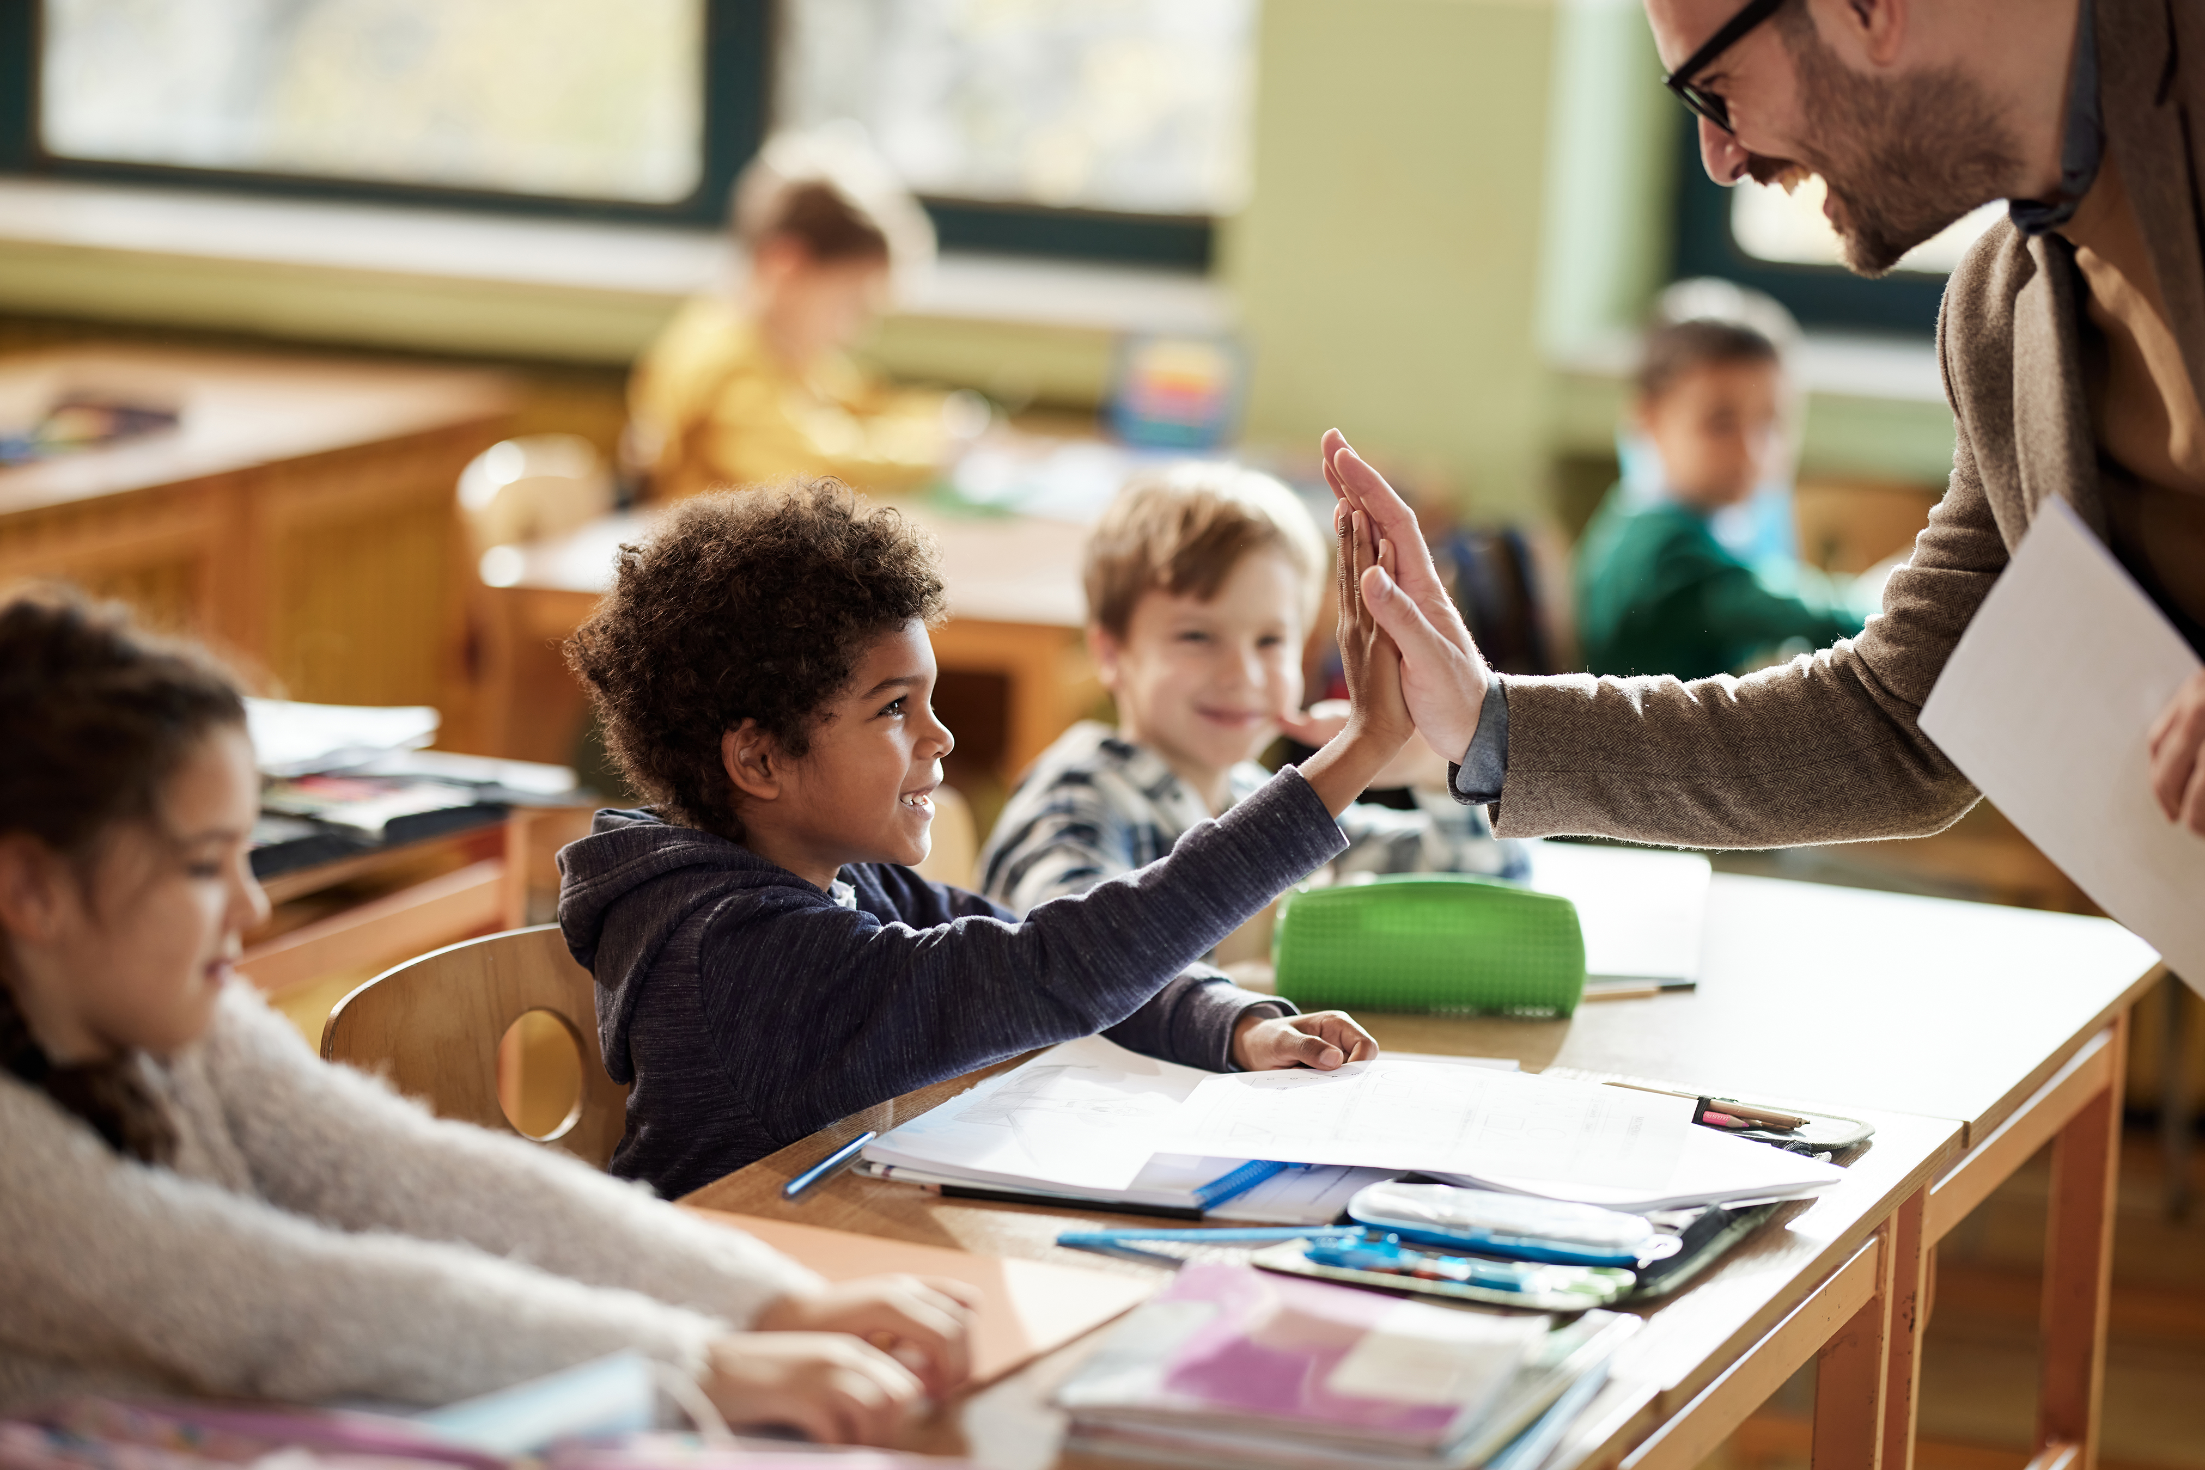
What is Social Emotional Learning (SEL)?
Social and Emotional Learning is the process through which all young people and adults acquire and apply the knowledge, skills, and attitudes to develop healthy identities, manage emotions and achieve personal and collective goals, feel and show empathy for others, establish and maintain supportive relationships.
Notes:
It is important to have a common definition and understanding of Social and Emotional Learning (SEL).
It is the process through which all young people and adults acquire and apply the knowledge, skills, and attitudes to develop healthy identities,
manage emotions and achieve personal and collective goals, feel and show empathy for others, establish and maintain supportive relationships.

Slide 4

Why is SEL important in Kindergarten? (1 of 3)
High-quality kindergarten programs take a systemic approach that emphasizes the importance of coordinating practices across key settings to enhance all students’ social, emotional, and academic learning.
(Collaborative for Academic, Social, and Emotional Learning [CASEL], n.d.).
Notes:
Social and Emotional Learning (SEL) is especially important in Kindergarten because it lays the foundation for both academic success and lifelong well-being. Here’s why it matters so much at this stage:
First, building self-awareness. Kindergartners are just beginning to understand their own emotions. SEL helps them:
Identify and name feelings (happy, sad, frustrated, excited).
Recognize their strengths and challenges.
Build confidence and a sense of identity.
Next, developing social skills. Children learn how to interact with others through SEL by:
Sharing, taking turns, and cooperating.
Listening and communicating respectfully.
Understanding and respecting differences among peers.
Supporting self-regulation is important young children often struggle with impulse control and managing big emotions. SEL teaches them strategies to:
Calm down when upset (e.g., deep breathing, using words instead of actions).
Wait patiently and follow directions.
Transition smoothly between activities.
Building empathy and relationships is also key. Kindergartners learn to see things from others’ perspectives. SEL promotes:
Kindness and compassion.
Helping behaviors and teamwork.
Conflict resolution through problem-solving instead of aggression.
Last, it sets the stage for academic success. Research shows that strong SEL skills improve:
Focus, motivation, and persistence in learning.
Classroom participation and cooperation.
Long-term academic achievement and school engagement.

Slide 5

Why is SEL important in Kindergarten? (2 of 3)
SEL contributes to safe, healthy school communities empowering young children and educators to be members of thriving schools and establishing equitable learning environments.
Notes:
Kindergarten is often a child’s first formal learning experience.
When all children—regardless of background, ability, or identity—feel included and supported, they develop confidence, curiosity, and a love of learning.
Inequities early on can lead to achievement gaps that widen over time.
An equitable classroom helps children see that everyone belongs and that differences (in language, culture, ability, family structure, etc.) are strengths. This fosters empathy, respect, and social-emotional skills that are essential for healthy relationships and citizenship.
SEL encourages students and educators to work together to solve problems, resolve conflicts peacefully, and make decisions collectively. This can empower kindergarten students to be active participants in shaping their school culture—promoting fairness and belonging rather than simply following rules made for them.
Social and Emotional Learning (SEL) helps address inequity by teaching people how to understand themselves and others, build respectful relationships, and work together to make fairer systems. It empowers young people and adults to co-create schools and communities where everyone feels safe, valued, and able to thrive.

Slide 6
Why is SEL important in Kindergarten? (3 of 3)
Integrating SEL into the curricula and daily experiences supports home/school partnerships. Research shows that SEL improves classroom behavior, motivation, and academic outcomes throughout schooling.
Notes:
It is most beneficial to integrate SEL throughout the kindergarten curricula and culture.
Benefits are:
Kindergarten is when children learn to manage their emotions, get along with others, and handle new challenges.
SEL helps them build self-awareness, self-control, empathy, and communication skills that are essential for both learning and life.
SEL in the curriculum also supports academic success.
Children who can focus, manage frustration, and cooperate with others are better able to engage in academic learning.
These benefits will extend beyond the classroom. Research shows that SEL improves classroom behavior, motivation, and academic outcomes throughout schooling.

Slide 7

Stop: Self-Reflection Time
How does your personal definition of SEL align with the one presented today?
What experiences have shaped your understanding of SEL in early childhood education?
Notes:
Please take a moment to stop this recording and take time to think about this Self-Reflection.
You may turn to a partner and share ideas.
Once you are done, please start the recording again.

Slide 8
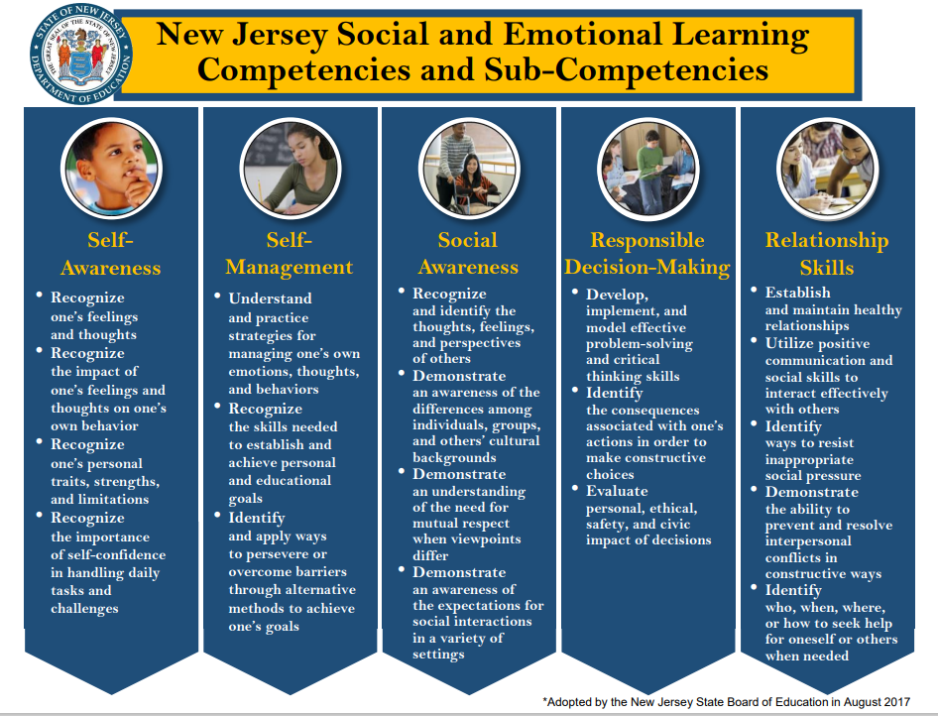
SEL Skills and Competencies
Self-awareness
Self-management
Social awareness
Relationship skills
Responsible decision-making
Social and Emotional Learning
Notes:
Educators should decide how best to prioritize, teach, and assess the growth and development of individual children in their kindergarten classrooms and schools.
NJDOE lists five categories that are interrelated areas of social and emotional development skills and competencies. This session will go into each Competency in more detail.
Social and emotional competence can be enhanced using a variety of classroom-based approaches such as explicit instruction through which social and emotional skills and attitudes are taught and practiced in developmentally, contextually, and culturally responsive ways; teaching practices such as cooperative learning and project-based learning; and integration of SEL and academic curriculum.
The NJDOE has many resources located on the Social and Emotional Learning website as listed on this slide. These are only some of the resources, lessons and research for SEL on the website.

Slide 9
Text version: New Jersey Social and Emotional Learning Competencies and Sub- Competencies
Self-awareness: Recognize one’s feelings and thoughts. Recognize the impact of one’s feelings and thoughts on one’s own behavior. Recognize one’s personal traits, strengths, and limitations. Recognize the importance of self-confidence in handling daily tasks and challenges.
Self-management: Understand and practice strategies for managing one’s own emotions, thoughts, and behaviors. Recognize the skills needed to establish and achieve personal and educational goals. Identify and apply ways to persevere or overcome barriers through alternative methods to achieve one’s goals.
Social awareness: Recognize and identify the thoughts, feelings, and perspectives of others. Demonstrate an awareness of the differences among individuals, groups, and others’ cultural backgrounds. Demonstrate an understanding of the need for mutual respect when viewpoints differ. Demonstrate an awareness of the expectations for social interactions in a variety of settings.
Responsible decision-making: Develop, implement, and model effective problem-solving and critical thinking skills. Identify the consequences associated with one’s actions in order to make constructive choices. Evaluate personal, ethical, safety, and civic impact of decisions.
Relationship skills: Establish and maintain healthy relationships. Utilize positive communication and social skills to interact effectively with others. Identify ways to resist inappropriate social pressure. Demonstrate the ability to prevent and resolve interpersonal conflicts in constructive ways. Identify who, when, where, or how to seek help for oneself or others when needed.

Slide 10
CASEL: SEL Skills and Competencies Video
SEL 101: What are the core competencies and key settings?
Social and emotional competence can be enhanced in kindergarten using a variety of classroom-based approaches.
Self-reflection questions:
Do you include explicit instruction through which social and emotional skills and attitudes are taught and practiced in developmentally, contextually, and culturally responsive ways?
Do you include teaching practices such as cooperative learning and project-based learning?
Do you incorporate SEL into academic curriculum?
Notes:
There is a link to watch the video on this slide that addresses the five categories of social and emotional development skills and competencies (please view on your own).
Use the guiding questions to reflect upon your school’s and/ or classroom’s practices. This self-reflection tool allows you to measure and discuss how your incorporation of SEL throughout the kindergarten day and your next steps for further implementation.
Self-reflection questions: Do you include…
Explicit instruction through which social and emotional skills and attitudes are taught and practiced in developmentally, contextually, and culturally responsive ways?
Teaching practices such as cooperative learning and project-based learning?
SEL in your academic curriculum?

Slide 11
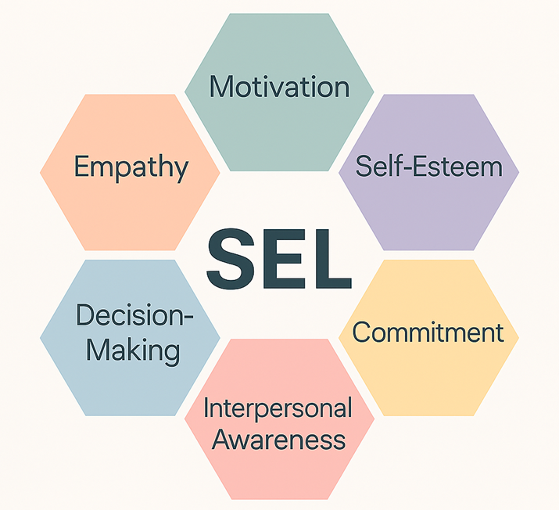
Self-Awareness
Self-awareness is the ability to understand one’s own emotions, thoughts, and values and how they influence behavior across contexts. This includes capacities to recognize one’s strengths and limitations with a well-grounded sense of confidence and purpose.
Examples of Teacher Practices (CASEL)
Set up small-group discussions that allow students to discuss how and why emotions can influence our behaviors (e.g., what happens when we get angry?).
Provide vocabulary words for feelings (e.g., happy, mad, sad, excited, bored).
Notes:
Self-awareness includes:
Integrating personal and social identities.
Identifying personal, cultural, and linguistic assets.
Identifying one’s emotions.
Demonstrating honesty and integrity.
Linking feelings, values, and thoughts.
Examining prejudices and biases.
Experiencing self-efficacy.
Having a growth mindset.
Developing interests and a sense of purpose.
Some examples included on the slide for your reference are specific to kindergarteners. Each slide for the components contains teacher practices for use in classrooms.

Slide 12
Self-Management
Self-management is the ability to manage one’s emotions, thoughts, and behaviors effectively in different situations and to achieve goals and aspirations. This includes the capacities to delay gratification, manage stress, and feel motivation and agency to accomplish personal/collective goals.
Examples of Teacher Practices (CASEL)
Teach self-management techniques such as belly breathing, yoga positions, counting to ten, self-talk, relaxation exercises, or mental rehearsal to help students develop concrete techniques for managing their own stress or anxiety.
Give students authentic feedback for self-management (e.g., regulating their emotions by taking a breath, or taking a break to think about a decision). For example, “I saw the way you used those math tools appropriately just now,” “I saw you cross your arms so you would keep your hands to yourself—you should be proud of yourself.”).
NJDOE Mindfulness website
Notes:
Self-management is:
Managing one’s emotions.
Identifying and using stress-management strategies.
Exhibiting self-discipline and self-motivation.
Setting personal and collective goals.
Using planning and organizational skills.
Showing the courage to take initiative.
Demonstrating personal and collective agency.
There are 2 kindergarten examples, one from the CASEL website and one from the NJDOE Mindfulness website. The links are embedded into the presentation for more ideas.

Slide 13
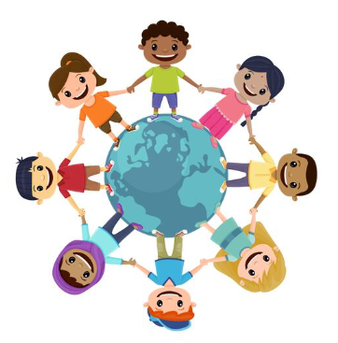
Social Awareness
Social awareness is the ability to understand the perspectives of and empathize with others, including those from diverse backgrounds, cultures, and contexts. This includes the capacity to feel compassion for others, understand broader historical and social norms for behavior in different settings, and recognize family, school, and community resources and supports.
Examples of Teacher Practices (CASEL)
Together with the class, create shared classroom rules and expectations and consequences so students can see the impact of their own actions and behaviors on outcomes.
Routinely discuss how we know the way characters in stories feel. Routinely ask how characters in stories feel.
Notes:
Social awareness is:
Taking others’ perspectives.
Recognizing strengths in others.
Demonstrating empathy and compassion.
Showing concern for the feelings of others.
Understanding and expressing gratitude.
Identifying diverse social norms, including unjust ones.
Recognizing situational demands and opportunities.
Understanding the influences of organizations/systems on behavior.
There are kindergarten examples from the CASEL website. The links are embedded into the presentation for more ideas.

Slide 14
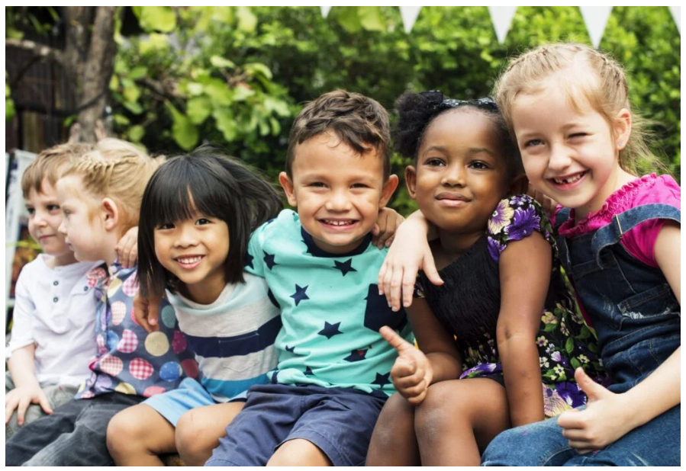
Relationship Skills (1 of 2)
Relationship skills support the ability to establish and maintain healthy relationships and to effectively navigate settings with diverse individuals and groups. This includes the capacities to communicate clearly, listen actively, cooperate, work collaboratively to problem solve and negotiate conflict constructively, navigate settings with differing social and cultural demands and opportunities, provide leadership, and seek or offer help when needed.
Notes:
Relationship skills involve:
Communicating effectively.
Developing positive relationships.
Demonstrating cultural competency.
Practicing teamwork and collaborative problem-solving.
Resolving conflicts constructively.
Resisting negative social pressure.
Showing leadership in groups.
Seeking or offering support when needed.
Standing up for the rights of others.

Slide 15
Relationship Skills (2 of 2)
Examples of Teacher Practices (CASEL)
Teach lessons on nonverbal classroom signals to encourage listening. For example, the class might use common hand signals to show agreement, to request clarification, or to recognize a different strategy.
Give students authentic feedback anytime they work well with others. Thank students whenever they listen well and tell them specifically what they did well. Give students authentic feedback for resolving conflicts peacefully.
Notes:
There are kindergarten examples from the CASEL website. The links are embedded into the presentation for more ideas.

Slide 16
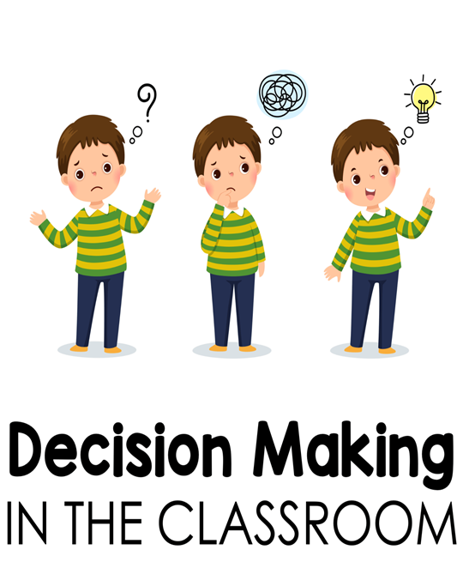
Responsible Decision-Making
Responsible decision-making is the ability to make caring and constructive choices about personal behavior and social interactions across diverse situations.
This includes the capacity to consider ethical standards and safety concerns and to evaluate the benefits and consequences of various actions for personal, social, and collective well-being.
Examples of Teacher Practices (CASEL)
Teach students a simple formula for making good decisions anytime they face a choice (e.g., stop, calm down, identify the choice to be made, consider the options, make a choice and do it, how did it go?).
Ask students to apply the decision-making formula to problems characters face in books or stories.
Notes:
Responsible decision-making includes:
Demonstrating curiosity and open-mindedness.
Identifying solutions for personal and social problems.
Learning to make a reasoned judgment after analyzing information, data, and facts.
Anticipating and evaluating the consequences of one’s actions.
Recognizing how critical thinking skills are useful both inside and outside of school.
Reflecting on one’s role to promote personal, family, and community well-being.
Evaluating personal, interpersonal, community, and institutional impacts.
There are kindergarten examples from the CASEL website. The links are embedded into the presentation for more ideas.

Slide 17

Stop: Self-Reflection Time
Which SEL practices feel most natural in your classroom, and which require more intentional planning?
How do you ensure SEL strategies are inclusive for multilingual learners and students with diverse needs?
Notes:
Please take a moment to stop this recording and take time to think about this Self-Reflection. Once you are done, please start the recording again.
What role do families play in reinforcing SEL at home, and how can you strengthen that partnership? How do you measure the impact of SEL on student engagement and classroom climate? What is one SEL goal you would like to set for your classroom for the next month? How can you embed SEL into academic instruction without it feeling like an “add-on”?

Slide 18
SEL for Kindergarteners: A Call to Action for Educators
How am I embedding SEL into daily routines and classroom culture?
What can I do tomorrow to strengthen safety, belonging, and emotional support for my students?
Where do I already see SEL thriving in my classroom?
What opportunities exist to deepen these practices and create an environment where every child feels safe, valued, and ready to learn?
Notes:
Take time to reflect on your current SEL practices and identify one actionable step you can implement immediately. Ask yourself ( as a teacher, as an administrator or as an instructional coach):
How am I embedding SEL into daily routines and classroom culture?
What can I do tomorrow to strengthen safety, belonging, and emotional support for my students?
Which strategy will I commit to for fostering empathy, kindness, and cooperative play?
Next Step: Choose one SEL practice to enhance or introduce this week—whether it’s adding a feelings chart, modeling calming strategies, or creating opportunities for teamwork—and share your plan with a colleague or PLC.

Slide 19
Additional Resources
Fundamentals of SEL – CASEL
NJDOE P–3 Approaches to Learning: How Young Children Learn
NJDOE Mental health
NJDOE Mindfulness
NJDOE, Office of Student Supports
NJDOE Social Emotional Learning
Notes:
Please check out these additional helpful resources that can support SEL in kindergarten.

Slide 20
NJDOE Resources for K-3 Early Elementary
K–3 Early Elementary Alignment
Kindergarten Implementation Guidelines and Resources
Kindergarten Consortium PowerPoints
First through Third Grade Implementation Guidelines and Resources
P-3 Educator Exemplars and Early Learning Experts Video Library
P-3 Approaches to Learning: How Young Children Learn
Notes:
Please visit the K-3 Early Elementary Alignment website to locate more resources for this grade level.

Slide 21
Optional Guiding Questions
Thinking of your kindergarten classroom, what does its environment communicate about safety, belonging, and care? What routines or visuals are used to support emotional vocabulary (e.g., feelings charts, stories)?
What strategies do you teach kindergartners for calming down or managing frustration (e.g., breathing, quiet corner)? What cues or supports do you provide for transitions or challenging moments?
What opportunities do you create for empathy and kindness? How do you teach and model sharing, taking turns, and cooperative play and encourage teamwork and peer support in your kindergarten classroom?
Notes:
These guiding questions are optional, and you may choose to discuss any that are listed as an extension to the presentation.
Whether in a PLC or grade level meeting, these questions may provide you with things to consider as you discuss next steps or explore how you can further incorporate SEL in your curricula and kindergarten classrooms.
A word document version of these “Guiding Questions and Next Steps from the Kindergarten Consortium Sessions” is located on the webpage with this PowerPoint for your convenience.

Slide 22
References
Collaborative for Academic, Social, and Emotional Learning. (n.d.). What is social emotional learning?
Freschi, E. (2023). Developmentally appropriate practice in kindergarten: Observation guide. Center to Improve Social and Emotional Learning and School Safety at WestEd.
Notes:
Here are the references which are also located in the kindergarten implementation guidelines pertaining to this topic.

Slide 23
Thank You
Beth Wharton
K–3 Coordinator
Beth.Wharton@doe.nj.gov
K–3 Unit, Office of Standards
K-3Unit@doe.nj.gov
Notes:
Thank you for viewing the session on Social Emotional Learning in the kindergarten classroom.

Slide 24
Follow Us
Facebook @njdeptofed
X @newjerseydoe
Instagram @newjerseydoe
LinkedIn New Jersey Department of Education
nj.gov/education
Threads @newjerseydoe
YouTube @newjerseydepartmentofeduca6565
Notes:
Please follow the NJDOE on any of the platforms listed for current and valuable information and resources.

