Slide 1

New Jersey Department of Education
School Structures Supporting High-Quality Kindergarten Programs
(Adapted from the Kindergarten Implementation Guidelines)
Beth Wharton, K-3 Coordinator
K-3 Unit, Office of Standards
nj.gov/education
Notes:
Hello, my name is Beth Wharton. I am a K-3 Coordinator in the Office of Standards in the Division of Teaching and Learning.
Today’s session, School Structures Supporting High-Quality Kindergarten Programs, is adapted from the Kindergarten Implementation Guidelines found on the K–3 Early Elementary Alignment page of the Office of Standards website. These guidelines represent the collaborative work of the New Jersey Department of Education (NJDOE) and early childhood professionals across the state, combining current research and best practices into one comprehensive resource designed to support school administrators, teachers, instructional coaches, and families in meeting the needs of all learners. Please note this session is intended only for administrators, teachers, and instructional coaches to support developmentally appropriate practices in kindergarten classrooms.
Please use this PowerPoint to turnkey this session’s information to your colleagues at your PLC or grade level meetings.
Today we will focus on the structures and supports needed in the school and classroom to support high-quality kindergarten programs.

Slide 2
Key Structures for Kindergarten Classrooms and Schools
This session discusses:
P–3 continuum that fosters a seamless alignment to support students’ transition needs and educational experience.
Curricula that supports and aligns with the NJ Student Learning Standards (NJSLS).
Developmentally appropriate experiences in kindergarten, choice time centers, and multiple types of play.
High-quality professional development opportunities for professional learning communities (PLC), classroom learning walks, and coaching.
Full-day kindergarten programs that include a comfortable, organized learning environment and daily transitions.
Positive Behavioral Interventions and Supports (PBIS) framework to support students.
Notes:
Today's session is focused on these “Key Structures” that need to be in place within kindergarten classrooms, and in school buildings which includes:
Having a P–3 continuum to help foster a seamless alignment and educational experience between P–3.
Establishing a P–3 transition team and deciding the roles and responsibilities using a sample checklist (which is shown later in this presentation).
Designing curricula that support and align with the New Jersey Student Learning Standards.
Creating meaningful experiences, choice time centers, and multiple types of play.
Establishing high-quality professional development opportunities for Professional Learning Communities, Classroom Learning Walks, and the Coaching Model.
Organizing the classroom and scheduling a full kindergarten day including a comfortable learning environment and daily transitions; and
Opportunities for sharing and celebrating student work to showcase and highlight the successes, experiences, and growth that take place in a high-quality kindergarten classroom.

Slide 3
NJDOE Resources for K-3 Early Elementary Alignment
K-3 Early Elementary Alignment
Kindergarten Implementation Guidelines and Resources
Kindergarten Consortium PowerPoints
First through Third Grade Implementation Guidelines and Resources
P-3 Educator Exemplars and Early Learning Experts Video Library
P-3 Approaches to Learning: How Young Children Learn
Notes:
Please visit the K-3 Early Elementary Alignment website to locate more resources for this grade level. Please find the Kindergarten Implementation Guidelines and Resources on this website.

Slide 4
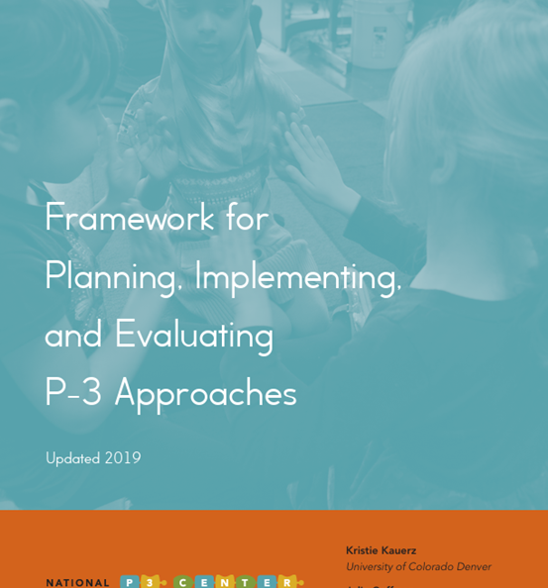
Preschool–Grade 3 (P–3) Learning Continuum
Cross-Sector Work
Administrator Effectiveness
Teacher Effectiveness
Instructional Tools
Learning Environment
Data-Driven Improvement
Engaged Families
Continuity and Pathways
There are eight categories within the Framework for Planning, Implementing, and Evaluating P–3 Approaches (Kauerz & Coffman, 2019).
Notes:
Based on the work of Kauerz & Coffman in their 2019 Framework for Planning, Implementing, and Evaluating P–3 Approaches , the first key component discussed in the Kindergarten Guidelines for supporting a high-quality kindergarten program is the understanding of a Preschool to Third Grade Learning Continuum.
To ensure the success of every student and close the achievement gap, it is imperative that all children have access to high-quality, aligned programs from Preschool to third grade.
Effective instruction, instructional consistency, and meaningful learning opportunities grounded in developmentally appropriate practices are central to a P–3 approach. There are eight components within the Framework for Planning, Implementing, and Evaluating P–3 Approaches.
Follow the link on the slide to the framework for further resources.

Slide 5

Transitions to Kindergarten
As preschool age children move into kindergarten classrooms, children will continue to learn by experiencing the world around them.
It is important to think about the transition into kindergarten as a partnership between children, early child teachers and providers, kindergarten teachers, and families.
As young children prepare to transition to kindergarten, it is essential for teachers and administrators to provide support for both children and families to ensure smooth transitions from one classroom setting to the next.
Notes:
Another key element in high quality kindergarten programs is supporting transitions to kindergarten.
It is one of the most critical moments in a child’s life as they enter the formalized K–12 education system.
This experience is the “sturdy bridge” linking their early childhood experiences with their future academic endeavors.
Successful transitions to kindergarten can result in reduced stress and improved social-emotional well-being at the onset of kindergarten, improved academic growth, and increased family engagement throughout the course of the school year.
To facilitate a successful transition from preschool, childcare, or home to kindergarten, a school may establish a transition team that can implement various strategies and activities to involve the family and child in the school setting.

Slide 6
A Sample Preschool through Third Grade Transition Team Checklist (1 of 3)
Administrators
P –3 Alignment
Strategy
Create a transition team that includes families, community leaders, preschool and elementary staff.
Designate a facilitator to organize and lead regular meetings, ensuring staff have time to participate.
Identify children at risk using valid screening tools and provide targeted supports.
Develop systems for data collection and analysis to monitor student progress and program quality across P–3.
Establish common planning time for teachers and specialists to align curriculum and assessments horizontally and vertically.
(Adapted from Kauerz & Schaper, 2021)
Notes:
This checklist is included in Word document form in the Kindergarten Implementation Guidelines located on the K-3 Early Elementary Alignment website. You may click on “P-3 Alignment” on the slide to go directly to the website.
The sample is meant to be a support for establishing important structures and activities to support effective Preschool to third grade transitions.
This is a possible checklist for creating a P–3 transition team.
These strategies are suggestions to help ensure smooth transitions and success for all.
This first part is for the School District Administrators.
Transition Team Composition: A strong team should represent multiple stakeholders—families, community agencies, preschool teachers, elementary teachers, child study teams, language specialists, and administrators. This ensures a holistic approach to supporting children and families during transitions.
Facilitator Role: The facilitator coordinates meetings, sets agendas, and ensures consistent communication. Providing dedicated time for staff to attend these meetings is critical for collaboration and continuity.
Early Identification of At-Risk Students: Screening tools help identify children who may need additional support before entering kindergarten. This proactive approach allows for individualized interventions that can ease the transition and promote success.
Data Systems: Collecting and analyzing data across preschool through third grade helps schools track student growth, evaluate program effectiveness, and inform instructional decisions. This supports accountability and continuous improvement.
Collaborative Planning: Common planning time fosters alignment of curriculum and assessments across grade levels. Horizontal alignment ensures consistency within a grade, while vertical alignment supports progression from preschool through third grade.

Slide 7
A Sample Preschool through Third Grade Transition Team Checklist (2 of 3)
Transition Team
Strategy
Survey families and the community to identify educational and social service needs.
Include a process for collaborating with families, early learning providers, and local public and private agencies.
Establish goals to ensure seamless support for all children as they move through each year.
Provide information to families on the transition to and from each grade level from preschool through third grade.
Create transition activities based on the goals created to ensure seamless support for children and families.
Generate a timeline for implementing the transition plan.
Revisit and update the transition plan annually.
(Adapted from Kauerz & Schaper, 2021)
Notes:
This section of the checklist is for the “Transition Team”. Creating a Transition Team is essential to engaging all stakeholders in the creation, development and implementation of truly meaningful transition practices for students in preschool to third grade.

Slide 8
A Sample Preschool through Third Grade Transition Team Checklist (3 of 3)
Teachers
Strategy
Participate on the transition team and/or provide suggestions for activities.
Meet with other teachers and specialists within and across grades to discuss and implement NJSLS.
Meet with teachers within and across grade levels to discuss transition activities and readiness goals for children and families throughout the year.
Prepare and disseminate developmentally appropriate home learning activities during the school year and the summer months.
Get to know each child and family and contact families prior to the start of school and communicate with them on a regular basis throughout the year.
Welcome new children and their families and let them know how they can be involved in their child’s school and classroom.
(Adapted from Kauerz & Schaper, 2021)
Notes:
This section of the checklist is for the “Teachers”.
Each stakeholder on the Transition Team has an integral role in student transitions.
Teachers’ vertical and horizonal articulation practices focused on student data, curricula and evidence-base practices are foundational to successful transitions for students whether they are transitioning from grade to grade, new to school, or have a change in specialized programs.

Slide 9

Stop: Self-Reflection Time
In what ways does the current program support a seamless P-3 continuum for your students? Where do you see gaps or “breaks” in alignment (e.g., between preschool → kindergarten, or K → grade 1)?
How effective are students’ transition needs from preschool into early elementary years being met? What more could you do to ease those transitions?
Notes:
Please take a moment to stop this recording and think about this Self-Reflection. Once you are done, please start the recording again.

Slide 10
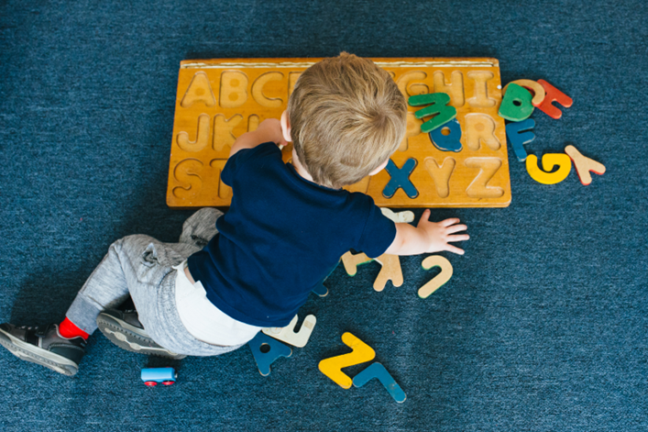
Key Components of Kindergarten Curricula
Kindergarten curricula should be:
Aligned to the NJSLS.
Developmentally appropriate.
Built on intentional goals.
Engaging for young learners.
Inclusive of critical concepts and foundational knowledge.
Notes:
When designing curricula for the kindergarten classroom, there are several factors for school districts to consider ensuring effective and impactful learning experiences for young children.
It is important that the curricula are aligned to the NJSLS, developmentally appropriate, built on intentional goals, engaging to young learners, and include critical concepts for students to learn.
In addition, curricula should be play-based and support students in working towards established learning objectives.
A curriculum review team consisting of teachers, instructional coaches, and administrators will review and evaluate each content area curriculum. Each member of a curriculum review team can be given the opportunity to provide feedback after the development to review and refine the curriculum that best meets the needs of the learners in the district.
Once curricula are approved at the district level, school districts create a professional development plan for teachers to learn how to implement each new curriculum in their classrooms.

Slide 11

Professional Learning for Kindergarten Educators
“Engage in continuous, collaborative learning to inform practice”
(The NAEYC Professional Standards and Competencies for Early Childhood Educators, 2019)
Notes:
Professional development is another key component of a high-quality kindergarten program.
Professional development can take place in many formats.
One way to support professional development is for administrators to build time into the weekly school schedule for available job-embedded coaching and professional learning communities (PLCs), enables professionals to grow and learn from one another and investigate research-based practices.
In addition, teachers can advocate for district-wide professional development opportunities that provide ongoing support for implementing new content and pedagogy. A continuous cycle of improvement should be available.
As professionals, educators grow their capacity to reflect on practice, revise instructional plans, and implement change.
The cyclical and reflective nature of this process ensures that educators are continually evolving, adapting, and improving their teaching methods.

Slide 12

Professional Learning Communities
Professional Learning Communities (PLCs) are groups of educators that meet to identify and focus on improving teaching practices and the impact on student learning and development.
The job of the facilitator is to communicate with the team members about the topic of the session, how members need to prepare, and the protocols that will be used.
To build capacity, all teachers can take the facilitator’s role at one time or another.
Notes:
Professional Learning Communities are valuable not only to kindergarten teachers and coaches, but also for administrators. All members of a school team are essential participants of a PLC.
PLCs are one form of job-embedded professional learning for building teaching efficacy and improve students' achievement.
PLCs can vary in terms of teacher configuration.
It can be beneficial for grade levels across a district to meet to specifically collaborate on grade level issues.
Typically, the same team of teachers meets regularly with one member of the team acting as the facilitator.
The key aspect of a PLC is that it provides a structured and collaborative framework for educators to work together to improve teaching practices and enhance student learning outcomes (e.g., same grade, same content area, same school, different schools within a district, interdisciplinary or other groupings).
The effectiveness of a PLC often depends on the clarity of goals, the commitment of participants, and the presence of a supportive organizational culture.
The configuration of a PLC should align with the specific needs and objectives of the educators involved and the context in which they work.
During PLC meetings, a clear goal tied to instructional practices and student achievement is set.
PLC time can be used for educators to analyze the implementation of the NJSLS in a particular content area curriculum, student data, student work, and other areas of practice that are directly tied to student achievement.
PLCs can also develop protocols for each meeting to ensure members stay on task and work to accomplish their goals.

Slide 13

Classroom Coaching in Kindergarten
Research has found that coaching had a more positive effect than traditional forms of professional development (Kraft, Blazar, & Hogan, 2018).
Coaches with expertise in early childhood education can provide teachers with the opportunity to reinforce research-proven methods of pedagogy.
Instructional coaches are invaluable resources for classroom teachers that support instructional goals and provide feedback that directly improves teaching practices and student learning.
Notes:
Another type of professional development is job-embedded instructional coaching.
Instructional coaches can support teachers in improving instruction through classroom visits, modeling through demonstration lessons and/or by collaboratively co-teaching.
During the classroom visits, the coach can provide “on-the-spot” feedback.
In this instance, the coach provides the teacher with tips to improve instruction to meet the goals during instruction.
A coaching cycle is a method used for instructional coaching.
In the coaching cycle, the coach engages in peer conversations by holding a pre-conference to determine areas of focus for coaching based on student data analysis, the kindergarten curricula and research-based best practices.
After the visit, a post-conference is planned between the teacher and coach to reflect together on the teaching and learning that occurred.
The post-conference ends with the next steps established for teaching and learning practice in the classroom and a time established for the coach’s next classroom visit.
When working with teachers, coaches can provide non-evaluative support through planning, student data analysis, modeling instruction, and reflection with the teacher.
Teachers and coaches can work together to plan for instruction, but the coach can also serve as a catalyst for reflection.
The coach and teacher can have continual conversations about strategies, assessments, student data and developmentally appropriate best practices.

Slide 14

Classroom Learning Walks
Prior to a learning walk, a purpose or focal point for the walk is determined by the administrators or teachers.
A tool is developed for the classroom walk. This tool can be created by teachers, coaches, or administrators.
During the learning walk, teachers spend no more than fifteen minutes in each classroom they visit to observe only the targeted focus of the walk.
Following the walk, the teachers reflect and develop a plan of action to improve practice in their own classroom and in the school.
These learning walks can also help administrators make professional development decisions specific to the kindergarten portion of the district’s overall plan.
Notes:
The last professional development option to discuss is learning walks.
Classroom learning walks can support change and growth within individual classrooms and entire school buildings.
They provide a chance for teachers and administrators to discuss and reflect on the environment and instruction, then develop a plan for improvement.
Research shows learning walks have been transformative in the schools and districts implementing, especially in moving from professional development to professional practice.
Through learning walks, teachers have a chance to develop a deeper understanding of how other teachers are implementing best practices to guide students toward meeting the NJSLS.

Slide 15
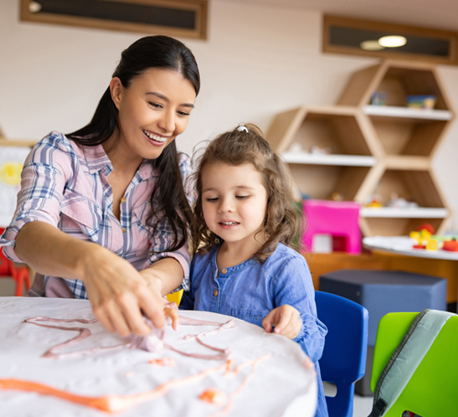
Arranging the Kindergarten Classroom
The set-up of a kindergarten classroom is a crucial element to support the flow of daily activities.
A kindergarten classroom should be culturally responsive, open, and child friendly without any obstacles that block the view of the children.
The ideal kindergarten classroom is an inviting space that facilitates playful learning and students’ movement.
Teachers set up the classroom, offer materials, and plan interactions that support children’s learning and interests.
Notes:
Classroom arrangement and organization are another key component for high-quality kindergarten programs and impact children’s experiences in the kindergarten learning environment. A well-planned kindergarten classroom setup is important because the physical environment directly supports how young children learn, behave, and interact. It supports early learning and development. Young children learn through play, exploration, and hands-on activities. A structured environment provides learning centers (reading, art, blocks, science, dramatic play), materials arranged for independence, and opportunities for fine- and gross-motor development.
Culturally responsive classrooms could include:
Books featuring characters of diverse races, languages, family structures, and abilities.
Dolls with different skin tones, hair types, and adaptive equipment (e.g., wheelchairs).
Posters and artwork that show children from various cultural backgrounds. Labels around the room in English and the students’ home languages. A “Welcome” sign written in every language represented in the classroom. A listening center with stories read in multiple languages.
Dramatic play areas with cultural clothing (e.g., saris, ponchos, kente cloth), cooking utensils, and pretend foods from different cultures.
Art centers with a variety of skin-tone crayons, markers, and paints.
Music centers with instruments from different cultural traditions (e.g., maracas).
Family photo walls to show each child’s family (e.g., “About Me” displays featuring student heritage, hobbies, or traditions).
Invitations for family members to share stories, songs, or traditions.
Each kindergarten school day should include blocks of time that engage children individually, in whole group and in small group settings with a balance of child-initiated choice time play, movement opportunities, and adult-guided learning experiences.
Children’s evolving interests and skills guide the choice of the materials and learning activities offered during group times and in classroom learning centers.

Slide 16
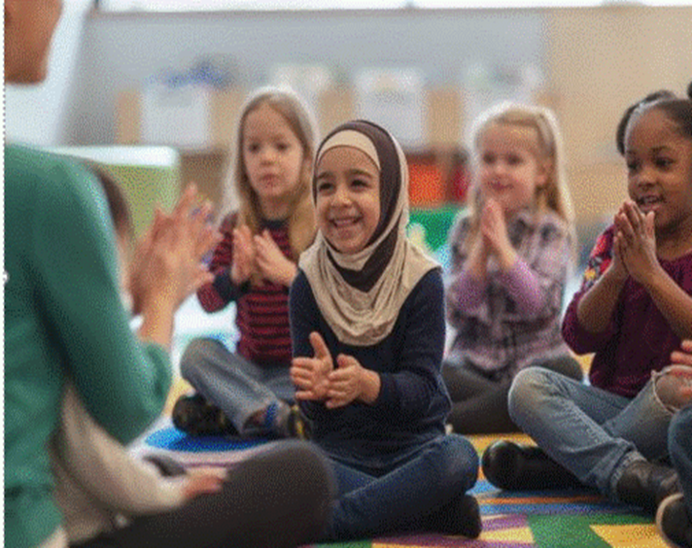
Managing the Kindergarten Classroom
Management techniques can be done whole class, in groups, or individually and can be goal-based.
Educators are encouraged to have a repertoire of techniques to understand what works best for the classroom from year to year.
Predictable routines and schedules, rules developed by the teacher and students and applied equitably, and shared classroom responsibilities are all qualities of an environment responsive to young diverse learners.
Notes:
Classroom management is another key component toward building positive relationships with students as well as creating a predictable structure and an efficiently running classroom.
Teachers who have established strong management techniques while keeping the child’s social-emotional well-being in mind are most effective.
A well-run kindergarten classroom functions as a community.
Management techniques can be done whole class, in groups, or individually and can be goal-based which means using specific, measurable objectives to guide and evaluate how the classroom is organized, how behavior is managed, and how students engage in learning.
Guidelines for acceptable behavior should be expressed in simple language accompanied by a clear rationale.
Work and play settings should be planned so that children can navigate through daily activities with as much independence as possible.
When children understand that they are able and expected to regulate many of their activities independently, they can develop self-control and self-direction.
These attributes, complemented by the presence of consistently warm and caring adults who nurture academic success and successful relationships between and among the diverse classroom community members, contribute to feelings of well-being and security that instill confidence in everyone in the kindergarten community.

Slide 17

Stop: Self-Reflection Time
How do you or your team use data, reflection, and collaboration to impact instruction?
How are strategies learned during professional development applied into classroom practice?
How do you know professional development efforts are improving student outcomes?
Notes:
Please take a moment to stop this recording and think about this Self-Reflection. Once you are done, please start the recording again.

Slide 18
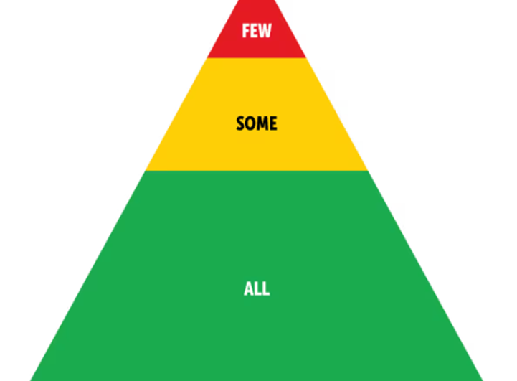
Positive Behavioral Interventions and Supports (PBIS)
Each intervention tier has a specific focus and set of practices that guide intervention design and delivery.
It is a multi-tiered intervention system designed using processes and practices that are culturally and contextually responsive to the strengths, needs, and priorities of the school and community.
It includes universal prevention (Tier 1), secondary targeted or selective interventions (Tier 2), and intensive tertiary interventions (Tier 3).
Positive Behavioral Interventions and Supports
(Center on PBIS, 2023
Notes:
The final key component discussed in this session to support a high-quality kindergarten program is Positive Behavioral Interventions and Supports (PBIS).
It is a framework (not a specific program or curriculum) used primarily in schools to promote positive behavior and improve school climate.
The goal of PBIS is to prevent behavioral problems and create a safe, supportive learning environment for all students.
It is a multi-tiered system approach to planning and implementing interventions with a focus on behavior, conduct, and social and emotional wellness.
In a multi-tiered system approach, like PBIS, interventions are organized along a continuum into three intervention delivery tiers.
Please click on the link provided for more information on PBIS.

Slide 19

Self-Regulation
Young learners’ abilities to self-regulate their behaviors is foundational to their well-being. Educators can:
Support their growth in the physical, social, emotional, cognitive, and language domains.
Help students find ways to cope with strong feelings, so children do not become overwhelmed.
Guide students toward goals, successfully manage behaviors, and build relationships with others.
NJDOE SEL
Notes:
Attaining self-regulation in early childhood leads to better performance in school, better relationships with others and fewer behavioral difficulties.
The classroom and school must be physically and emotionally safe for children to explore and learn at their developmental level.
Consistent, predictable routines and expectations promote a sense of security for children.
Educators can teach self-regulation skills through modeling, instruction, and opportunities for practice.
Within the kindergarten classroom, self-regulation can be developed through a supportive process of “co-regulation” between adults and children.
It is important to provide a warm, responsive relationship so that children will feel respected as individuals, comforted, supported in times of stress, and confident that they are cared for no matter what. This support will allow children to feel secure enough to practice new skills and learn from their mistakes.

Slide 20
NJDOE Resources for K-3 Early Elementary
K–3 Early Elementary Alignment
Kindergarten Implementation Guidelines and Resources
Kindergarten Consortium PowerPoints
First through Third Grade Implementation Guidelines and Resources
P-3 Educator Exemplars and Early Learning Experts Video Library
P-3 Approaches to Learning: How Young Children Learn
Notes:
Please visit the K-3 Early Elementary Alignment website to locate more resources for this grade level.

Slide 21
Optional Guiding Questions
How are meaningful experiences, choice time centers, and multiple types of play provided in kindergarten classroom?
Does the current kindergarten curricula support and align with the NJ Student Learning Standards (NJSLS)?
What school data demonstrates the impact professional development has on kindergarten classrooms?
How do kindergarten classroom include a comfortable, organized learning environment and daily transitions?
Are Positive Behavioral Interventions and Supports (PBIS) currently incorporated into the kindergarten day? If so, what does that look like?
How does your school or district work toward a P–3 learning continuum?
Notes:
These guided questions are optional, and you may choose to discuss any that are listed.
It is an extension activity to the presentation that can be discussed after the presentation or a later date.
They are here to provide you with some time to reflect as a group, whether in PLC or grade level meetings.
A Word document version of these “Guiding Questions and Next Steps from the Kindergarten Consortium Sessions” is located on the webpage with this PowerPoint for your convenience.

Slide 22
References
Center on PBIS. (2023). Positive Behavioral Interventions and Supports. www.pbis.org
Kauerz, K., & Coffman, J. (2019). Framework for planning, implementing, and evaluating
p–3 approaches. National P–3 Center.
Kauerz, K., & Schaper, A. (2021) Transition to kindergarten: Findings from recent research. Education Commission of the States, National P – 3 Center.
Kraft, M. A., Blazar, D., & Hogan, H. (2018). The effect of teacher coaching on instruction and achievement: A meta-analysis of the causal evidence. Review of Educational Research, 88(4), 547–588.
National Association for the Education of Young Children. (2019). Professional Standards and Competencies for Early Childhood Educators.
Notes:
Here are the references which also located in the kindergarten implementation guidelines pertaining to this topic.

Slide 23
Thank You
Beth Wharton
K-3 Coordinator
Beth.Wharton@doe.nj.gov
K-3 Unit, Office of Standards
K-3Unit@doe.nj.gov
Notes:
Thank you for viewing the session on School Structures Supporting High-Quality Kindergarten Programs.

Slide 24
Follow Us
Facebook
@njdeptofed
X
@newjerseydoe
Instagram
@newjerseydoe
LinkedIn
New Jersey Department of Education
nj.gov/education
Threads
@newjerseydoe
YouTube
@newjerseydepartmentofeduca6565
Notes:
Please follow the NJDOE on any of the platforms listed for current and valuable information and resources.

