Slide 1

New Jersey Department of Education
Movement & Engagement in Kindergarten
(Adapted from the Kindergarten Implementation Guidelines)
Beth Wharton, K–3 Coordinator
K–3 Unit, Office of Standards
nj.gov/education
Notes:
Hello, my name is Beth Wharton.
I am a K-3 Coordinator in the Office of Standards in the Division of Teaching and Learning.
The session today will be on Movement & Engagement in Kindergarten; a presentation adapted from the resources in the Kindergarten Implementation Guidelines located on our K-3 Early Elementary Alignment page on the Office of Standards main webpage.
This presentation was adapted from the resources in the Kindergarten Implementation Guidelines located on our K-3 Early Elementary Alignment page on the Office of Standards main webpage that reflect the collaborative efforts of the New Jersey Department of Education (NJDOE) and early childhood professionals across the state bringing current research and best practices together in one usable document originally intended for school administrators, teachers, instructional coaches, and families to meet the needs of all learners.
Please note this session is intended only for administrators, teachers, and instructional coaches to support developmentally appropriate practices in kindergarten classrooms.
Please use this PowerPoint to turnkey information on Movement & Engagement in Kindergarten, to your colleagues or use at your PLC or grade level meetings.

Slide 2
Movement & Engagement in Kindergarten
This session discusses:
Conducting physical activities in the classroom, at recess, and within the outdoor environment which supports physical development for kindergarten students.
Integrating intentional play in meeting the New Jersey Student Learning Standards (NJSLS).
Designing and effectively utilizing choice centers in the kindergarten classroom.
Notes:
Overview of the session.
This section includes:
Physical activities in the classroom, at recess, and within the outdoor environment which supports physical development for kindergarten students.
Integrating intentional play inside the classroom while meeting the New Jersey Student Learning Standards (NJSLS).
Designing and effectively utilizing choice centers that promote movement within the kindergarten day.

Slide 3
NJDOE Resources for K–3 Early Elementary
K–3 Early Elementary Alignment
Kindergarten Implementation Guidelines and Resources
Kindergarten Consortium PowerPoints
First through Third Grade Implementation Guidelines and Resources
P–3 Educator Exemplars and Early Learning Experts Video Library
P–3 Approaches to Learning: How Young Children Learn
Notes:
Please visit the K–3 Early Elementary Alignment website to locate more resources for this grade level.
Please find the Kindergarten Implementation Guidelines and Resources on this website.

Slide 4
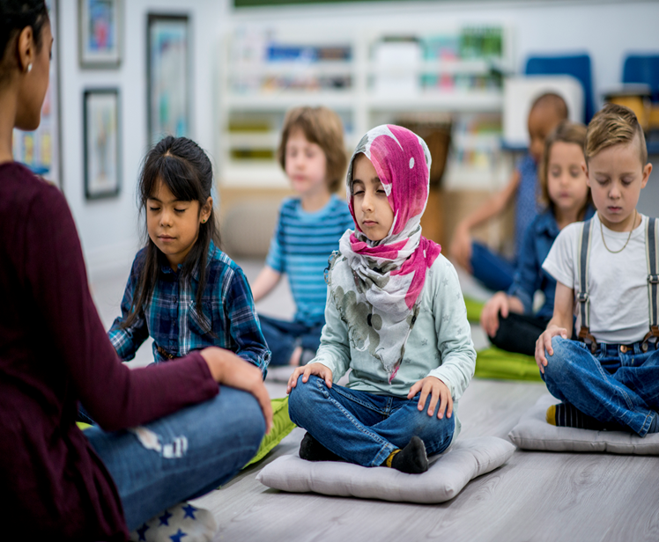
The Importance of Physical Activity in the Kindergarten Day (1 of 2)
Physical activity is important for children in kindergarten because it:
Builds strong bodies.
Supports brain development.
Enhances motor skills.
Promotes social and emotional growth.
Encourages healthy habits.
Boosts confidence and independence.
Supports positive behavior.
Can take place at any time and occur in one or several brief periods during the kindergarten school day.
(Center for Disease Control and Prevention, 2023)
Notes:
This session will focus on various ways to get students moving throughout the day.
It is critical that children are not just sitting all day long but rather given opportunities to engage in physical activities and movement while in the classroom, during recess, and other opportunities that allow for it.
Classroom physical activity can be offered in addition to physical education and recess.
Students need opportunities and encouragement to participate in physical activities that are appropriate and enjoyable for their age.
It is important to integrate physical activity into academic instruction as well as provide breaks from instruction.
Breaks from instruction are good for the students as well as the teachers because it allows the brain to refocus and calm down reducing stress and improving recall and memory.

Slide 5
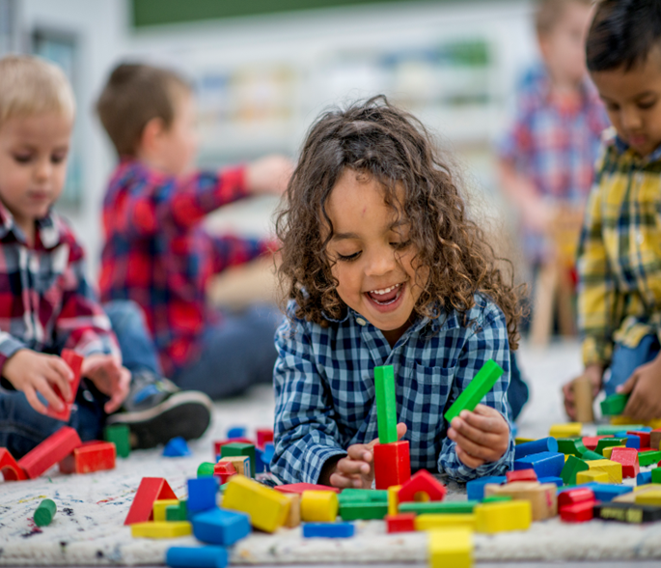
The Importance of Physical Activity in the Kindergarten Day (2 of 2)
Classroom physical activity can benefit students by:
Improving concentration and the ability to stay on-task in the classroom.
Reducing disruptive behavior (e.g., getting out of seat while the teacher is giving directions).
Encouraging motivation and engagement in the learning process.
Helping to improve academic performance.
(Center for Disease Control and Prevention, 2023)
Notes:
According to the Center for Disease Control, a child’s physical development determines the control of their body and movements, including muscle development and coordination including both fine and gross motor movements. Fine motor skills refer to the use of the small muscles found in individual body parts, especially those in the hands and feet. Children use their fine motor skills to grasp, hold, and manipulate small objects and use tools including pencils, crayons, scissors, and paint brushes. Gross motor skills refer to moving the whole body and using larger muscles, such as those in the arms and legs including walking, kicking, stretching, skipping, hopping, and running.
Kindergarten students become increasingly more competent in fine and gross motor skills throughout the school year when provided with daily opportunities either inside or outside the classroom to use their large and small muscles through play and intentional play-based activities. According to the Center for Disease Control and Prevention, typical developing kindergarteners, for example, will be able to stand on one foot for 10 seconds or longer, hop, do a somersault, swing, climb, use a fork and spoon, and use the toilet on their own. Please note there are references with hyperlinks at the end of this session.

Slide 6

Stop: Self-Reflection Time
In what ways are physical activities valued as much as academic learning in daily planning? Why or why not?
How does kindergarten have a balance of structured physical activities (e.g., games, guided movement) and unstructured play?
In what ways are transitions in the kindergarten classroom opportunities for movement, or do they tend to be sedentary?
Notes:
Please take a moment to stop this recording and think about this Self-Reflection.
Once you are done, please start the recording again.

Slide 7
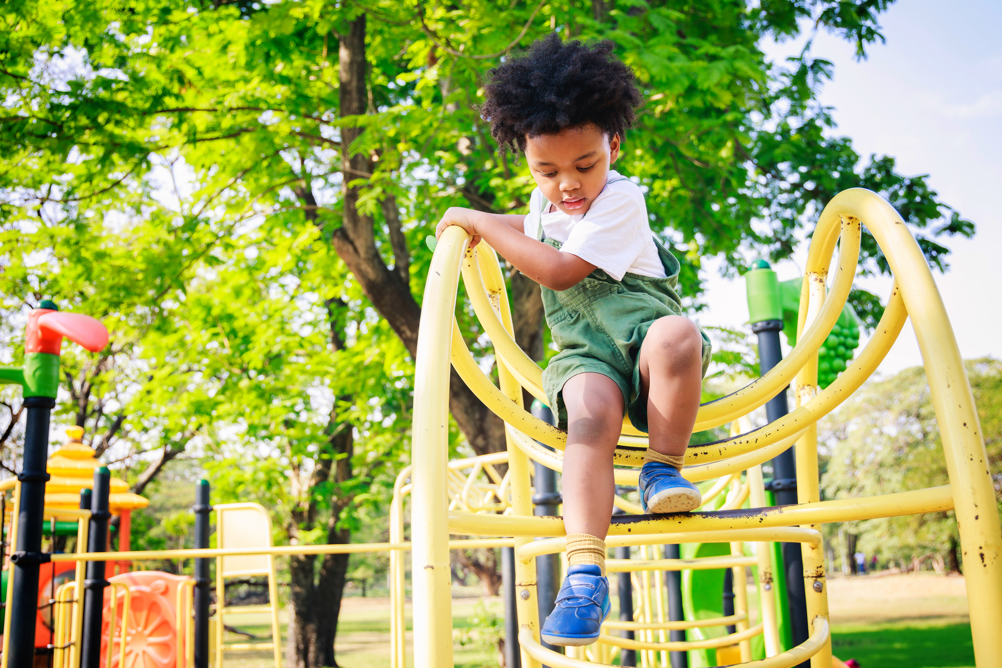
Recess Period
NJDOE (N.J.S.A. 18A:35-4.31) states that “public school districts shall provide a daily recess period of at least 20 minutes for students in grades kindergarten through five. The recess period shall be held outdoors, if feasible. A student shall not be denied recess for any reason, except as a consequence of a violation of the district’s code of student conduct. If a student is denied recess, the student shall be provided restorative justice activities during the recess period. A student may not be denied recess more than twice per week.”
NJ Rev Stat § 18A:35-4.31 (2024)
Notes:
Recess is essential for physical activity, social development, and mental breaks.
This Administrative Code applies to K-5.
Recess is a regularly scheduled period in the school day for physical activity and play that is monitored by trained staff. During recess, students are encouraged to be physically active and engaged with their peers in activities of their choice. Recess is a crucial part of the kindergarten day. Research has found “that recess is an important factor in children’s performance in school and should be considered an important part of the school day. Recess helps to take the stress off the day by giving students a much-needed break between academics.”
In Murray and Ramstetters' research (2013) they say, “recess ought to be safe and well-supervised, yet teachers do not have to direct student activity. The frequency and duration of breaks should allow time for children to mentally decompress, and schools should allow students to experience recess periods daily.”
Although free choice is an important part of recess, there should still be adult supervision to provide safety and student accountability.

Slide 8

The Outdoor Environment
The outdoor environment should include materials for making choices, socializing, and collaborating in addition to using large muscles in gross motor play.
These materials may include balls, jump ropes, hula hoops, climbing equipment, etc.
Indoor gross motor activities should be substituted for the outdoor time during severe weather conditions.
(Center for Disease Control and Prevention, 2023)
Notes:
Research shows the outdoor learning environment provides the opportunity to improve sensory integration skills. It is also beneficial for the students and teachers to do some teaching and learning outside so both parties can partake in a larger space for movement. Activities involve the child as an active participant and address motor, cognitive, social, and linguistic domains.
Students can use the outdoor environment to learn about many things including all content areas. Educators can provide kindergarten students with magnifying glasses to explore and investigate and encourage students to look for insects, worms, or birds. They can have children collect leaves of different shapes, sizes, and colors. Students can sort, compare, and describe them, learning about patterns, textures, and plant diversity. Students can observe the clouds, sun, wind, and temperature.
Teachers can provide sticks, rocks, and natural materials to build small structures or shelters. Children can pour, measure, and experiment to learn about volume, flow, and cause-and-effect. Students can also help plant seeds and observe how they grow over time. Students can plant gardens and take a walk to listen to the birds or use fine motor skills to color or paint.

Slide 9

Indoor Classroom Environment
Setting up an indoor classroom environment for kindergartners to move around means designing a space that encourages safe, purposeful movement while supporting learning, exploration, and social interaction.
The ideal kindergarten classroom is an inviting space that facilitates playful learning and students’ movement.
Notes:
The indoor classroom environment should allow for free space to move and play in the classroom. Open, Flexible Layouts include:
Clear pathways: Arrange furniture so children can easily move between areas without bumping into things. Avoid clutter and sharp corners.
Large open space: Dedicate a central area for group activities, music, movement, and games.
Flexible seating options—pillows, wobble stools, floor mats, and standing tables—to support different movement needs.
Movement-friendly centers encourage both learning and physical activity in subtle ways such as these:
Classrooms can include music and movement between lessons—songs with actions, dance breaks, or yoga poses.
Use visual floor markers or colored tape to guide line-ups, rotations, and physical games.
You can also incorporate movement into learning with:
Alphabet movement games: e.g., jump on letters, shape letters with bodies.
Math with motion: count hops, skip in patterns.
Story movement: act out stories or animal movements.
These examples help keep movement purposeful and tied to the curriculum.

Slide 10

Stop: Self-Reflection Time
How do indoor and outdoor spaces reflect consistent expectations, routines, and learning goals?
In what ways is learning visible across both environments (e.g., nature journals, outdoor art brought indoors)?
Describe how indoor and outdoor learning environments support social–emotional development through calm, inviting spaces.
Notes:
Please take a moment to stop this recording and think about this Self-Reflection.
Once you are done, please start the recording again.

Slide 11
Intentional Play in the Kindergarten Classroom
Intentional play is a vital part of early childhood education because it combines purposeful learning with joyful exploration.
In an intentional play environment, teachers carefully design play activities that support academic, social, emotional, and physical development while still allowing children to have fun and make choices.
Joyful Play: Engaging Children in Learning in the P–3 Classroom
Notes:
Through intentional play, children develop essential skills such as problem-solving, communication, creativity, and self-regulation. For example, building with blocks can strengthen math and spatial reasoning, while pretend play can enhance language and social understanding. Teachers play a key role by observing, guiding, and extending children’s play to connect it with learning goals in literacy, math, science, and social studies.
Intentional play also supports emotional growth—children learn to share, negotiate, and express feelings in a safe and supportive space. It encourages curiosity, independence, and a love for learning that continues beyond kindergarten. Intentional play is not just “fun time;” it is a powerful teaching strategy that helps children build the foundation for lifelong learning.
Please click on the link to see our video on Joyful Play: Engaging Children in Learning in the P-3 Classroom by Dr. Muriel Rand in our Expert Video Library on our K-3 Early Elementary alignment web page.

Slide 12
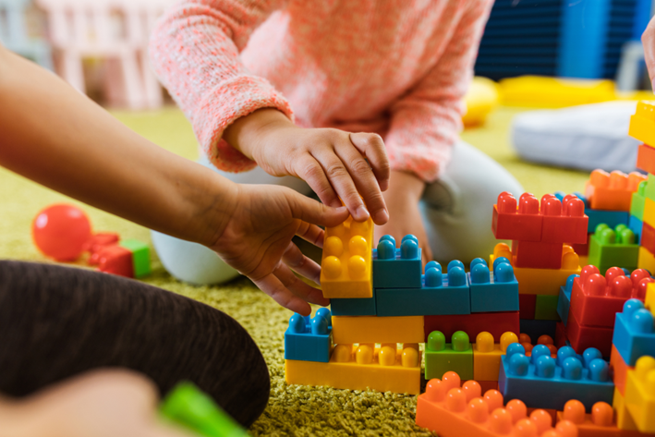
Learning through Play: Choice Time Centers
Choice time is a dedicated part of the day when children can engage in play-based learning through centers.
Children can freely choose an available center of their choice based on the teacher’s center-management system.
Movement from one center to another will be based upon student interest, engagement, and availability of space in the desired location.
Developmentally Appropriate Practices: Joyful Learning & Instruction Across the P–3 Classroom
Notes:
Play provides children the opportunity to practice what they have learned, build and negotiate relationships, communicate, listen, and develop ideas. Research shows learning occurs best when children are mentally active, engaged, socially interactive, and building meaningful connections to their lives--all components found during play.
Play is also intrinsically motivating for children. It fulfills their natural desire to understand the world. Through this intrinsic need to play with peers, children develop self-regulation. Infusing play into the kindergarten curriculum and daily structure will allow children to experience learning in a joyful way while developing socially, emotionally, and academically.
Please click on the link to see another expert in this library, Dr. Katherine Beauchat, on Developmentally Appropriate Practices: Joyful Learning & Instruction Across the P–3 Classroom on our K-3 Early Elementary alignment web page.

Slide 13
NJDOE resources for K-3 Early Elementary
K–3 Early Elementary Alignment
Kindergarten Implementation Guidelines and Resources
Kindergarten Consortium PowerPoints
First through Third Grade Implementation Guidelines and Resources
P-3 Educator Exemplars and Early Learning Experts Video Library
P-3 Approaches to Learning: How Young Children Learn
Notes:
Please visit the K-3 Early Elementary Alignment website to locate more resources for this grade level.

Slide 14
Optional Guiding Questions
How is movement intentionally incorporated into kindergarten daily routines and learning experiences?
In what ways does movement support kindergarten students’ cognitive, social, and emotional development?
How is your kindergarten classroom setup to allow for free movement, exploration, and flexible use of space?
Describe how areas in the classroom are clear and safe areas for both active play and quiet engagement in your kindergarten classroom.
How are materials and furniture used to encourage independence and physical activity in kindergarten?
How often are songs, dance, or movement-based games included in kindergarten lessons? How is movement integrated into literacy, math, and other learning areas?
Discuss opportunities provided for both structured movement (e.g., guided activities) and unstructured movement (e.g., free play).
Describe how outdoor environment activities are incorporated into your kindergarten lessons.
Notes:
These guided questions are optional, and you may choose to discuss any that are listed.
It is an extension activity to the presentation that can be discussed after the presentation or a later date.
They are here to provide you with some time to reflect as a group, whether in PLC or grade level meetings.
It is also a great opportunity to discuss next steps or how you can further incorporate Movement and Engagement in your curricula and kindergarten classrooms.
A Word document version of these “Guiding Questions and Next Steps from the Kindergarten Consortium Sessions” is located on the webpage with this PowerPoint for your convenience.

Slide 15
References
Brez, C., & Sheets, V. (2017). Classroom benefits of recess. Learning Environments Research, 16(2).
Center for Disease Control and Prevention. (2023). Child development basics. U.S. Department of Health & Human Services.
Murray, R., & Ramstetter, C. (2013). The crucial role of recess in school. Pediatrics, 131(1), 183–188.
Murray, R., & Ramstetter, C. (2017). Recognizing the benefits of recess. American Educator, 41(1).
NJ Rev Stat § 18A:35-4.31 (2024)
Notes:
Here are the references which are also located in the kindergarten implementation guidelines pertaining to this topic.

Slide 16
Thank You
Beth Wharton
K–3 Coordinator
Beth.Wharton@doe.nj.gov
K–3 Unit, Office of Standards
K-3Unit@doe.nj.gov
Notes:
Thank you for viewing the session on Movement & Engagement in Kindergarten.

Slide 17
Follow Us
Facebook @njdeptofed
X @newjerseydoe
Instagram @newjerseydoe
LinkedIn New Jersey Department of Education
nj.gov/education
Threads @newjerseydoe
YouTube @newjerseydepartmentofeduca6565
Notes:
Please follow the NJDOE on any of the platforms listed for current and valuable information and resources.

