Slide 1
Completing the 2023-2024
Title I, Part A Performance Report
Office of Fiscal and Data Services
Division of Educational Services
November 2024

Slide 2
Completing the 2023-2024 Title I, Part A
Performance Report
This PowerPoint presentation will cover the following:
  Purpose of the report;
  What local education agencies (LEAs) need to complete the report;
  Information needed to complete the report;
  How to log on to the Electronic Web-Enabled Grant (EWEG) system;
  Navigating EWEG and creating the report;
  Completing the different report tabs;
  Submission of the report;
  Amendments to the report; and
  Contact information.

Slide 3
Purpose of Title I, Part A Performance Report
  Contributes data to the larger comprehensive Consolidated State
  Performance Report that the New Jersey Department of Education (NJDOE)
  must submit to the United States Department of Education (ESEA §8303); and
  Provides a summative analysis of Title I, Part A funds and the services provided by LEAs utilizing these funds for the 2024 regular school year (instructional period not including intercession and summer sessions).
  Note: Title I, Part A requires two reports, each with different purposes and data elements:
  Title I, Part A Performance Report and
  Title I Comparability Report (due December 6, 2024)
  Please ensure that both reports are submitted to the NJDOE.

Slide 4
LEAs Required to Submit the Report
  The Elementary and Secondary Education Act (ESEA) requires the annual collection of data from LEAs that receive Title I, Part A funds.
  All LEAs that received Title I, Part A funds in the 2023-24 school year must complete and submit a report.
  LEAs that were allocated Title I, Part A funds, submitted an ESEA Consolidated Subgrant Application but refused Title I, Part A funds or did not submit an ESEA Consolidated Subgrant Application do not need to complete this report.
  Note: The submission due date is December 20, 2024.

Slide 5
Information Needed to Complete Report
EWEG logon information
Current contact information for LEA’s administrative offices, Chief School Administrator, Business Manager, Board President, and the ESEA Project Director
Student enrollment workbooks provided by NJDOE (downloaded from Homeroom)
Counts of students served for TAS and SWP by racial/ethnic group
Counts of students served for Public TAS, Public SWP, Neglected, and Nonpublic by grade level
Counts of students served for SWP and TAS by special service group: Homeless, Multilingual Learners, Migrant, and Children with Disabilities (IDEA)

Slide 6
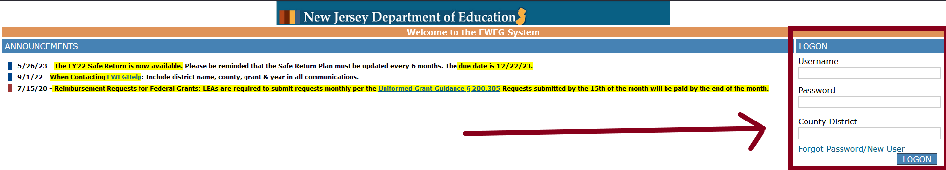
EWEG Logon
The report is accessed via the Electronic Web-Enabled Grant (EWEG) system at:
EWEG Logon Page.
On the righthand side of the EWEG Logon Page, enter your EWEG user ID, password, and county district code and hit the “LOGON” button. User IDs are limited to eight characters. Each user must have their own unique ID and password. Passwords are case sensitive. Please allow 48 hours for your permissions to become active.

Slide 7
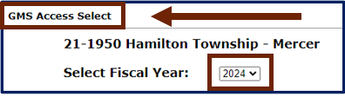
How to Create the Title I, Part A Performance Report
On the GMS Access Select Screen, you will need to select the pertinent year from the drop-down box labeled “Select Fiscal Year.”
Notes:
Make sure you’re on the GMS Access Select Screen
Make sure you select the correct fiscal year for the report from the drop down. For the current cycle it is 2024.

Slide 8
How to Create the Title I, Part A Performance Report
(cont’d)
The GMS Access Select screen will also list the “Title I – Performance Report” and you will need to select the report and create it by clicking the button labeled “Create.”
Note: Make sure you’re on the row for Title I – Performance Report and then click Create.

Slide 9
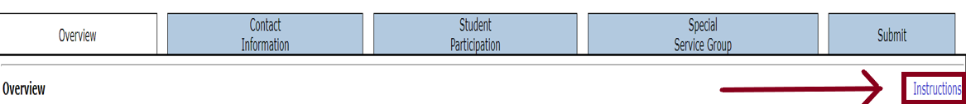
Selecting & Navigating the 2023-2024
Title I, Part A Performance Report in EWEG
Once the 2024 report is created, select the “Open” button associated with the
Title I – Performance Report for data input into the report.
The EWEG system has a tabbed interface available for navigating throughout the system. A link for the corresponding instructions is located in the upper righthand corner of each screen.
Click on the instructions link (outlined in red below) to download the instructions

Slide 10
Helpful Hints for Navigating EWEG
Do not use the browser “Back” button when you are working in the EWEG system. This will cause errors and may log you out of the system. All necessary navigation within the system can be accomplished by clicking on the different tabs.
White cells are available for entering data, and gray cells are calculated cells.
The “Save Page” button must be clicked before you leave each tab, or you will lose the data entered. Please note, you will not be able to save your work if there is an error message.
The EWEG system has built-in edits that interact to verify column totals and cross-reference tables, if appropriate. If totals do not correlate, you may receive an error or warning message on the tab or on the submit tab when a consistency check is unsuccessfully conducted. Remedy all errors and warnings before attempting to submit.

Slide 11
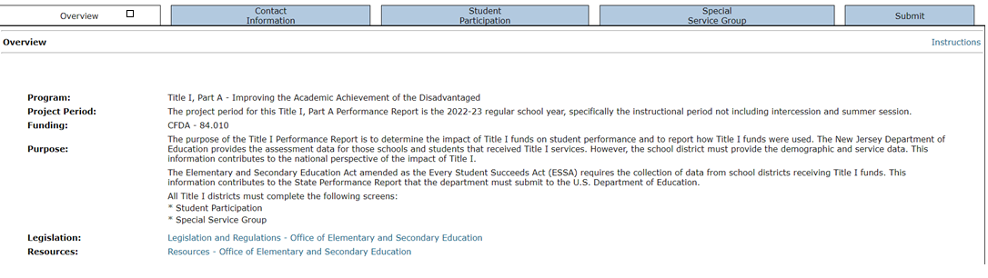
Overview Tab
This screen provides the purpose and other useful information to assist with the completion and submission of the Title I, Part A Performance Report. No data input is required.

Slide 12
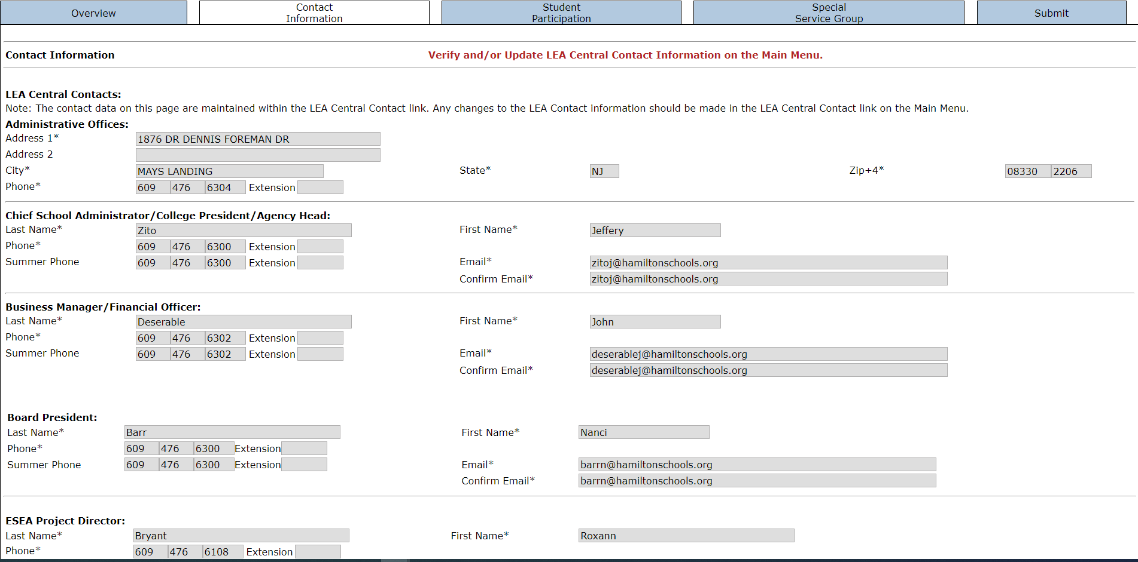
Contact Information Tab
The Contact Information tab does not require any data input in the Title I Performance Report, because the data are maintained within the LEA Central Contact system. The information displayed on this tab is the same as the 2024-2025 ESEA Consolidated Subgrant Application.
Be sure you have updated the Central Contact system to reflect LEA staff currently responsible for the various programs and functions. Any changes to the LEA Contact information should be made in the LEA Central Contact system. NJDOE staff use this information to contact district personnel.

Slide 13
Student Participation Tab
The Student Participation tab contains two subtabs - Student Participation by Racial/Ethnic
Group and Student Participants by Grade Level. Please note that the Total Public TAS and Total
Public SWP participants in Table 1b (Grade Level) must equal the Total Student Participants in Table 1a (Racial/Ethnic Group).
Please note that a workbook has been uploaded to the homeroom page to assist you in completing the following subtabs. The workbook can be accessed by going to Homeroom and selecting “Federal Program Insights” from the Application column on the left-hand side of the page.
Student Participation by Racial/Ethnic Group Subtab
This subtab contains Table 1a and collects data for public school students by type of Title I, Part A program―targeted assistance (TAS) or schoolwide (SWP) and the student counts must be disaggregated according to racial/ethnic group.
Student Participation by Grade Level Subtab
This subtab contains Table 1b. collects data by age/grade level for all students served with Title I, Part A funds.

Slide 14
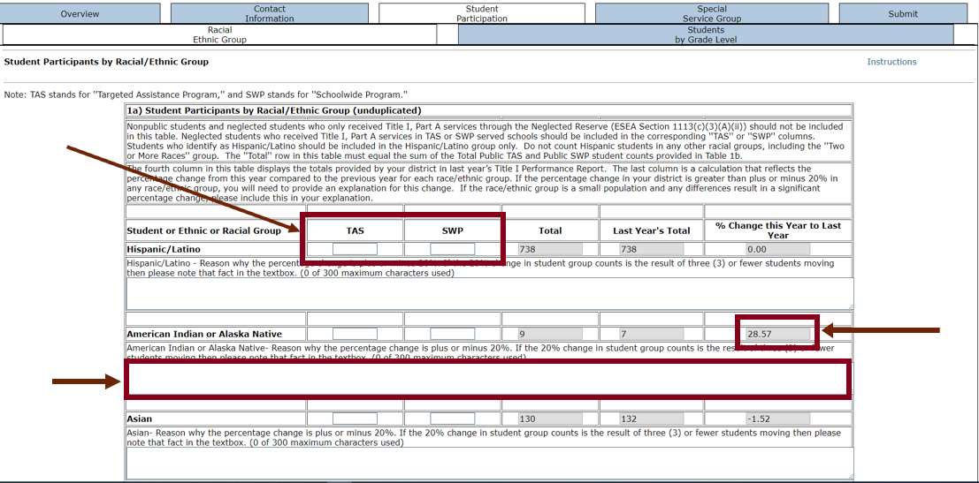
Student Participation by Racial/Ethnic Group Subtab
For each racial/ethnic group, be sure to enter the number of students served in TAS and/or SWP Programs.
If the total number of students served in a group has increased or decreased by more than 20% from last year, an explanation will need to be input into the text box under the specific group.

Slide 15
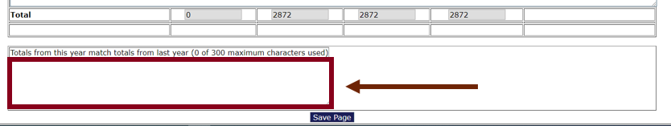
Student Participation by Racial/Ethnic Group Subtab (Cont.)
An explanation is required if the total number of students served this year equals the total number of students served last year.

Slide 16
Racial/Ethnic Group Subtab General Information
This tab contains Table 1a. Student Participants by Racial/Ethnic Group (Unduplicated) and requires data on public school students by type of program that your LEA funds―targeted assistance (TAS) or schoolwide (SWP).
If your LEA has both TAS and SWP programs, the expectation is that data will be input for both. The student data must be disaggregated according to racial/ethnic group.
As a reminder, all students in a served SWP school are considered as having participated in and received Title I, Part A services.

Slide 17
Table 1a. Student Participants by Racial/Ethnic Group (Unduplicated)
For Table 1a. enter the unduplicated count, by racial/ethnic group, for students who participated in a Title I, Part A program at any time during the regular school year (excluding intercession or summer sessions). Include students in targeted assistance programs (TAS) and schoolwide programs (SWP).
Count a student only once in each racial/ethic category even if the student participated during more than one term or in more than one school during the reporting period.
Any racial/ethnic combination that includes Hispanic/Latino must be counted as Hispanic/Latino only and students of multiple races/ethnicities must be counted as two or more races.

Slide 18
Table 1a. Student Participants by Racial/Ethnic Group
Include students in Pre-K through Grade 12. Do not include neglected students who only receive Title I, Part A services through the Neglected Reserve (ESEA Section 1113(c)(3)(A)(ii)), nonpublic students, or adult participants in adult literacy programs funded by Title I, Part A in this table. Zeros must be entered in any entry box that your LEA does not have any student counts.
The counts of students must reflect the type(s) of Title I, Part A programs the LEA was approved to run in 2023-2024. Students who participated in Title I, Part A services in a school that operated a Targeted Assistance Program need to be reflected in the first column labeled “TAS” and those students who participated in a school that operated an approved Title I, Part A Schoolwide Program need to be reflected in the second column labeled “SWP.”

Slide 19
Table 1a. Student Participants by Racial/Ethnic Group (Cont.)
The sum of the counts entered into the two columns - “TAS” and “SWP” are calculated by the EWEG system and reflected in the total column. The report also reflects counts for each racial/ethnic group the district submitted in 2022-2023 and is reflected in the “Last Year’s Total” column. The EWEG system calculates the percentage difference between this year’s total counts compared to last year’s total count and is reflected in “% Change This Year to Last Year” column.
An explanation is required if the total number of students served this year equals the total number of students served last year.

Slide 20
Differences for Student Participation by Racial/Ethnic Group
For each racial/ethnic group which has a calculated percentage difference greater than ±20%, a brief explanation is required. The text box where the explanation must be entered is located under each racial/ethnic group.
If the difference can be attributed to a small population size and associated difference resulting in greater than ±20%, please include it in the explanation. The explanation text boxes are limited to 300 characters.

Slide 21
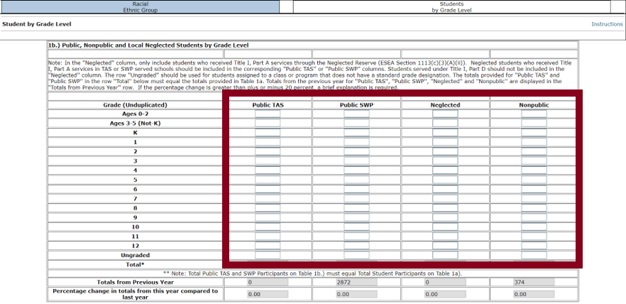
Student Participation by Grade Level Subtab
For each group (Public TAS, Public SWP, Neglected, and Nonpublic) be sure to enter the number of students served in each grade level.

Slide 22
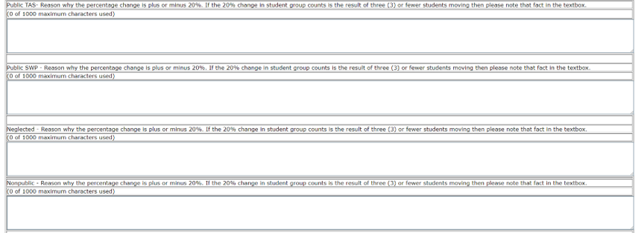
Student Participation by Grade Level Subtab (Cont.)
If the total number of students served in a group has increased or decreased by
more than 20% from last year, an explanation is required to be input into the text box under the group.

Slide 23

Student Participation by Grade Level Subtab (Cont. 2)
If the total number of students served in a group this year totals the exact same amount as was served last year for that group (for groups with greater than zero students served), an explanation is required to be input into the text box(es) under the total.

Slide 24
Students by Grade Level Subtab General Information
This subtab contains Table 1b Public, Nonpublic, and Local Neglected Students by Grade Level and requires data on public school students by type of program―targeted assistance (TAS) or schoolwide (SWP), local neglected students, and nonpublic school students served with Title I, Part A funds. The student data must be disaggregated according to age/grade level.

Slide 25
Table 1b. Public, Nonpublic, and Local Neglected Students by Grade Level
In Table 1b, enter unduplicated counts by age/grade level, for students who participated in a Title I, Part A program at anytime during the regular school year (excluding intersession or summer session). Count each student only once in each category even if the student participated during more than one term or in more than one school during the reporting period.
The counts of students must reflect the type(s) of Title I, Part A programs the district was approved to run in 2023-2024. Students who participated in Title I, Part A services in a school that operated a Targeted Assistance Program need to be reflected in the first column labeled “TAS” and those students who participated in a school that operated an approved Title I, Part A Schoolwide Program need to be reflected in the second column labeled “SWP.”

Slide 26
Table 1b. Public, Nonpublic, and Local Neglected Students by Grade Level (Cont. 1 of 3)
Include students in ages 0 –2, 3 –5 (Not K), grades K –12, and ungraded students.
Updated information from the United States Department of Education about whether students receiving early childhood education (e.g., pre-K services) should be counted as participating in and served by a school’s Title I, Part A program
  If the pre-K program is part of a school’s Title I schoolwide program, the students in the pre-K program should be included in the counts for schoolwide program schools regardless of whether the pre-K students are served using Title I, Part A funds.
  If the pre-K program is part of a school’s Title I targeted assistance program, eligible pre-K students served by using Title I funds in the pre-K program should be included in the counts for targeted assistance programs.
  However, if the pre-K program is part of a district run program (i.e., if the pre-K program is operated by the LEA within the school’s building and is not part of the school’s schoolwide program), the students in the pre-K program should not be included in the school counts.

Slide 27
Table 1b. Public, Nonpublic, and Local Neglected Students by Grade Level (Cont. 2 of 3)
In the “Neglected” column, only include students who received Title I, Part A services through the Neglected Reserve (ESEA Section 1113(c)(3)(A)(ii)). Only districts with neglected institutions within the district’s boundary will be able to input student counts in this column. Neglected students who received Title I, Part A services in TAS or SWP served schools should be included in the corresponding “Public TAS” or “Public SWP” columns. Students served under Title I, Part D should not be included in the “Neglected” column.
Students served with Title I, Part A funds that attend nonpublic schools need to be reflected by age/grade in the column labeled “Nonpublic.”

Slide 28
Table 1b. Public, Nonpublic, and Local Neglected Students by Grade Level (Cont. 3 of 3)
The sum of the counts entered into the four columns are calculated by the EWEG system and reflected in the “Total*” row. The report also displays for each column the total count submitted in 2022-2023 and is reflected in the “Totals from Previous Year” row. The EWEG system calculates the percentage difference between this year’s total counts for each column compared to last year’s total count and is reflected in “Percentage Change in Totals from This Year Compared to Last Year” row. For each column that has a calculated percentage difference greater than ±20%, a brief explanation is required.
Additionally, if the count in the “Total*” row is equal to the count in the “Total from Previous Year” row for any of the columns (for groups with greater than zero students served), an explanation will need to be input into the text box(es) under the totals.

Slide 29
Subtab General Information
The system calculates the total for each row and column for both tables and saves each subtab when the “Save Page” button at the bottom of the screen is clicked.
The Public TAS column total in Table 1b must equal the TAS column total reflected in Table 1a.
The Public SWP column total in Table 1b must equal the SWP column total reflected in Table 1a.
The “Total*” row for the “Public TAS” and/or “Public SWP” column in Table 1b must be greater than zero and equal to the student totals for “TAS” and “SWP” in Table 1a. If totals do not equal, you will receive an error message.

Slide 30
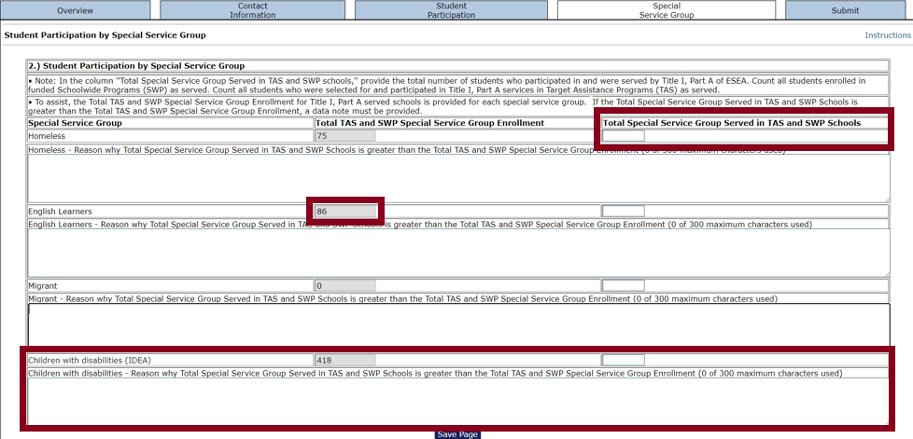
Special Service Group Tab
For each special service group, be sure to enter the total number of students served in TAS and/or SWP Programs.
If the total number of students served in a group is greater than the enrollment information provided by the NJDOE, an explanation will need to be input into the text box under the group.

Slide 31
Special Service Group Tab General Information
This tab requires the total unduplicated count of LEA students experiencing Homelessness, Multilingual Learners, students who are Migrant, and Children with Disabilities and that received Title I, Part A services at any time during the regular school year (excluding intersession or summer sessions).

Slide 32
Special Service Group Tab Information
Enter in the “Totals Special Service Group Served in TAS and SWP Schools” boxes the total number of public students experiencing Homelessness, Multilingual Learners, students who are Migrant, and Children with Disabilities who received services funded by Title I, Part A during the 2023-2024 school year in TAS and/or SWP programs. Count students in pre-K through Grade 12.
Count each student in as many categories as apply to the student but count a student only once in each category even if the student participated during more than one term or in more than one school during the reporting period.

Slide 33
Special Service Group Tab Information (Cont.)
For each group, the column titled “Total TAS and SWP Special Service Group Enrollment” reflects your LEA’s student enrollment counts as reported in NJSMART as of October 2023. If the number of students served is higher than the enrollment count, a brief explanation is required to be entered into the text box below the special service group.
Any count entered on this tab should not include nonpublic students, local neglected students served via the neglected reserve, or participants of adult literacy programs funded by Title I, Part A.
If your LEA does not have any children that reflect the special service group and received Title I, Part A services, a zero should be placed in the associated row.

Slide 34
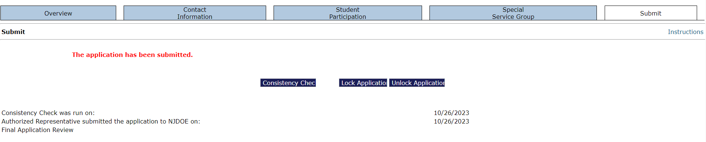
Submit Tab

Slide 35
Submit Tab – Information
Prior to submission, a consistency check must be performed by clicking the “Consistency Check” button. A consistency check validates the data entered into the EWEG system based on programmed edits. If any errors are detected, corresponding error messages will appear on the tab in red. All errors must be corrected on the applicable tabs. To ensure all errors have been rectified prior to submission, a consistency check must be conducted again. The EWEG system will not allow the submission of the report with any remaining unresolved errors.
Once the consistency check is successful, the report is considered locked but not yet submitted to the NJDOE.

Slide 36
Submit Tab – Information (Cont.)
If revisions need to be made, the report can be unlocked by selecting the “Unlock Application” button. After unlocking the report and revising any data, a consistency check will need to be re-run to verify that the data passes the programmed edits.
If the consistency check is successful, the “Submit to NJDOE” button should appear on the tab and needs to be clicked for the reported to be considered submitted to the NJDOE.

Slide 37
Amendments
If you realize data was incorrectly entered and your report has been successfully submitted to the NJDOE, you will need to create an amendment.
After the report is submitted, you will need to create an amendment by clicking the “Amend” button on the GMS Access Select Screen in the Title I – Performance Report row.
Once the data has been entered, a consistency check must be re-run and any errors corrected prior to submission.

Slide 38
Thank You!
New Jersey Department of Education: nj.gov/education
For Title I, Part A Performance Report program and data questions, please contact the Office of Fiscal and Data Services (OFDS):
Ryan Gilbert: Ryan.Gilbert@doe.nj.gov
Kari Dalane: Kari.Dalane@doe.nj.gov
OFDS: OFDS@doe.nj.gov or (609) 376-9101
For EWEG or authorization questions, please contact the EWEG Help Desk at: Eweghelp@doe.nj.gov

Slide 39
Follow Us on Social Media
Facebook:
@njdeptofed
Instagram:
@newjerseydoe
LinkedIn:
New Jersey Department of Education
Threads:
@NewJerseyDOE
X: @NewJerseyDOE
YouTube: @newjerseydepartmentofeduca6565

