Slide 1
FY25 Summer 2024 Contract & Budget Training
OFFICE OF THE SECRETARY OF HIGHER EDUCATION (OSHE)
Educational Opportunity Fund (EOF)

Slide 2
Purpose of this Training
To provide an overview of the EOF Summer Contract and changes to the Budget Documents (Contract Attachment B2)
To review the allowable expenditures for the 2024 Summer Program
To review the process of completing the 2024 Summer Budget and submission deadlines

Slide 3
OSHE/EOF Central Staff
Dr. Hasani Carter
Hasani.Carter@oshe.nj.gov
Peter Collazo
Peter.Collazo@oshe.nj.gov
Hema Patel
Hema.Patel@oshe.nj.gov
Catherine Sackey
Catherine.Sackey@oshe.nj.gov
Dr. Stephanie Shanklin
Stephanie.Shanklin@oshe.nj.gov
OSHE Finance
Tiffany Hazzard
Tiffany.Hazzard@oshe.nj.gov
Kevin Kobylowski
Kevin.Kobylowski@oshe.nj.gov

Slide 4
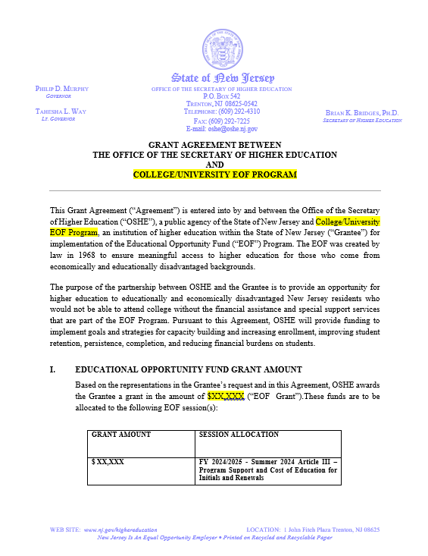
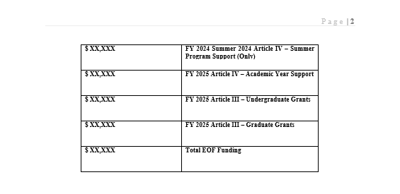
FY25 EOF Program Contracts
Notes:
FY24 contract includes 2023 Summer Program Allocations AND FY24 Academic Year Allocations
Please note that EOF summer payments cannot be executed until a signed contract has been received.
Programs should use this information to develop their respective budgets attachments.

Slide 5
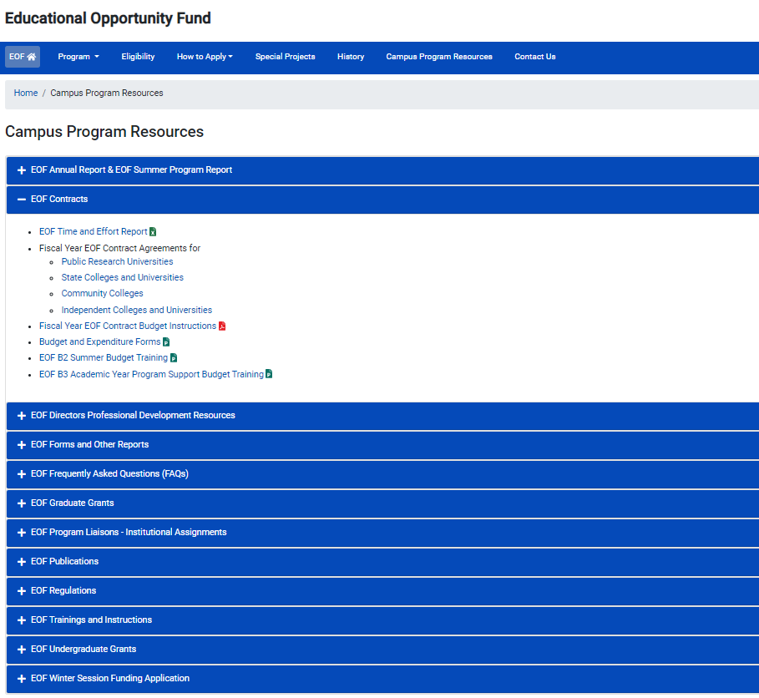
FY25 EOF Program Contracts
Click here to access EOF Campus Resources
Notes:
FY24 contract includes 2023 Summer Program Allocations AND FY24 Academic Year Allocations
Please note that EOF summer payments cannot be executed until a signed contract has been received.
Programs should use this information to develop their respective budgets attachments.

Slide 6
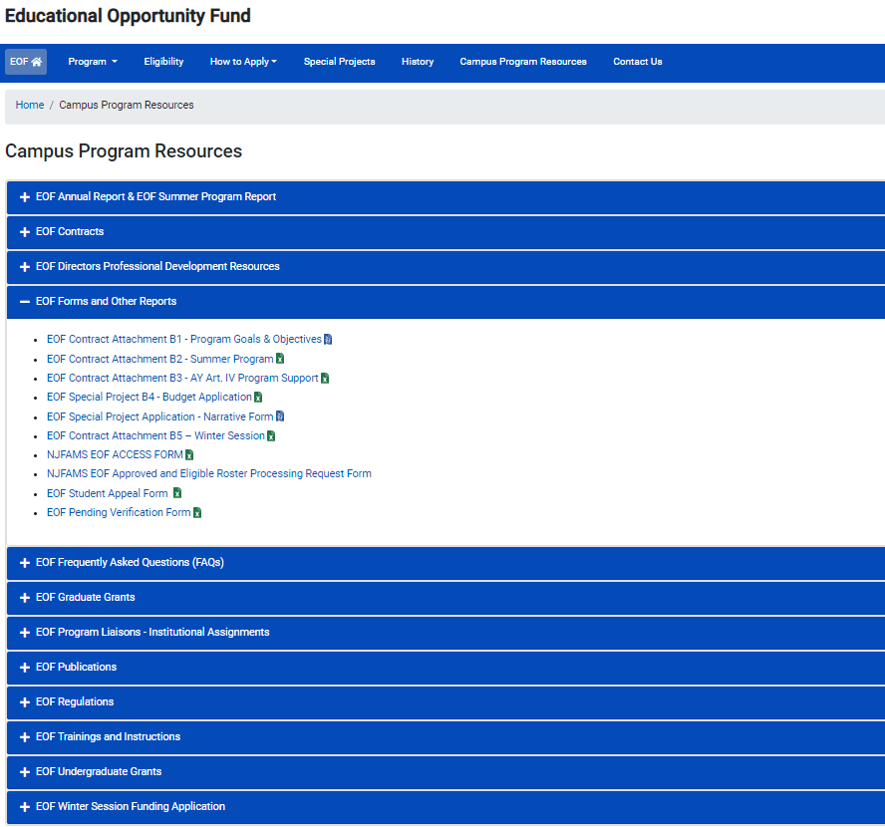
FY25 EOF B2 Contract Attachment
Notes:
FY24 contract includes 2023 Summer Program Allocations AND FY24 Academic Year Allocations
Please note that EOF summer payments cannot be executed until a signed contract has been received.
Programs should use this information to develop their respective budgets attachments.

Slide 7
Only cells that require information to be inputted are accessible. All other cells are locked.
Programs can still, however, add tabs if needed.
All programs must start on the Initial tab. EOF special programs that only provide support to Renewals must start on the Initial tab and put your allocation at the top.
All line items require a “Narrative Description”. Items must include a clear educational purpose and where appropriate, any associated pre- and post-activity assessments that will be conducted.
Programs must report on all EOF students supported during the Summer, even if they only received program support.
Programs must report all forms of aid received by students (e.g., Summer TAG funds, institutional funds, and aid charged to other resources).
Things to Know When
Completing the B2 Summer
Budget

Slide 8
Disbursement of 2024 Summer Funds and Budget Modifications
Payment Distribution:
For 2024 Summer: Programs will receive 100% of their Article 3 and Article 4 funds. (Note: As noted in the May 9, 2024 EOF Board materials, the total amount of Summer Article 3 funds may be paid out via two fiscal sources (i.e. FY24 and FY25 funds). FY25 funds will not be remitted until OSHE has been able to verify that these funds are available in our account and the EOF program has successfully submitted a signed FY25 contract and a copy of its Policy and Procedures manual.)
Example of 2024 Summer Program payee reference format = EOF SUM324 FY24/5 (Inst./Program Name) PMT
Summer Program Budget Modification Deadline:
Due to variable lengths of Summer Sessions, OSHE/EOF defines the last day of the EOF summer program as the day before your institution’s Fall 2024 term.
Remain aware of any anticipated under-expenditures/cost savings on a weekly basis.
Re-purpose any available funds immediately with a budget modification request to the OSHE/EOF office.

Slide 9
Summer Article III - Allowable Expenditures
The EOF Article III summer program grant shall be applied to the student’s educational costs.
Such costs shall include the participating institution’s educational budget and/or instructional costs as follows:
Tuition charged per student or instructional costs (instructors’/teaching assistants’ salaries), but never both for any single course​
Fees, room & board, books, educational supplies, transportation, and childcare, as well as stipends and insurance​
Salaries and room and/or board for professional, graduate, and/or peer tutors
Educational materials used to support instruction
Notes:
All programs will receive both Article 3 and Article 4 funding for the Summer.
Programs were informed about how the 2022 Summer Program allocations were determined during the EOF Board meeting and the EOF Post-Board town-hall meeting.
Summer Article 3 funds may be used for both EOF Program Support and Cost of Education items for initials and renewals. Per 9A:11-6.3(b):
The EOF Article III summer program grant shall be applied to the student’s educational costs.
Funds awarded for the summer session are to be used solely for courses and educational costs that occur during the summer session.
Courses taken during the summer session must be recorded on the students’ academic transcripts as completed during the summer session.
In the summer, such costs shall include whatever constitutes the participating institution’s educational budget and/or instructional costs as follows:
1. Tuition charged per student or instructional costs (that is, instructors’ and teaching assistants’ salaries), but never both for any single course;
2. Fees, room and board, books, educational supplies, transportation, and child care, as well as stipends and insurance;
3. Salaries, and room and/or board for professional, graduate, and/or peer tutors; and
4. Educational materials used to support instruction.
Summer Article 4 funds can only be used on the EOF Program Support tab (i.e. toward program support). It may not be used to pay for Cost of Education items (i.e. the items highlighted in green on the Initials or Renewals tab).
Programs are reminded that the regulations that govern the usage of EOF Article 4 funds remain the same throughout the year.

Slide 10
Summer Article III - Differences Between AY and Summer (9A:11-6.3)
(a) EOF Article III academic year funds are processed as semester grants per student and shall be applied toward student’s educational costs only. Funds awarded in the fall and spring terms are to be used solely for courses and educational costs that specifically occur within the fall and spring terms. Such costs shall include whatever constitutes the participating institution’s educational budget and may include tuition, fees, room and board, books, required educational materials and supplies, transportation and child care.
(b) The EOF Article III summer program grant shall be applied to the student’s educational costs. Funds awarded for the summer session are to be used solely for courses and educational costs that occur during the summer session. Courses taken during the summer session must be recorded on the students’ academic transcripts as completed during the summer session. In the summer, such costs shall include whatever constitutes the participating institution’s educational budget and/or instructional costs as follows: 1. Tuition charged per student or instructional costs (that is, instructors’ and teaching assistants’ salaries), but never both for any single course; 2. Fees, room and board, books, educational supplies, transportation, and childcare, as well as stipends and insurance; 3. Salaries, and room and/or board for professional, graduate, and/or peer tutors; and 4. Educational materials used to support instruction.
Notes:
All programs will receive both Article 3 and Article 4 funding for the Summer.
Programs were informed about how the 2022 Summer Program allocations were determined during the EOF Board meeting and the EOF Post-Board town-hall meeting.
Summer Article 3 funds may be used for both EOF Program Support and Cost of Education items for initials and renewals. Per 9A:11-6.3(b):
The EOF Article III summer program grant shall be applied to the student’s educational costs.
Funds awarded for the summer session are to be used solely for courses and educational costs that occur during the summer session.
Courses taken during the summer session must be recorded on the students’ academic transcripts as completed during the summer session.
In the summer, such costs shall include whatever constitutes the participating institution’s educational budget and/or instructional costs as follows:
1. Tuition charged per student or instructional costs (that is, instructors’ and teaching assistants’ salaries), but never both for any single course;
2. Fees, room and board, books, educational supplies, transportation, and child care, as well as stipends and insurance;
3. Salaries, and room and/or board for professional, graduate, and/or peer tutors; and
4. Educational materials used to support instruction.
Summer Article 4 funds can only be used on the EOF Program Support tab (i.e. toward program support). It may not be used to pay for Cost of Education items (i.e. the items highlighted in green on the Initials or Renewals tab).
Programs are reminded that the regulations that govern the usage of EOF Article 4 funds remain the same throughout the year.

Slide 11
Summer Article IV - Allowable Expenditures
EOF Article IV Funds are to be used for EOF Program Support activities.
Article IV program support funds shall not be used for the following items:
Cost of Education Items (highlighted in green on Initials/Renewal Tabs). Student costs covered by a student’s financial aid package
Fringe benefits for AY student assistants, part-time personnel, campus EOF administrator/director, or 12-month EOF staff at public senior institutions; fringe benefits in excess of 21% of the salaries paid by EOF funds for 12-month EOF staff at community colleges and independent institutions
Transportation of students for normal commuting costs
The cost of instruction for which students are charged tuition
For additional details, please refer to EOF Regulations (N.J.A.C. 9A:11-6.10) (Pgs. 35-36)​
Notes:
All programs will receive both Article 3 and Article 4 funding for the Summer.
Programs were informed about how the 2022 Summer Program allocations were determined during the EOF Board meeting and the EOF Post-Board town-hall meeting.
Summer Article 3 funds may be used for both EOF Program Support and Cost of Education items for initials and renewals. Per 9A:11-6.3(b):
The EOF Article III summer program grant shall be applied to the student’s educational costs.
Funds awarded for the summer session are to be used solely for courses and educational costs that occur during the summer session.
Courses taken during the summer session must be recorded on the students’ academic transcripts as completed during the summer session.
In the summer, such costs shall include whatever constitutes the participating institution’s educational budget and/or instructional costs as follows:
1. Tuition charged per student or instructional costs (that is, instructors’ and teaching assistants’ salaries), but never both for any single course;
2. Fees, room and board, books, educational supplies, transportation, and child care, as well as stipends and insurance;
3. Salaries, and room and/or board for professional, graduate, and/or peer tutors; and
4. Educational materials used to support instruction.
Summer Article 4 funds can only be used on the EOF Program Support tab (i.e. toward program support). It may not be used to pay for Cost of Education items (i.e. the items highlighted in green on the Initials or Renewals tab).
Programs are reminded that the regulations that govern the usage of EOF Article 4 funds remain the same throughout the year.

Slide 12
Tuition & Fees = Credits Attempted/Earned During Summer
If a student is charged for “X” credits, then this number of credits should appear on the student’s transcript for the Summer program.
For example:
Student is registered for 9 credits during the summer.
EOF funds are used to pay for those 9 credits.
Student’s transcript must show that the student was enrolled for 9 credits during the Summer session.
Notes:
If the course is an enrichment course with no credits earned toward the degree, then this should be properly documented (i.e. Developmental Math 0001; 3 credits (P/F)).
If a student attempts 9 credits and only earns less than 9 credits due to not passing a course, then this should also be reflected on the student’s transcript for the summer.
If a EOF renewal student completed their FAFSA for the 2021-2022 academic year and the ONLY reason the student was not eligible for an EOF AY grant was due to the student having reached the maximum number of EOF AY payments, then this student may be considered for EOF Summer Funding support.

Slide 13
Stipends: Article III Funds
Cost of education purposes only (supplies, commuter costs, textbooks, etc.)
Programs must have documentation to reflect how the amount was determined (ex: cost of actual textbooks, mileage reimbursement rate, on-campus meal plan price, etc.)
OSHE/EOF does not determine stipend award levels
Program should not wait until the end of the summer session to seek adjustments to stipends.
Institutions/EOF campus programs assume all liability associated with the distribution of stipends (i.e., future financial aid eligibility for independent students, etc.)
Stipends may not be used to reimburse or pay a student directly for taking a course at another institution

Slide 14
Special Circumstances: Courses at Another Institution
Should seek to establish a formal arrangement/agreement
Must be at an institution that participates in EOF
Allow for the institution to be billed directly for the student’s enrollment at another institution/program
Ensure appropriate documentation between institutions for audit purposes

Slide 15
Prior to Completing the 2024 Summer Budget
Review the FY25 contract and 2024 Summer allocations to ensure you are working with the correct figures.
Instructions for completing the budget template are in the template file – the tab is labeled “Directions to Complete”
Program Directors should work with your OSHE/EOF program liaison if you have any questions regarding the development of your budget and allowable expenses.

Slide 16
Completing the 2024 Summer Budget: Summer Budget Template
A walk-through of how to properly complete the 2024 Summer Budget Template
(Contract Attachment B2)
https://www.nj.gov/highereducation/EOF/EOFBudgetForms/FY24Contracts/FY2025EOF2024SummerB2ContractAttachment.xlsx
Notes:
Summer Program
Support Services
Personnel salaries & wages (do not include instructors’ salaries for cost of instruction if students are charged tuition for the course)
Educational materials & supplies (do not include cost of textbooks for initial & renewal summer program participants)
Other administrative costs
Initial & Renewal
Cost of Education
Tuition
Fees
Room
Board
Books
Stipends
Insurance

Slide 17
Completing the 2024 Summer Budget: Final Checklist for Submission
Provided Institution/EOF Program Name
Provided the total number of Initial and Renewal students on the respective tabs
Provided the appropriate Narrative Descriptions per budget category utilized, including a breakdown of the expenses summarized by the total
Utilized full allocation for the 2024 Summer Program

Slide 18
EOF Document Submissions
All Documents must be submitted via email to EOF@OSHE.NJ.GOV. Institutions can include new tabs within this workbook to provide additional details.
Email Subject Line: School/Program NAME 2024 B2 Summer Budget
- Ex: New Jersey State College Health Careers Program 2024 B2 Summer Budget
File Naming Convention: School/Program NAME 2024 B2 Summer Budget
- Ex. New Jersey State College Health Careers Program 2024 B2 Summer Budget
Note: the current excel file name should be changed to reflect the file naming convention above. The file name may also indicate it is an FY24 file link, but it is in fact the FY25 B2 Contract Attachment.

Slide 19
Completing the 2024 Summer Budget
A final version of your EOF 2024 Summer Budget (Contract Attachment B2) must be e-mailed to EOF@OSHE.NJ.GOV and the EOF Executive Director by:
June 12, 2024
C1 Contract Attachment (Final Summer 2024 Expenditure Report) must be e-mailed to EOF@OSHE.NJ.GOV and the EOF Executive Director by:
September 23, 2024

Slide 20
EOF Program Liaison Assignments
HASANI CARTER | PETER COLLAZO | HEMA PATEL | STEPHANIE SHANKLIN
Email: hasani.carter@oshe.nj.gov | Email: peter.collazo@oshe.nj.gov | Email: hema.patel@oshe.nj.gov | Email: stephanie.shanklin@oshe.nj.gov
Rutgers University - Camden | County College of Morris | Bergen Community College | Atlantic Cape Community College
Rutgers University - College of Nursing | Felician University | Brookdale Community College | Caldwell University
Rutgers University - Graduate Bio-medical | Middlesex College | Essex County College | Camden County College
Rutgers University - Graduate Education Prep | Monmouth University | Fairleigh Dickinson University - Florham | Centenary University
Rutgers University - Graduate Studies (except Bio-medical) | Ramapo College of New Jersey | Fairleigh Dickinson University - Metropolitan | Drew University
Rutgers University - New Jersey Medical School | Rowan School of Osteopathic Medicine (SOM) - Graduate (Only) | Hudson County Community College | Georgian Court University
Rutgers University - Newark | Rowan School of Osteopathic Medicine (SOM) - Pre-Matric | Kean University | Montclair State University
Rutgers University - ODASIS | Rowan School of Osteopathic Medicine (SOM) - Summer Prep | Mercer County Community College | Montclair State University - Bloomfield
Rutgers University - Office of EOF Administration | Rowan University - Camden | New Jersey City University | Montclair State University - Health Careers Program
Rutgers University - Robert Wood Johnson Medical School | Rowan University - Cooper Medical School - Graduate (Only) | New Jersey Institute of Technology | Rider University
Rutgers University - School of Arts and Sciences (New Brunswick) | Rowan University - Cooper Medical School - PULSE Program | Ocean County College | Rowan College at Burlington County
Rutgers University - School of Engineering | Rowan University - Glassboro | Passaic County Community College | Rowan College of South Jersey - Cumberland
Rutgers University - School of Environmental and Biological Sciences | Rowan University - Graduate Bio-medical | Raritan Valley Community College | Rowan College of South Jersey - Gloucester
Rutgers University - School of Health Professions | Saint Peter's University | Sussex County Community College | Seton Hall - Law
Rutgers University - School of Pharmacy | Salem Community College | The College of New Jersey | Seton Hall University - Main
Rutgers University - Summer Grads | St. Elizabeth University | Union College of Union County, NJ | Seton Hall University - Pre-Legal
 | Stevens Institute of Technology | Warren County Community College | Seton Hall University - Pre-Med/Pre-Dent Plus
 | William Paterson University |  | Stockton University - Atlantic City
 |  |  | Stockton University - Galloway

Slide 21
OSHE/EOF Campus Resources Website
https://www.nj.gov/highereducation/EOF/EOF_Program_Resources.shtml

Slide 22
QUESTIONS?

Slide 23
Thank You! We look forward to working with you

