Slide 1
Special Projects Grants Outcomes Report
Reported By:
EOF Office &
Office of Social Justice, Inclusion and Conflict Resolution
10/3/2017

Slide 2
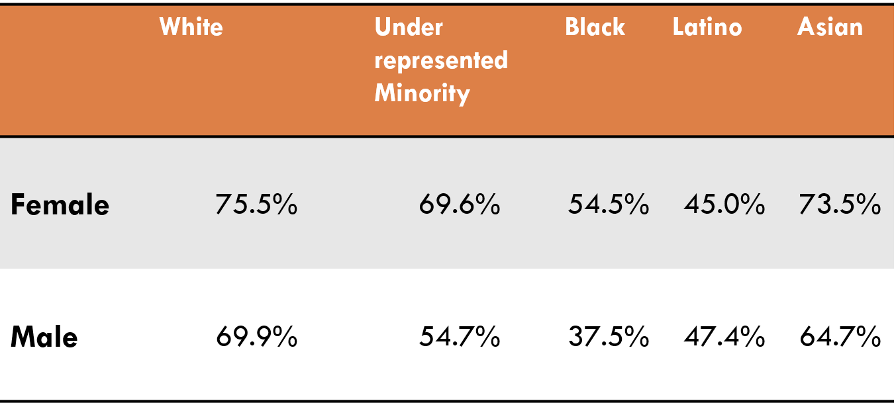
Who Is The MCM Retreat For?
Rowan’s Demographics
Black 8.2%
Latino 8.9%
Native American 0.2%
Asian 3.3%
White 75.4%
Female 49.2%
Male 50.8%
Rowan’s 6-Year Grad Rates
The ethnic make-up of these graduation rates was disproportionate and concerning, when compared to their female counterparts. Subsequently, the statistical trends coupled with the social state of the men of color at Rowan during the ‘13/’14 and ’14/’15 academic years was a catalyst for the creation of the MCM Retreat.

Slide 3
The overarching goal of this leadership retreat is to encourage participants to think critically about what it means to be a successful man at Rowan and in the wider community. We offer you opportunities define successful manhood and outline a roadmap toward wise leadership.

Slide 4
2017 Multicultural Men’s Retreat Demographics
Total Participants: 24 young men
11 of 24 (46%) young men Non-EOF
13 of 24 (54%) young men in EOF
All data is based on the total 24 young men.
Maintaining anonymity required sacrifice of knowing the identity of the respondents, thus we are not aware which surveys belonged to the 13 EOF students.

Slide 5
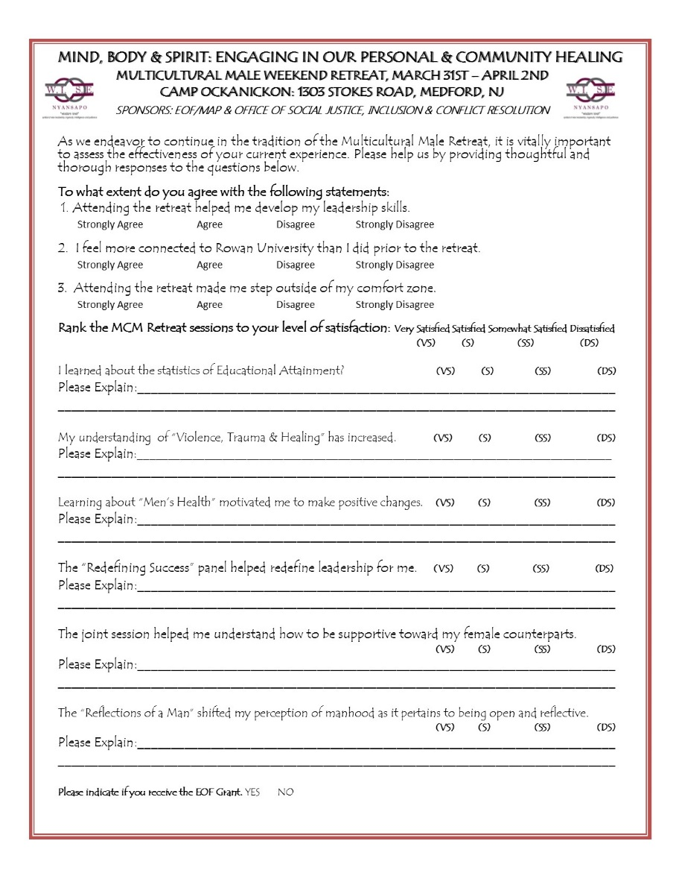
Assessment Tool (Image on left = Magnified portion of survey)

Slide 6
Impact over Impression

Slide 7
Impact over Impression

Slide 8
Impact over Impression

Slide 9
Impact over Impression

Slide 10
Qualitative Feedback From Students
“Education is vital to everything you do in life, even being educated about your emotions or how you think plays a big role in growing as a man.”
“I was able to comfortably open up and express myself without “the world” pushing my feeling out of the way or saying “man up and move on.”
“I’m going to work harder to make changes in my personal life and be better for other people.”
“From now on I will take personal time to be reflective in my personal life because of this retreat.”
“I was able to open up fully about something deep because the space provided was created for that to happen and it was really progressive.”
“Hearing an unfiltered real perspective helped me understand how to help, but more importantly support women.”

Slide 11
Working Intelligently & Succeeding through Engagement
In efforts to build upon the work done at the retreat, the EOF Office and the Office of Social Justice, Inclusion and Conflict Resolution will create opportunities for continued engagement, to include:
Collective Check-In Meetings
Accountability Partners
Tri-Pod Mentoring
Social Bonding Activities

