Slide 1



Diabetes and your health
New Jersey Department of Human Services
Commission for the Blind and Visually Impaired
Project BEST
(Better Eye-Health Services and Treatment)
Notes:
NOTE:
To change the image on this slide, select the picture and delete it. Then click the Pictures icon in the placeholder to insert your own image.

Slide 2
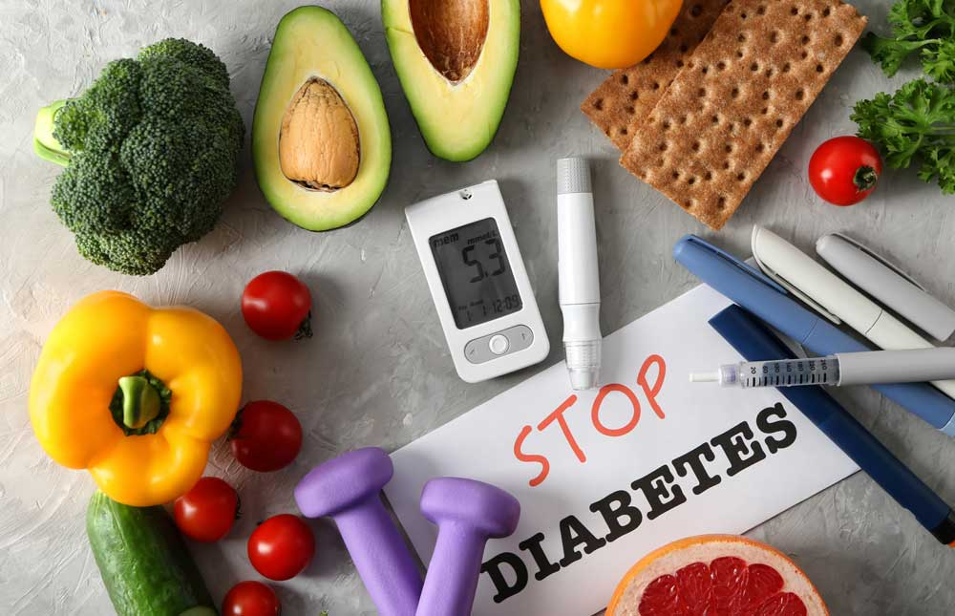
DIABETES
Types of Diabetes
How Diabetes affects your body?
How Diabetes affects your eyes?
3 Leading causes of Vision Loss
  Diabetic Retinopathy
  Glaucoma
  Cataracts
Risk of losing your vision
Ways to manage or prevent Diabetes

Slide 3
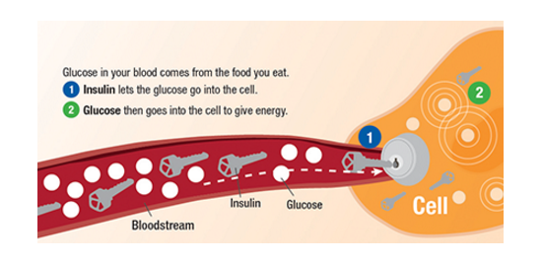
What is Diabetes?
Diabetes is a serious condition that causes higher than normal blood sugar levels. Diabetes occurs when your body cannot make or effectively use its own insulin. Insulin serves as a “key” to open your cells, to allow the sugar (glucose) from the food you eat to enter. Then, your body uses that glucose for energy.

Slide 4

WHAT IS DIABETES?

Slide 5
3 Types of Diabetes
Gestational (GDM)
During pregnancy- associated with complications to both mother and child
Women affected and their children are at increased risk of developing type 2 diabetes later in life
Type 1
Body does not make Insulin
Most frequently in children and adolescents
Under 40 years old (in most cases)
Type 2
Body does not respond to Insulin
40 Years old and up (in most cases)
Most common in adults
CDC “Type 2 diabetes accounts for approximately 90% to 95% of all diagnosed cases of diabetes; type 1 diabetes accounts for approximately 5-10%.”

Slide 6
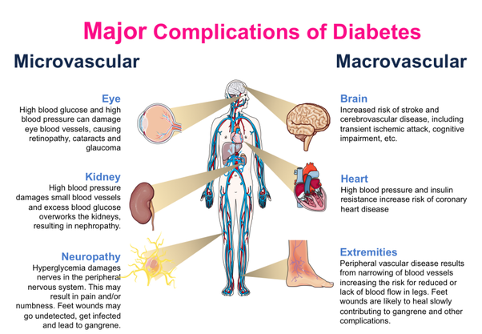

Slide 7
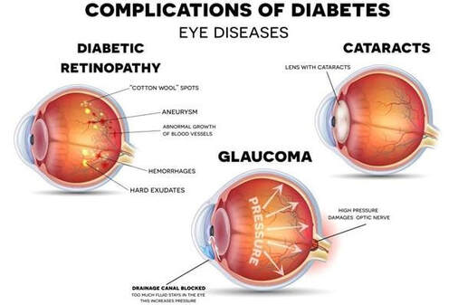
HOW DIABETES AFFECTS YOUR EYES
Diabetes is the leading cause of blindness and visual impairment in individuals of working age. Individuals with diabetes are at greater risk of experiencing vision loss from cataracts and glaucoma, secondary to their diabetic retinopathy.
Having high levels of sugar in your blood for a long time can harm the tiny blood vessels in your eyes. This can result in vision problems or blindness.

Slide 8


While not everyone who is diabetic will have visual impairment due to diabetic retinopathy, the longer an individual is insulin-dependent, the greater the chance that their vision will be affected.
Diabetic Retinopathy occurs when blood vessels stop feeding the retina properly. In later stages, in an attempt to feed the retina, new incomplete blood vessels may grow and break, leaking blood into the center of the eye causing serious vision loss.
Diabetic RETINOPATHY
Normal Vision with Diabetic Retinopathy

Slide 9


Cataract
Glaucoma - Legally Blind

Slide 10

True Story #1
Fact: diabetes is the leading cause of blindness in adults ages 20 to 74.

Slide 11

True story -2

Slide 12
Statistics About Diabetes
Prevalence: In 2018, 34.2 million Americans, or 10.5% of the population, had diabetes.
Diabetes was the seventh leading cause of death in the United States in 2017
As of 2020, the rates of diagnosed diabetes in adults by race/ethnic background are:
  7.5% of non-Hispanic whites
  9.2% of Asian Americans
  12.5% of Hispanics
  11.7% of non-Hispanic blacks
  14.7% of American Indians/Alaskan Natives
New cases: 1.5 million Americans are diagnosed with diabetes every year.
https://www.cdc.gov/diabetes/data/statistics/statistics-report.html

Slide 13
Diabetes and COVID-19
Are people with diabetes more likely to get COVID-19?
People with diabetes are not more likely to get COVID-19 than the general population. The problem people with diabetes face is primarily a problem of worse outcomes, not greater chance of contracting the virus.
Your risk of getting very sick from COVID-19 is likely to be lower if your diabetes is well-managed. When people with diabetes do not manage their diabetes well and experience fluctuating blood sugars, they are generally at risk for a number of diabetes-related complications. Having heart disease or other complications in addition to diabetes could worsen the chance of getting seriously ill from COVID-19, like other viral infections, because your body’s ability to fight off an infection is compromised.
https://www.diabetes.org/coronavirus-covid-19/how-coronavirus-impacts-people-with-diabetes

Slide 14
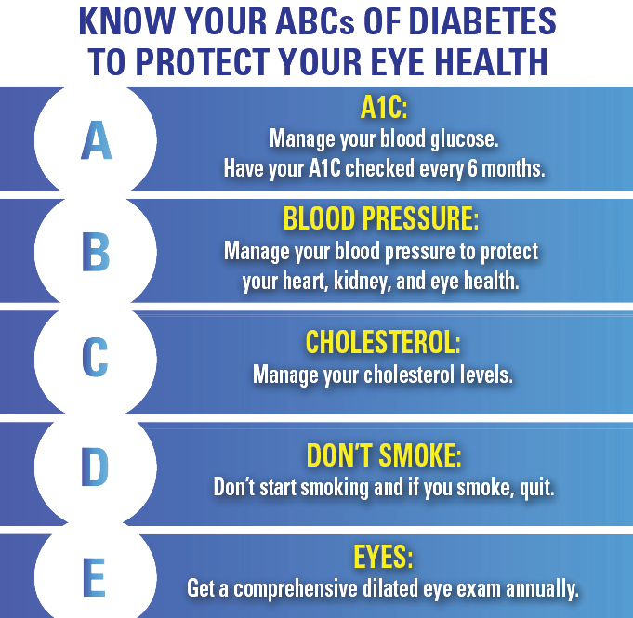
F
FOODS:
Choose your foods wisely

Slide 15
Works Cited
“ACBVI | Vision Simulation Presentation.” Vision Loss Simulation Presentation, ARIZONACENTER FOR THE BLIND AND VISUALLY IMPAIRED, INC., vision.acbvi.org/slide26.html. Accessed 6 May 2020.
“---.” Vision Loss Simulation Presentation, ARIZONACENTER FOR THE BLIND AND VISUALLY IMPAIRED, INC., 6 May 2020, vision.acbvi.org/slide16.html. https://youtu.be/vC6eZxbVmHo
“Diabetes Quick Facts.” Centers for Disease Control and Prevention , 6 Aug. 2019, www.cdc.gov/diabetes/basics/quick-facts.html.
“ “What Is Diabetes?” Diabetes Research Institute Foundation, www.cdc.gov/diabetes/basics/quick-facts.html. Accessed 5 May 2020.
“What Is Diabetes?” Youtube, uploaded by National Institute of Diabetes and Digestive and Kidney Diseases, 3 Aug. 2016, www.youtube.com/watch?v=2TWelC6SHr8. https://www.diabetes.org/coronavirus-covid-19/how-coronavirus-impacts-people-with-diabetes https://www.cdc.gov/diabetes/data/statistics/statistics-report.html
References

