Slide 1

NJ VF/EA
Acumen Transition- Webinar
Date: July 24, 2025
Notes:
Navigating The Participant Life Cycle with Ease:
Click on the “Slide Show” icon in the lower right hand of the PowerPoint. The icon will be very small. (Should look like a box sitting on top of an upside-down T)
Click on the “See all Slides” icon. (Should look like a box with three surrounding boxes with it.)
You can then pick the Participant Life Cycle (on slide 5) and put the hand on any step you want, it will take you directly there.
When finished, click the “See all Slides” and you can navigate back to the Participant Life Cycle (slide 5) and navigate further steps if needed. You can also click on the acumen Logo on any slide and it will return you to The Participant Life Cycle.
When finished, click on the three dots, right click and choose “End Show.” Exit out

Slide 2

Don't Wait, Enroll Now!
Acumen encourages all Employers/Authorized Representatives to enroll as soon as possible. All Cohorts (1, 2, 3, 4, 4a, and 5) can complete their enrollment now through the Electronic Enrollment System (EES). You can also book an appointment with a NJ Agent, which will help to ensure you complete all necessary steps.
Book an Appointment
Electronic Enrollment System (EES)
NJ Training Materials
Notes:
For anyone who choses to self- service their enrollment or want to learn more about the Acumen timekeeping and invoice submission system DCI, please Check our NJ Training Website for the most up to date Schedule:

Slide 3
What You'll Need to Enroll
The Employer/Authorized Representative will need to gather all required information and documentation before starting the enrollment process through EES.
If the Employer/ Authorized Representative does not have the necessary information at the time of enrollment, they will not be able to complete the process.
Review this information on our Acumen NJ Website under the Vendors and Employers/Authorized Representatives tabs.
  What You'll Need to Enroll - Vendor.pdf
  What You'll Need to Enroll - Employer and Employees.pdf

Slide 4
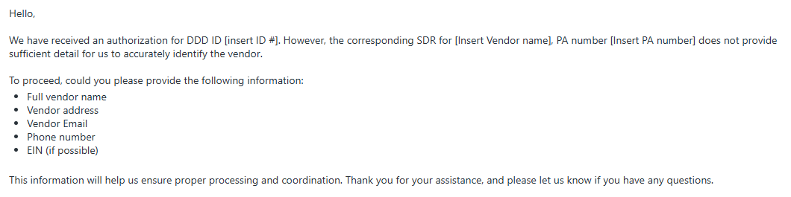
Support Coordinator Reminders
If a vendor service does not have accurate, up-to-date Community Vendor details in the Service Description box, the Acumen Vendor Team will need to contact the Support Coordinator.
It is important that Support Coordinators respond as soon as possible and provide the requested vendor information. Without that information, the individual cannot be linked to that vendor in the Acumen system.
Sample email outreach to a Support Coordinator:

Slide 5
Community Vendor Reminders
Community Vendors that provide services to DDD-enrolled individuals need to enroll with Acumen as soon as possible.
  Any active vendor that has not received the Docusign packet with the Electronic Funds Transfer (EFT) and W-9 form should contact the Acumen Vendor Team by phone at 848-400-5738 or by email at vendor-nj@acumen2.net.
  To be fully enrolled with Acumen, Community Vendors must complete the Docusign packet. Completing the Electronic Funds Transfer (EFT) and W-9 form manually and submitting them to Acumen by email, fax, or mail will delay processing.
PLEASE NOTE: Once an Authorized Representative has completed the Electronic Enrollment System process, they do not need to log in again to complete the Vendor Agreement for a NEW Community Vendor service that has been added to the plan. Support Coordinators should follow their usual process for adding a new vendor service. Once the service is approved, Acumen will receive the plan revision electronically, process it, and add it to the vendor's account.

Slide 6
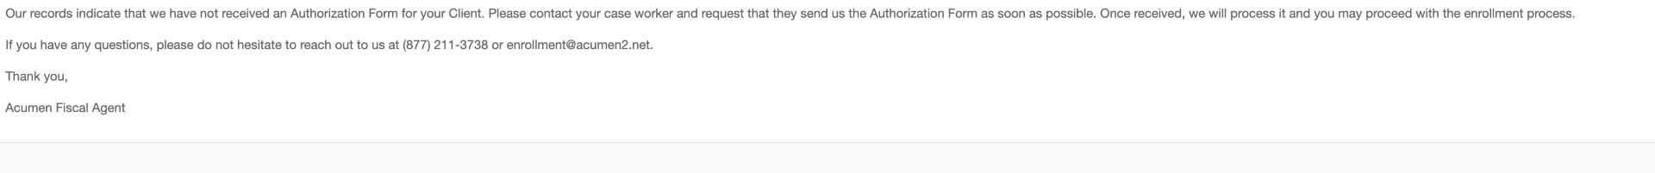
Electronic Enrollment System Reminders
If the message below appears when the Employer/Authorized Representative is completing initial registration in the Electronic Enrollment System, they should call 848-400-5903 or email enrollment-nj@acumen2.net to get assistance to resolve the issue and allow enrollment to proceed. This message indicates that information entered by the enrollee does not match information provided to Acumen by the Division.

Slide 7
Revision Start and End Dates
Acumen Enrollment Window | Cohort | Plan-Revision Approval End Date (last date a revised plan can be approved) | Last Date SC can add a new PPL vendor service | Service End Date for current PPL vendor services | Acumen Go-Live Date (service start date for new Acumen vendor services)
Open Now for ALL Cohorts | Combined Cohorts 1-4 | July 21 | CANNOT ADD | July 30 | July 31
 | 4a | August 1 | August 4 | August 10 | August 11
 | 5 | TBD | TBD | TBD | September 14
Notes:
Support Coordinators can make plan revisions, ending services with PPL and starting services with Acumen following the SC Plan Revision Guidance provided by the Division for the individual's assigned Cohort.
https://nj.gov/humanservices/ddd/assets/documents/individuals/sc-plan-revision-guidance.pdf
Support Coordinators must make plan revisions for all individuals assigned to Cohorts 1-4a at this time.
NOTE: If there is a one-time service or item with PPL as FI (e.g., gym membership, environmental modification), the Support Coordinator must (a) confirm that the one-time service or item through PPL has been delivered before (b) revising the plan to end the one-time service or item, following the Plan Revision Timeline.
Individuals or Authorized Representatives must complete their enrollment documents before they can submit invoices for community vendor payments.
To avoid delays in payment Individuals or Authorized Representatives should still enroll within their Cohort Enrollment Window

Slide 8
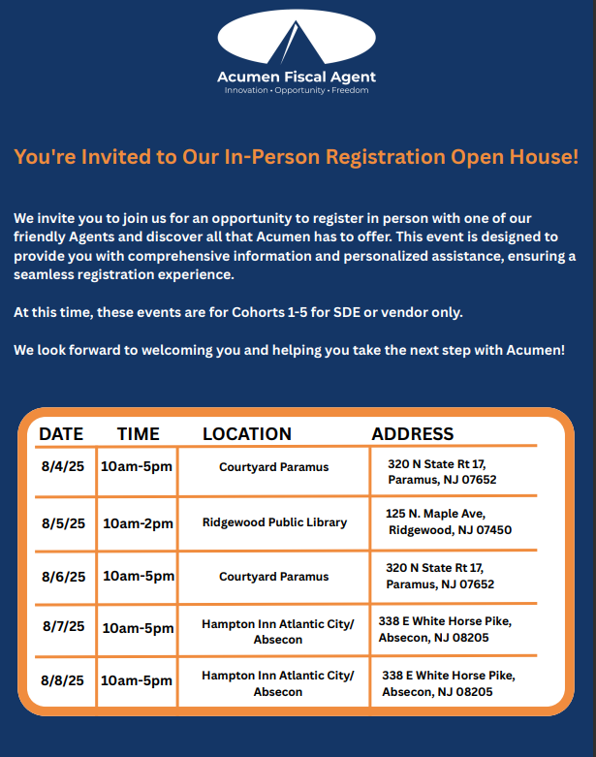
Notes:
Support Coordinators can make plan revisions, ending services with PPL and starting services with Acumen following the SC Plan Revision Guidance provided by the Division for the individual's assigned Cohort.
https://nj.gov/humanservices/ddd/assets/documents/individuals/sc-plan-revision-guidance.pdf
Support Coordinators must make plan revisions for all individuals assigned to Cohorts 1-4a at this time.
NOTE: If there is a one-time service or item with PPL as FI (e.g., gym membership, environmental modification), the Support Coordinator must (a) confirm that the one-time service or item through PPL has been delivered before (b) revising the plan to end the one-time service or item, following the Plan Revision Timeline.
Individuals or Authorized Representatives must complete their enrollment documents before they can submit invoices for community vendor payments.
To avoid delays in payment Individuals or Authorized Representatives should still enroll within their Cohort Enrollment Window

Slide 9
Who To Contact:
Client Service Agent Team
  848-400-5903
  Enrollment-NJ@acumen2.net
Vendor Service Agent Team
  848-400-5738
  Vendor-NJ@acumen2.net
Customer Service Team
  833-892-0413
Notes:
Donna

