Slide 1

DMHAS Statewide Diversity Cultural Competency Review
Dr. June DePonte Sernak, Statewide diversity Consultant
Center for family services

Slide 2
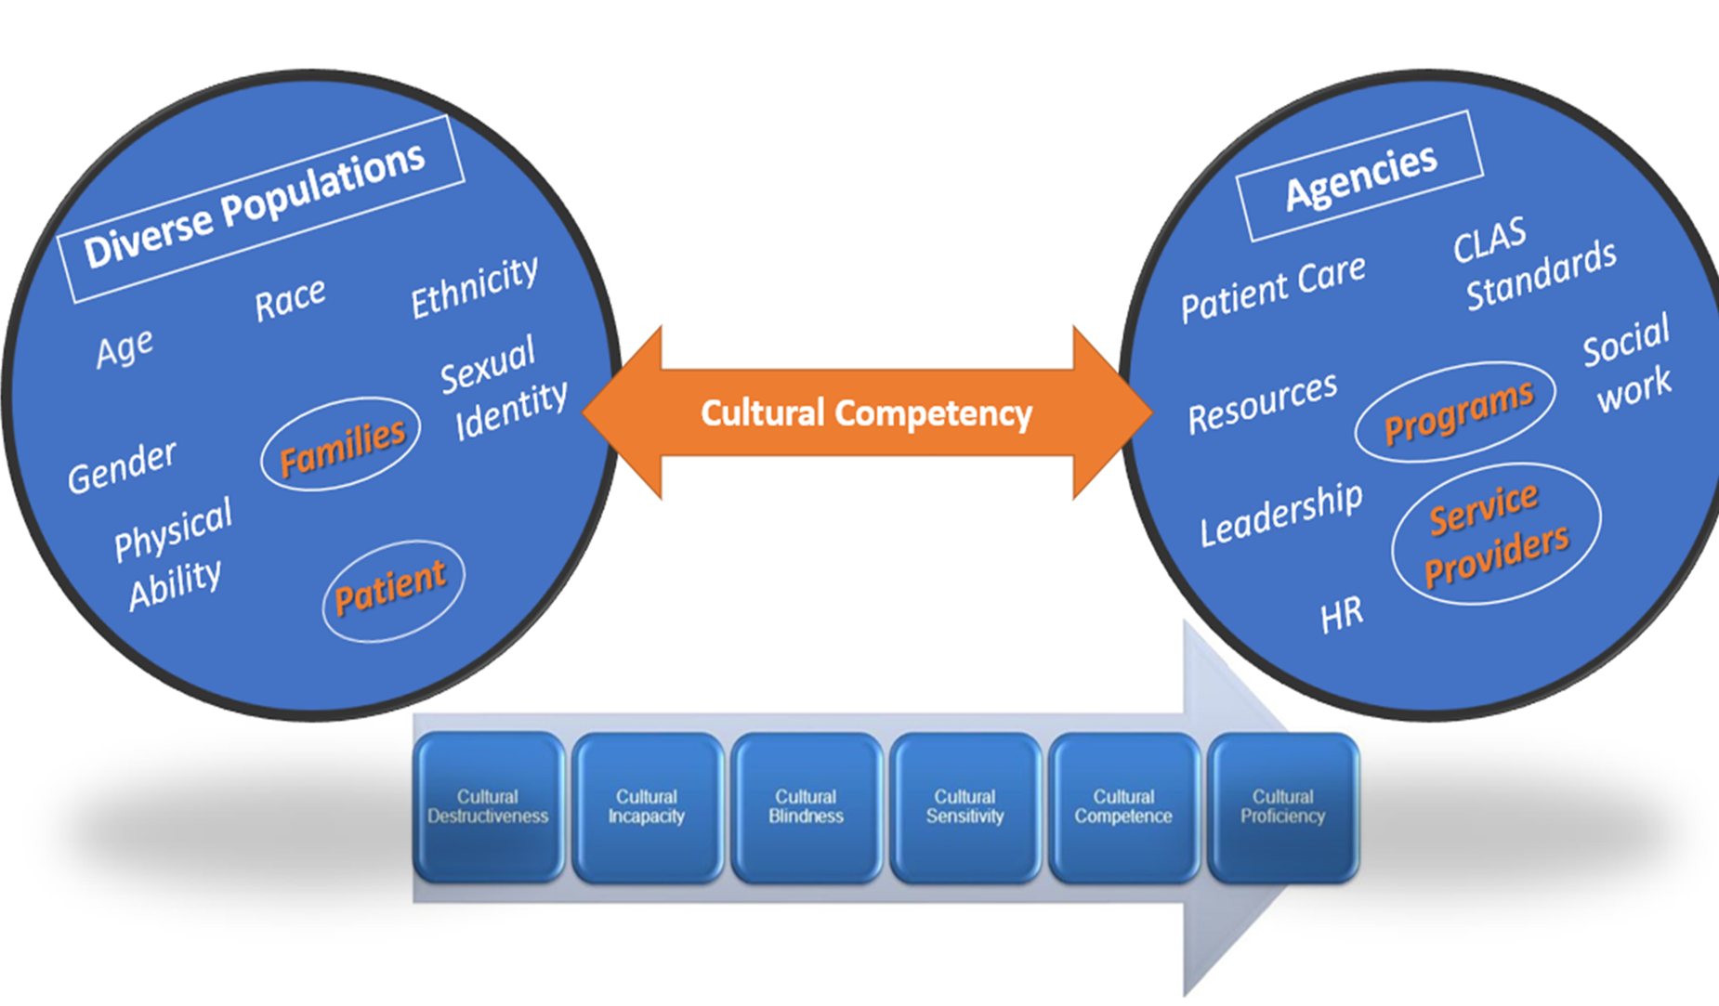
Cultural Competency Continuum
Cultural competency is a critical component of effective mental health care delivery to address diversity and equity issues.
Cultural competency provides advancement to capture process and procedure to gain capacity for diverse individual care, incorporating sociocultural differences and bias to reduce systemic disparities.
Levels of Cultural Competency
Macro- Societal Level
Meso- I Institutional Level
Meso- P Programmatic Level
Micro- Individual Clinical Level

Slide 3
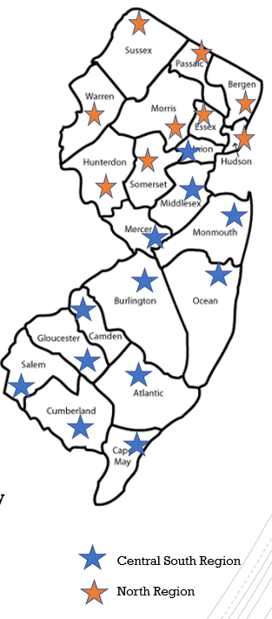
Current DMHAS CC Structure
Over 200+ Mental Health and Addiction Service Providers Statewide
North Region*
Central South Region*
Regional Workshops
Research-based trainings
Yearly conferences
Technical Assistance

Slide 4
2020-2021 Completed
30% have followed the template for CC plans and took advantage of Technical Assistance.
There are approximately 40 agencies that participated in Technical Assistance
Match with the CLAS Standards with the CC Template with a checklist for a overview.
25% have clear goals and timeframes assigned to promote cultural competency consistently in their agencies and align logically with CLAS standards. Each submission is written very differently and requires interpretation as to whether the CLAS standards are fully aligned. Several submitted assessment results or short narratives without SMART goals and objectives.
There are noticeable differences depending on their areas of service. For example, those with housing included COVID guidelines with their CC Plans.

Slide 5
Cultural Competency SWot
Weaknesses
CRM or Formatted agency list for follow up
Statewide Agency participation
Varied levels on Cultural Competency Continuum
Marketing
Strengths
DMHAS Support
Statewide Diversity Consultant Role
Technical Assistance
Multicultural Services Advisory Committee (MSAC)
Analysis and review of existing completed plans
Opportunities
Cultural Competency Toolkit
Regional Trainings
CLAS Standard Metrics
CC Leadership Council
Threats
CC Trends
DEI Initiatives by Agency
Global Systemic Issues
Mindshare/Staffing/Timing

Slide 6

2021-2022 DMHAS Statewide Diversity Consultant Update
Creation of Cultural Competency Toolkit
Schedule strategy review sessions with agencies
Metrics for CC Plans following Checklist & CLAS Standards
Quarterly Reporting

Slide 7
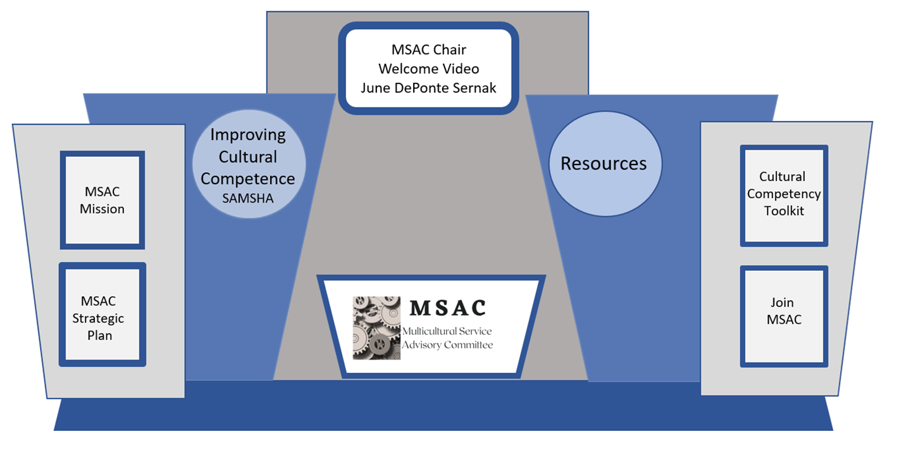
Multicultural Services Advisory Committee (MSAC)
Strategic Planning Review
Training Opportunities
Updated Website (https://www.centerffs.org/msac )
Volunteerism, Ambassadorship
Virtual Booth at NJ Prevention Network Summit

Slide 8
Regional Training sessions to review CC Toolkit
Central/South Region
June 29th
9:30 am-12:30 pm
In Person Location: RWJ Hamilton, 3100 Quakerbridge Rd, Mercerville, NJ 08619
Conference Room A/B
Register In Person: https://www.eventbrite.com/e/regional-summit-centralsouth-region-leading-with-cultural-competency-tickets-349070488227
Virtual Location: Zoom
Register Virtually: https://www.eventbrite.com/e/regional-summit-centralsouth-region-leading-with-cultural-competency-tickets-349095503047
Contact Person: Dr. June DePonte Sernak, june.depontesernak@centerffs.org
June 29th
1:30 pm- 4:30 pm
In Person Location: RWJ Hamilton, 3100 Quakerbridge Rd, Mercerville, NJ 08619
Conference Room A/B
Register In Person: https://www.eventbrite.com/e/regional-summit-centralsouth-region-leading-with-cultural-competency-tickets-349091521137
Virtual Location: Zoom
Register Virtually: https://www.eventbrite.com/e/regional-summit-centralsouth-region-leading-with-cultural-competency-tickets-349092373687
Contact Person: Dr. June DePonte Sernak, june.depontesernak@centerffs.org
Northern Region
June 21
9:30-12:30
In Person Location: Morris County Public Safety Training Academy, 500 West Hanover Avenue, Morristown, NJ, 07960
Register In Person: https://www.eventbrite.com/e/northern-regionals-technical-assistance-leadership-workshop-tickets-345676145657
Virtual Location: Zoom
Register Virtually: https://www.eventbrite.com/e/virtual-northern-regionals-technical-assistance-leadership-workshop-tickets-345687880757
Contact Person: Jayme Ganey, FCCultureConnections@familyconnectionsnj.org
June 27
9:30-12:30
In Person Location: Morris County Public Safety Training Academy, 500 West Hanover Avenue, Morristown, NJ, 07960
Register In Person: https://www.eventbrite.com/e/northern-regionals-technical-assistance-leadership-workshop-vol-2-tickets-345689866697
Virtual Location: Zoom
Register Virtually: https://www.eventbrite.com/e/virtual-northern-regionals-technical-assistance-leadership-workshop-vol-2-tickets-345691993057
Contact Person: Jayme Ganey, FCCultureConnections@familyconnectionsnj.org

Slide 9



Slide 10
Cultural Competency Toolkit
Dr. June DePonte Sernak
Statewide Diversity Consultant
Center for Family Services

Slide 11
Cultural Competency in Mental Health and Addiction Services
Cultural competency is a critical component of effective mental health care delivery to address diversity and equity issues.
Cultural competency provides advancement to capture process and procedure to gain capacity for diverse patient care, incorporating sociocultural differences and bias to reduce systemic disparities.

Slide 12
Cultural Competency Metrics
Cultural Competency Continuum
CLAS Standards
CC Levels

Slide 13
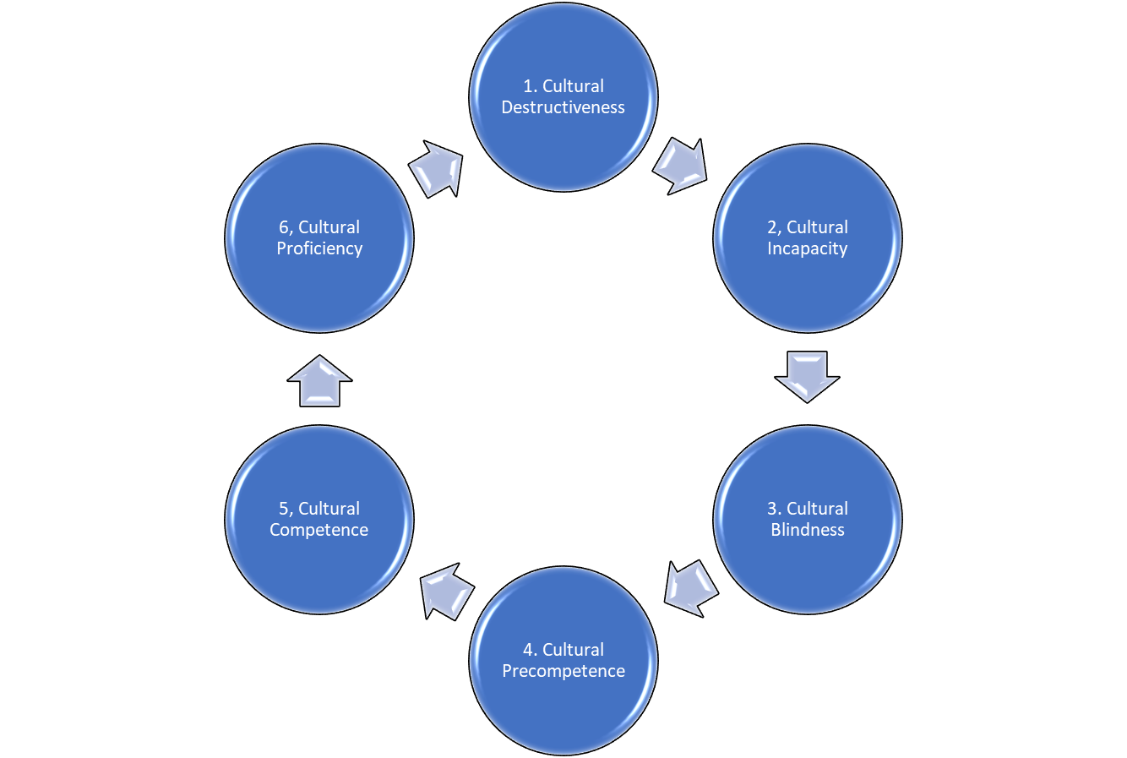
Cultural Competency Continuum

Slide 14
Cultural Proficiency Continuum
There are six points along the cultural proficiency continuum that indicate how people see and respond to difference:
Cultural Destructiveness. See the difference, stomp it out. Negating, disparaging, or purging cultures that are different from your own.
Cultural Incapacity. See the difference, make it wrong. Elevating the superiority of your own cultural values and beliefs and suppressing those of cultures that are different from your own.
Cultural Blindness. See the difference, act as if you don’t. Acting as if the cultural differences you see do not matter, or not recognizing that there are differences among and between cultures.
Cultural Pre-competence. See the differences, respond inadequately. Recognizing that lack of knowledge, experience, and understanding of other cultures limits your ability to effectively interact with them.
Cultural Competence. See the difference, understand the difference that difference makes. Interacting with other cultural groups in ways that recognize and value their differences.
Cultural Proficiency. See the difference and respond. Honoring the differences among cultures, viewing diversity as a benefit, and interacting knowledgeably and respectfully among a variety of cultural groups.

Slide 15
Culturally and Linguistically Appropriate Services (CLAS) National Standards
Provide effective, equitable, understandable, and respectful quality care and services that are responsive to diverse cultural health beliefs and practices, preferred languages, health literacy, and other communication needs.

Slide 16
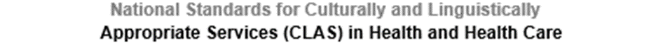
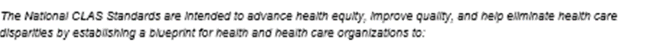
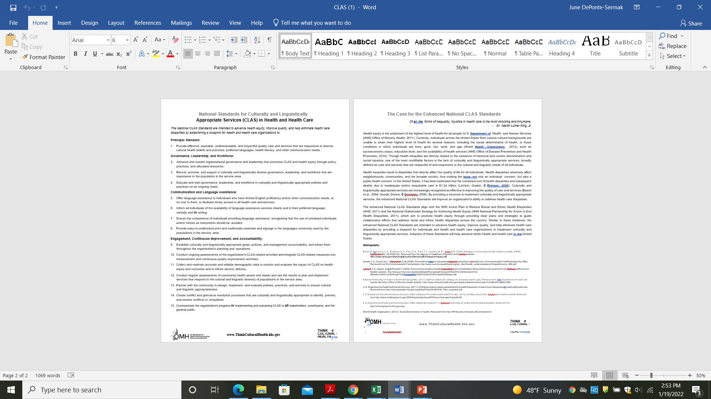
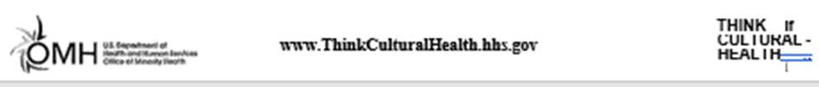

Slide 17
Cultural Competency Levels
Agencies can review CC at multiple levels in their structure to ensure competency in all facets.
Macro- Societal Level
Meso- I Institutional Level
Meso- P Programmatic Level
Micro- Individual Clinical Level

Slide 18
Tools for Cultural Competency
Regional Technical Assistance Training Session
Cultural Competency Agency Assessment
Technical Assistance for CC Plan Completion
CC Plan Submission and Review
CC Strategy Sessions
CC Leadership Forum
CC Annual Review

Slide 19
Regional Technical Assistance Training Session
Quarterly Regional TA Sessions
All agencies encouraged to attend
Provide framework to complete CC Plans
Presented by:
South & Central Diversity Consultant (TBD)
North Region Diversity Coach (Andreea DiLorenzo, Family Connections)
Dr. June DePonte Sernak, Statewide Diversity Consultant

Slide 20
Cultural Competency Agency Assessment
CC Assessment in Survey Monkey (approx. 10 minute completion)
Open to all agency staff to participate
Demographic information
National CLAS Standard category based questions

Slide 21
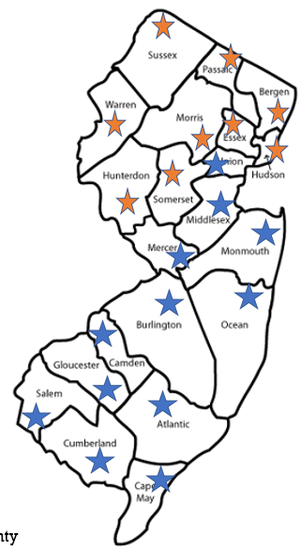


TA for CC Plan Completion
Primary TA contact by county
Set up TA Session
Provide CC Template
North Region
Central South Region

Slide 22
CC Plan Submission and Review
Complete CC Plan with goals, benchmarks and contact information
Submit completed plan to:
Dr. June DePonte Sernak, Statewide Diversity Consultant june.depontesernak@centerffs.org
CC Plans will be reviewed and follow up scheduled as necessary for clarification purposes
Semi-annual/ Annual review for updates and changes to CC Plan

Slide 26
CC Strategy Sessions
Agency leaders, departments or programs can request training sessions and strategic support for TA
Topic areas may include*:
Unconscious Bias
Cultural Intelligence
Team Building and Diversity
Women in the Workforce
Generational Diversity

Slide 27
CC Leadership Forum
Annual Leadership Conference to share insights and trends with agency leads and representatives
Keynote speaker
Breakout sessions
Networking opportunities
*Author corner featuring local authors and resources.

Slide 28
CC Annual Review
Scheduled strategy review session with agencies
Review goals for CC Plan
Update action items
Create metrics for 2022
Provide resources and/or TA sessions for review

Slide 29

Contact Information
Dr. June DePonte Sernak
Statewide Diversity Consultant
Center for Family Services
june.depontesernak@centerffs.org
1-609-569-0239 x62126
1-609-707-4070 (cell)
www.centerffs.org

