Slide 1
FUTURE FOCUS: RESEARCH AND PREVENTION HIGHLIGHTS
AN OPIA NEWSLETTER
RED FLAG RADAR
Recognizing Exploitation Before It Escalates
Quick Recognition Quiz

Slide 2

PREVENTION BEGINS at RECOGNITION
Exploitation rarely starts with dramatic incidents. It begins with small
boundary violations, minor oversights, and seemingly innocent requests—situations that feel harmless until they're not.
This newsletter presents 5 real scenarios representing the most common early warning signs of exploitation. Each one shows how everyday situations can become serious risks when left unaddressed.
YOUR CHALLENGE:
For each scenario, ask yourself: Is this a red flag?
Make your decision, then review the explanation to sharpen your recognition skills and understand the underlying risks.
Remember: What you recognize, you can prevent.

Slide 3
5 TYPES OF EXPLOITATION
🛑 BOUNDARY VIOLATIONS
The exploitation that doesn't look like exploitation
💰 FINANCIAL MISMANAGEMENT
When "helping" becomes stealing
📱 DIGITAL EXPLOITATION
Modern theft through technology
🔒 SECURITY FAILURES
When protection becomes vulnerability
⚙️ SYSTEMIC ENABLERS
When the system fails to protect

Slide 4

SCENARIO 1 OF 5: BOUNDARY VIOLATIONS
THE SITUATION
During a team meeting, staff members joke about how David "always brings the best snacks" and "never says no when we need something”.
They laugh about it together and don't see this as problematic since David seems happy to help.
Several staff members have asked David to pick up coffee, bring in food, or loan them small amounts of money.
David always agrees with a smile.
IS THIS A RED FLAG?
○ YES - This is concerning and should be addressed
○ NO - This is acceptable with reasonable explanations
Make your choice before continuing to the next slide.

Slide 5
YES - THIS IS A RED FLAG
WHY THIS IS EXPLOITATION
This scenario reveals a team culture that has normalized exploitation.
The staff's casual attitude about regularly receiving goods and services from David indicates systematic boundary violations that have become embedded in daily practice.
David's apparent "willingness" likely stems from fear of receiving poor care if he refuses—not genuine generosity.
People with disabilities often feel pressured to comply with staff requests to maintain positive relationships with their caregivers.
The power imbalance makes true consent impossible. The team's failure to recognize this as problematic demonstrates dangerous ignorance of professional boundaries and power dynamics.
ROOT CAUSES
- Lack of explicit boundary training for staff
Cultural normalization of "small favors"
Staff ignorance of power imbalance dynamics
No clear policies prohibiting gifts/services from individuals
CONSEQUENCE
- Personal funds depleted
Other individuals feel pressured to provide similar "favors"
- Individual’s dignity and autonomy compromised
Escalation to larger financial requests
- Individuals fear refusing and receiving retaliation through poor care
- Legal and regulatory liability for the organization

Slide 6

PREVENTING BOUNDARY EXPLOITATION
SUGGESTED IMMEDIATE ACTIONS
✓ Stop all staff requests to David immediately
✓ Conduct emergency boundary training for entire team
✓ Meet privately with David to affirm his right to say no without consequences
✓ Review other individuals for similar patterns
SYSTEMIC PREVENTION CONSIDERATIONS
✓ Implement zero-tolerance policy on boundary violations
✓ Mandate annual ethics training including power dynamics education
✓ Consider if the boundary violation is a reportable incident
✓ Include boundary scenarios in new hire orientation
✓ Regular supervision check-ins about staff/individual relationships
✓ Clear consequences for violations

Slide 7
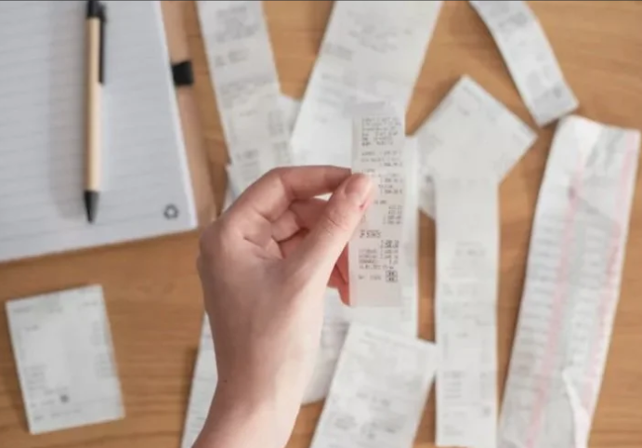
SCENARIO 2 OF 5: FINANCIAL MISMANAGEMENT
THE SITUATION
Staff members frequently return from shopping trips without receipts for purchases made with individuals' funds.
When questioned, they explain: "The machine was broken" or "I forgot to ask for it, but I remember what we spent" or "The receipt faded, and I threw it away."
This happens multiple times per month across different staff members. Supervisors accept these explanations and don't pursue documentation.
IS THIS A RED FLAG?
○ YES - This is concerning and should be addressed
○ NO - This is acceptable with reasonable explanations
Make your choice before continuing to the next slide.

Slide 8
YES - THIS IS A RED FLAG
WHY THIS IS CONCERNING
Consistent lack of receipts indicates either poor financial oversight or intentional avoidance of accountability.
Without receipts, there's no way to verify actual purchases, costs, or whether items were truly purchased for the individual.
This creates multiple opportunities for exploitation:
- Staff can pocket cash by claiming higher prices
-Personal purchases can be mixed with individual's purchases
-Theft becomes untraceable
- Pattern of missing receipts suggests systematic problem, not occasional mishaps
ROOT CAUSES
- Inadequate financial protocols and enforcement
- Lack of meaningful oversight and consequences
- Staff’s own financial stress creating temptation
- No verification systems for undocumented expenses
- Supervisors prioritizing convenience over accountability
CONSEQUENCE
Funds disappear without trace; exploitation continues unchecked; weak culture of financial responsibility spreads throughout organization.

Slide 9
FINANCIAL ACCOUNTABILITY SOLUTIONS
SUGGESTED IMMEDIATE ACTIONS
✓ Implement mandatory receipt policy with same-day submission requirement
✓ Require supervisor sign-off on all expenses over $20
✓ For missing receipts: Staff must return to store for duplicate or provide manager verification within 24 hours
✓ Review past 6 months of expenses for patterns
✓ Meet with staff to clarify expectations and consequences
SYSTEMIC PREVENTION CONSIDERATIONS
✓ Digital receipt submission via photo/app for real-time tracking
✓ Random audits of purchases and documentation
✓ Pre-approved shopping lists for routine purchases
✓ Consequences for repeated violations (counseling → suspension → termination)
✓ Monthly reconciliation of all individual accounts
✓ Staff training on financial management and documentation standards

Slide 10

SCENARIO 3 OF 5: DIGITAL EXPLOITATION
THE SITUATION
A staff member helps an individual set up a CashApp account to make it easier for the individual to send money to family and make online purchases.
To "help with transactions," the staff member keeps the login information and password.
The staff member regularly accesses the account to make purchases, saying "I'm helping them get what they need.”
The individual doesn't have independent access to check their account balance or transaction history.
IS THIS A RED FLAG?
○ YES - This is concerning and should be addressed
○ NO - This is acceptable with reasonable explanations
Make your choice before continuing to the next slide

Slide 11
YES - THIS IS A SERIOUS RED FLAG
WHY THIS IS EXPLOITATION
Maintaining control over an individual's digital payment account creates unlimited opportunities for exploitation. CashApp, Zelle,Venmo, Paypal and similar services offer minimal oversight, instant transfers, and limited recovery options for unauthorized transactions.
THE PROBLEM
Staff should NEVER retain exclusive login credentials for individuals' personal financial accounts. This scenario isn't "helping"—it's controlling the individual's money.
ROOT CAUSES
Staff confuse "helping" with "controlling"- Lack of training on digital exploitation risks
No policies addressing modern payment apps and technology
Convenience prioritized over individual rights and security
- Absence of monitoring for digital transactions
WHAT COULD HAPPEN
Unauthorized transfers to staff or others
Subscription services signed up for staff benefit
Individual's funds depleted without their knowledge
- No paper trail or accountability for transactions
- Individual has no way to monitor or control their own money

Slide 12
DIGITAL SAFETY SOLUTIONS
SUGGESTED IMMEDIATE ACTIONS
✓ Change all passwords immediately—give individual exclusive access
✓ Review all transactions for past 6 months for unauthorized activity
✓ Remove staff from any digital accounts where they have login access
✓ Report suspected unauthorized transactions to platform and authorities
✓ Provide individual with password manager or secure password storage
SYSTEMIC PREVENTION CONSIDERATIONS
✓ Clear technology boundary policy: Staff never retain login credentials
✓ Digital literacy training: Teach individuals to manage their own accounts safely
✓ Monitored assistance model: Staff help while individual maintains control
✓ Regular digital account audits as part of financial reviews
✓ Two-factor authentication on all financial accounts
✓ Staff training on recognizing and preventing digital exploitation

Slide 13
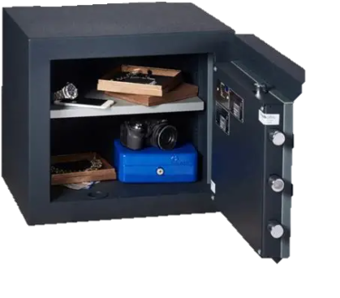
SCENARIO 4 OF 5: SECURITY FAILURES
THE SITUATION
The safe in the residential home is consistently left unlocked during day shifts because staff say "we're always going in and out of it, so it's easier this way."
Multiple staff members have keys and access.
There is no log of who opens the safe, when, or for what purpose.
When the supervisor notices the unlocked safe, staff respond "Don't worry, we're all here watching it" or "We'll lock it before we leave."
IS THIS A RED FLAG?
○ YES - This is concerning and should be addressed
○ NO - This is acceptable with reasonable explanations
Make your choice before continuing to the next slide.

Slide 14
YES - THIS IS A SERIOUS RED FLAG
WHY THIS IS AN EXPLOITATION RISK
Consistently unlocked safes eliminate the primary security measure protecting individuals' funds and personal valuables.
This isn't a minor convenience issue—it's a fundamental security failure.
THE PROBLEM
"Everyone is watching" is not a security system. Staff may be distracted, in different rooms, or on breaks. Visitors, contractors, maintenance workers, or even other individuals could access unlocked funds without detection. Convenience should never override protection protocols.
ROOT CAUSES
Prioritizing staff convenience over individual protection
Lack of enforcement of security protocols
Inadequate supervision and accountability
No consequences for leaving safe unlocked
Staff don't understand the serious risk they're creating
- Culture that treats security measures as optional suggestion
WHAT COULD HAPPEN (CONSEQUENCES)
- Cash and valuables stolen with no accountability
Impossible to identify who took what or when
Multiple individuals' funds at risk simultaneously
Creates opportunity for both external theft and staff exploitation
No way to prove or disprove theft allegations
- Organizational liability and regulatory violations

Slide 15
PHYSICAL SECURITY SOLUTIONS
SUGGESTED IMMEDIATE ACTIONS
✓ Lock safe immediately—no exceptions during any shift
✓ Implement access log: Staff must document who, when, purpose, and amount for every safe access
✓ Reduce number of staff with safe keys to minimum necessary
✓ Supervisor spot-checks throughout all shifts
✓ Clear consequences for leaving safe unlocked (written warning → suspension)
✓ Post security protocol reminder at safe location
SYSTEMIC PREVENTION
✓ Electronic safe with automatic locking and digital access log
✓ Security camera monitoring safe area
✓ Dual-access system requiring two staff signatures for large amounts
✓ Weekly safe audits by supervisor
✓ Monthly external security reviews
✓ Staff training on security protocols and consequences
✓ Annual security system evaluation and updates

Slide 16

SCENARIO 5 OF 5: SYSTEMIC ENABLERS
THE SITUATION
Scheduled monthly financial audits haven't been completed in six months because "everyone's too busy" and "there's too much other work to do."
When questioned, leadership responds: "Nothing seems wrong anyway. We'd know if there was a problem."
Staff financial documentation is incomplete, but supervisors say they'll "catch up when things slow down."
IS THIS A RED FLAG?
○ YES - This is concerning and should be addressed
○ NO - This is acceptable with reasonable explanations
Make your choice before continuing to the next slide.

Slide 17
YES - THIS IS A CRITICAL FAILURE
WHY THIS IS AN EXPLOITATION RISK
Skipped audits eliminate the primary detection mechanism for financial exploitation.
This isn't about being "too busy"—it's about organizational priorities that enable exploitation to flourish unchecked.
THE PROBLEM
"Nothing seems wrong" is meaningless without verification.
Most exploitation goes undetected for months or years precisely because there's no systematic oversight.
By the time problems become obvious, significant damage has already occurred. Workload pressures are never an acceptable reason to skip financial safeguards.
ROOT CAUSES
Leadership failure to prioritize individual protection- No accountability for completing required oversight
Staff workload genuinely overwhelming (understaffing issue)
Culture that treats audits as bureaucratic paperwork rather than protection
No consequences for skipping mandated reviews
Lack of dedicated oversight personnel or clear responsibility
WHAT COULD HAPPEN (CONSEQUENCES)
Exploitation continues undetected for extended periods
Financial losses accumulate across multiple individuals
Documentation gaps make it impossible to reconstruct what happened
Regulatory sanctions and loss of licensure
Legal liability for negligent oversight
Organization loses credibility and community trust
Pattern of neglect extends beyond financial issues

Slide 18
OVERSIGHT ACCOUNTABILITY SOLUTIONS
SUGGESTED IMMEDIATE ACTIONS
✓ Complete all six months of overdue audits within 30 days—hire temporary help if needed
✓ Assign specific person accountable for monthly audits with protected time
✓ Implement automated calendar alerts and reminders for audit deadlines
✓ Leadership review of audit completion monthly
✓ Address staffing levels if workload genuinely prevents completion
✓ Clear consequences for missed audits (for both staff and leadership)
SYSTEMIC PREVENTION
✓ Mandatory audit schedule is non-negotiable regardless of workload
✓ External auditor if internal capacity is insufficient
✓ Digital tracking systems that flag missing reviews
✓ Quarterly leadership oversight of audit completion rates
✓ Adequate staffing to allow time for required oversight
✓ Regular evaluation of whether current systems are realistic and sustainable
✓ Build redundancy—multiple people trained to conduct audits
✓ Audit completion as performance metric for supervisors

Slide 19


PREVENTON BEGINS WITH YOU!!

Slide 20
WHAT YOU'VE LEARNED TODAY
Exploitation starts small—recognize the early warning signs
Good intentions don't excuse boundary violations or poor oversight
Modern technology creates new exploitation risks that require new policies
Systems and safeguards must be maintained, not just created
Power imbalances make true consent impossible in staff/individual relationships

Slide 21
SUGGESTED NEXT STEPS
Share these scenarios with your management team this week
2. Review your current policies against these five examples—identify gaps
3. Conduct immediate spot-checks of your financial safeguards and security protocols
4. Schedule comprehensive exploitation prevention training for all staff levels
5. Implement at least one new safeguard within the next 30 days

Slide 22


REMEMBER:
Every red flag you recognize is an opportunity to protect someone's dignity, safety, and financial resources. The question isn't whether exploitation could happen in your organization.
The question is:
What are you doing today to prevent it?
What will you do differently tomorrow?

Slide 23
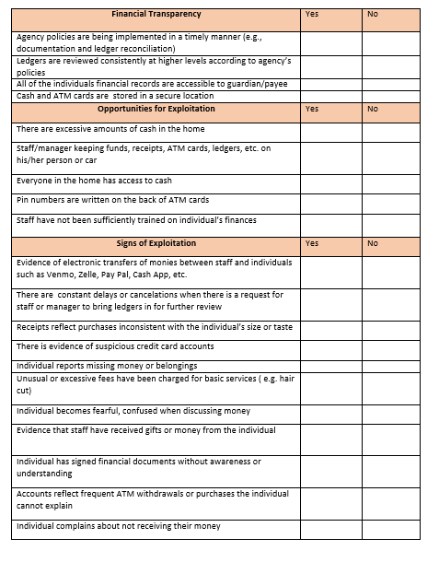
Financial Checklist Tool
How to Use This Tool
• Conduct regular reviews using this checklist to identify red flags.
• Use findings to initiate corrective actions or deeper investigations.
• Integrate into staff onboarding or periodic financial policy training.
• Pair with documentation audits and secure storage protocols.

Slide 24


