Slide 1

FUTURE FOCUS:
RESEARCH AND PREVENTION HIGHLIGHTS
AN OPIA NEWSLETTER
Volume 1- August 2025

Slide 2


PREVENTION BEGINS AT RECRUITMENT
Recruiting dedicated, compassionate, and skilled Direct Support Professionals (DSPs) is crucial for providing exceptional care to individuals with developmental disabilities.

Slide 3

To get more applicants for DSP positions, focus your job post on what a DSP GETS to do!
By focusing on what a DSP GETS to do, you’ll stand out above all the job posts that include long lists of what employees have to do.

Slide 4
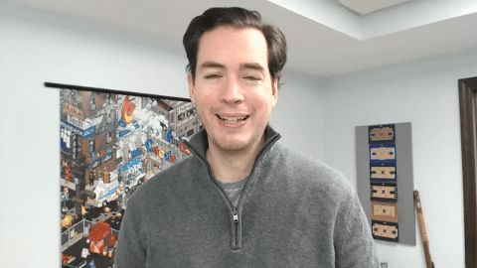
FOCUS ON ONE SPECIFIC THING!

Slide 5
SET CLEAR EXPECTATIONS
Highlight Roles, Responsibilities, and Rewards: Provide a clear picture of what the job entails and the benefits of the position.
Outline Required Qualifications: Specify the necessary skills and qualifications to set clear expectations.
Empathy, Patience, and Communication: These are critical soft skills for quality care.
Well crafted job descriptions set clear expectations and attract candidates who are well suited for the role by highlighting the essential skills and values needed for success!

Slide 6

Did you know there are 101Ways to Recruit New Caregivers?
Click here to read the article
???
Demand for caregivers is greater than ever and with the current job market, you’re competing for caregivers not only with other agencies but with retail giants like Amazon and Walmart, fast food chains like McDonalds, and gig platforms like Uber and Task Rabbit.

Slide 7


Diverse Recruitment Channels
Utilizing a variety of recruitment channels ensures you a wide and diverse pool of candidates
Connect with Immigrants
Immigrants account for a good percentage of health care support; connecting with immigrant populations may be a way to find workers. Faith based and human services agencies, ethnic grocery stores, and ESL programs could be useful resources when searching for workers new to the United States. Immigrants contribute to New Jersey’s workforce and bring a wealth of talent and skills. Connect with the local Service Provider if you have employment opportunities.
Click here to visit the New Jersey Office of New American’s Support Page
Online Job Boards and Social Media: Post job openings on various platforms to reach a wider audience
Fairs and Community Events: Attend events to meet potential candidates in person.
Vocational Programs and Schools: Partner with educational institutions to find qualified candidates.
Employee Advocacy: Encourage current DSPs to share job postings within their personal networks or on social media.
Click here for Recruiting Strategies from industry experts.

Slide 8

Consider creating a video and posting on social media in target areas.
Attracting candidates who value professional growth can enhance the quality of care provided.
Seek individuals who are enthusiastic about ongoing professional development.
Keep in mind, employees who have adopted your company culture are your best sales tools!
Click to watch the video.

Slide 9


SOME OUT OF THE BOX IDEAS
Your employees can be your eyes and ears. Develop a business card they can offer when they see people doing great things. There are people all over the community; in supermarkets, doctor offices, churches, etc.
When employees observe optimal care being given by someone in the community, let them have a card ready they can hand someone while saying, “Hey I see you are a compassionate and patient person. Have you considered a career in caring for other people? I work at a great place! Check it out!
Consider joining Facebook group town pages in areas you are recruiting.
Offer incentives for employees who refer successful candidates! Employee referral bonus amounts don’t need to be over the top. Simple and inexpensive incentives such as event tickets, gift cards or extra days off can easily motivate employees.
Click here to view “The Art of the Employee Referral Guide”
Have you considered working as a Direct Support Professional?
I work for a great agency.
Give them a call
ABC Agency
123 Main Drive, Anywhere USA
(800)123-4567

Slide 10
Upcoming Training Opportunities

Slide 11


Slide 12
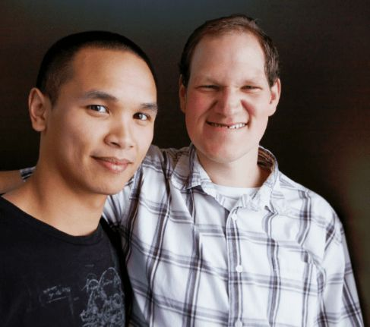
Target Audience: Service Provider Leadership including Directors, Program Directors, HR Staff, Training Department Staff, and similar leadership positions.
The Boggs Center is collaborating with the University of Minnesota, Institute on Community Integration’s Direct Support Workforce Solutions to bring a 10-part learning series for provider agency leaders to New Jersey. Through this series, experts in the field will provide presentations and guided learning focused on 10 strategies essential to effective Direct Support Professional Recruitment and Retention.
Each topic will be presented across two sessions, the first being an engaging presentation. The second, taking place a week later, will be a facilitated Learning Forum to allow for more questions and answers, collective idea sharing, and networking.
Certificates of Attendance will be provided to those who complete both days of the sessions.
Space is limited. Interested professionals within the target audience must register by topic. We ask that those registering, mark their calendars and plan to attend due to demand and space limits.
.

Slide 13
To register click here
Then click on Workforce Development & Frontline Supervisors
Data Tells a Story: Leveraging Data for Workforce Results
August 14 & 21, 2025 l 1:00 PM – 3:00 PM l Zoom
Recruitment Marketing
September 18 & 25, 2025 l 1:00 PM – 3:00 PM l Zoom
Realistic Job Preview
October 16 & 23, 2025 l 1:00 PM – 3:00 PM l Zoom
Competency-Based Job Analysis & Job Descriptions
November 13 & 29, 2025 l 1:00 PM – 3:00 PM l Zoom
Structured Behavioral Interviewing and Score Guide
January 22 & 29, 2026 l 1:00 PM – 3:00 PM l Zoom
Orientation and Onboarding
February 12 & 19, 2026 l 1:00 PM – 3:00 PM l Zoom
Competency-Based Training
March 12 & 19, 2026 l 1:00 PM – 3:00 PM l Zoom
Career Pathways & Credentialing
April 16 & 23, 2026 l 1:00 PM – 3:00 PM l Zoom
Competency-Based Evaluations & Performance Reviews
May 14 & 21, 2026 l 1:00 PM – 3:00 PM l Zoom
Employee Feedback & Engagement
June 18 & 25, 2026 l 1:00 PM – 3:00 PM l Zoom

Slide 14

Office of Prevention

