Slide 1
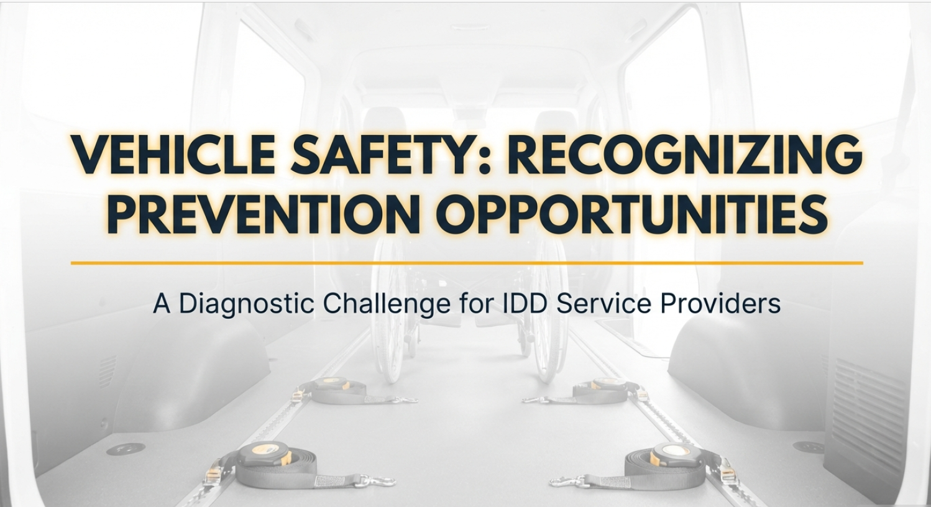

Slide 2
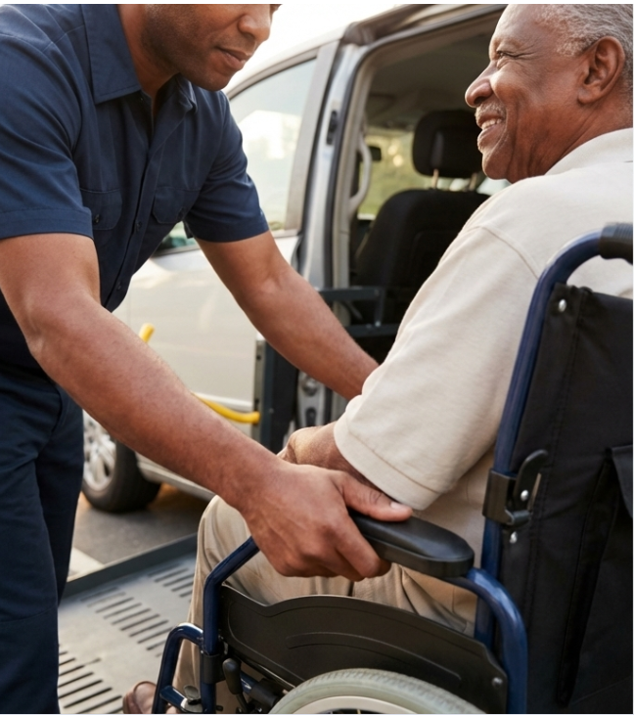
PREVENTION BEGINS WITH RECOGNITION.
Neglect during transportation rarely starts with dramatic incidents. It begins with minor oversights and unchallenged assumptions—situations that seem manageable until they’re not.
This presentation contains 5 real-world case files, representing the most common opportunities for prevention.
Space hold for photo
PREVENTION OPPORTUNITIES - YOUR APPROACH
As you review each case file:
Use the 6 Lenses to identify prevention opportunities
Analyze for similar vulnerabilities in your own agencies
Compare your analysis to the learning points provided
After all 5 case files, you'll find comprehensive prevention planning recommendations.
What you recognize, you can prevent.

Slide 3











YOUR DIAGNOSTIC TOOLKIT: THE 6 LENSES OF PREVENTION
Analyze each case file through these six critical lenses
Person-Specific
Driving Safely
Training
Individual needs, including behavioral, medical, and physical considerations.
Safe driving behaviors, technology supports, and defensive driving.
Staff knowledge, competency, and proficiency in areas like defensive driving, loading/unloading, and wheelchair securement.
Admin. Oversight
Safe Equipment
Procedures
Policies, verification systems, driver license checks, and proficiency assessments.
Condition of the vehicle and personal equipment, such as crashworthy wheelchairs and proper seating with seatbelts.
Protocols for loading, unloading, transfers, and supervision.

Slide 4
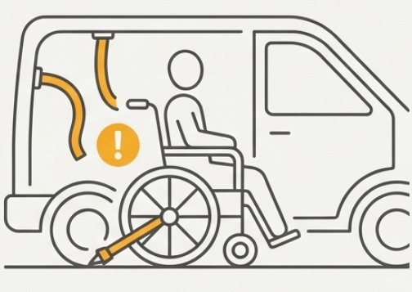
CASE FILE #1: THE OVERTURNED WHEELCHAIR
What prevention opportunities can you identify?
THE SITUATION
An individual was seated in a van. During a turn, the individual’s wheelchair fell over, and their head struck the interior wall. Staff pulled over, returned the wheelchair upright, and seeing no obvious injuries, continued the trip. Upon arrival, surveillance footage reviewed by supervisors showed the head impact and revealed that staff had incorrectly secured the wheelchair—the straps appeared attached but were not properly tightened. The individual was then sent for medical evaluation
What prevention opportunities do you see?
Use the 6 Lenses to identify what could have prevented this incident

Slide 5




What Prevention opportunities do you see?
Case File #1 Your Analysis
Use the 6 Lenses of Prevention
Safe Equipment
Training
How can staff verify that securement straps are truly secure?
What wheelchair securement skills do staff need?
What physical checks should be done on tie-down systems?
How can organizations check that staff can properly secure wheelchairs?
Procedures
When should staff skills be checked again?
What should happen right away after a head impact during transport?
Person Specific
What review steps should happen before the vehicle leaves?
Are there individual factors that might call for extra securement steps?
What guidelines direct response to injuries during transport?
Administrative Oversight
Driving Safety
What systems could check for proper securement before leaving?
How does the way you drive affect whether wheelchairs stay stable during transport?
How can organizations track securement practices?
What supervision or review steps could catch errors?
What safe driving practices are important when transporting wheelchairs?

Slide 6
Prevention Opportunities Identified
Case File #1 Compare your analysis
6 Lenses of Prevention
Safe Equipment
Training
Pull on each strap before leaving (pull test) to make sure it's tight
Good training builds staff skills in securing wheelchairs safely
Looking at straps isn't enough—you should physically test them
Staff who know how to tighten straps with no slack create safer conditions
Procedures
Skills can weaken over time without regular practice and review
When someone hits their head during transport, they need a medical check-up right away
Person Specific
Review all safety steps before the vehicle leaves
Knowing each person's needs helps determine the best way to secure them safely
Administrative Oversight
Driving Safety
Having two people check (double-check system) can catch mistakes before leaving
Drive slowly and carefully when transporting wheelchairs—anticipate turns to reduce risk
Cameras and GPS in vehicles can track how staff secure wheelchairs and drive
How you drive affects whether wheelchairs stay stable during turns and stops

Slide 7
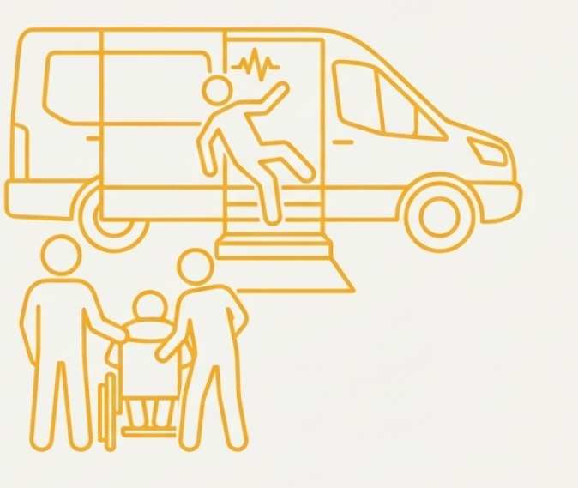
CASE FILE #2: THE FALL FROM THE STEPS
What prevention opportunities can you identify?
THE SITUATION
An individual, whose support plan requires assistance for all vehicle transfers due to a seizure disorder, was waiting to board a van. While staff were busy assisting another individual, this person began ascending the van steps independently, experienced a seizure, and fell backward onto the pavement, sustaining significant head trauma requiring hospitalization.
What prevention opportunities do you see?
Use the 6 Lenses to identify what could have prevented this incident

Slide 8
What Prevention opportunities do you see?
Case File #2 Your Analysis
Use the 6 Lenses of Prevention
Safe Equipment
Training
What physical features of vehicles support safe boarding?
What do transportation staff need to know about individual support plans?
What equipment helps reduce fall risk during transfers?
What seizure-related knowledge is important for transportation staff?
Procedures
What training supports safe transfer assistance?
What boarding order could prevent unsafe independent transfers?
Person Specific
How should staff be positioned during boarding?
What written information exists about the person’s needs?
What guidelines address assistance needs during high-risk activities?
How should seizure risk guide boarding procedures?
What medical conditions need special attention during transfers?
Administrative Oversight
How can organizations make sure support plans are reviewed and followed?
Driving Safety
What role does the driver play in safe boarding procedures?
What assignment or supervision systems support safe boarding?
How should parking and vehicle position support safe transfers?
How can multiple people boarding at the same time be managed safely?

Slide 9
Prevention Opportunities Identified
Case File #2 Compare your analysis
6 Lenses of Prevention
Safe Equipment
Training
Non-slip surfaces and handrails on van steps are an important safety features
All transportation staff need to review and understand each person's support plan
Procedures
Knowledge of seizure first aid and how to keep transfers safe is important
Boarding people who need help first (before those who don't) prevents gaps in supervision
Person Specific
Staff should stay within arm's reach when providing one-to-one help
This person's support plan said they needed help with all vehicle transfers
Administrative Oversight
Having a seizure disorder creates higher risk during transfers and boarding
All transportation staff should review support plans
Driving Safety
Assigning one staff member to be responsible for each person during boarding can help
How you position and park the vehicle supports a stable boarding area
Having supervision systems helps make sure people get the assistance they need during boarding

Slide 10

CASE FILE #3: THE MID-TRIP EMERGENCY
What prevention opportunities can you identify?
THE SITUATION
An individual had a seizure in transit. As the van pulled over, their wheelchair tipped, causing an injury. The tie-down equipment was broken and mismatched. Staff admitted to intentionally securing only the front tie-downs for convenience to avoid moving individual’s personal bag. Staff did not provide first aid and continued to the destination instead of calling 911 immediately.
What prevention opportunities do you see?
Use the 6 Lenses to identify what could have prevented this incident

Slide 11
What Prevention opportunities do you see?
Case File #3 Your Analysis
Use the 6 Lenses of Prevention
Safe Equipment
Training
What was the condition of the tie-down system?
What equipment standards should exist for compatibility?
What training gaps became apparent in this incident?.
What emergency medical supplies should be in every vehicle?
What emergency response knowledge should all transportation staff have?
Procedures
What securement training do staff need?
What are the requirements for wheelchair securement?
Person Specific
What should staff do when obstacles (like personal bags) interfere with safety procedures?
What should the individual's seizure history have told staff about securement needs?
What is the protocol when someone experiences a medical emergency in transit?
Should this person's support plan have included specific transportation requirements?
What first aid response was needed for the injury?
Administrative Oversight
Driving Safety
What processes are in place to take broken equipment out of active service?
How does driving behavior affect wheelchair stability?
What inspection schedules should be in place?
What should a driver do immediately when a medical emergency occurs during transport?
What verification systems could ensure drivers are qualified?

Slide 12
Prevention Opportunities Identified
Case File #3 Compare your analysis
6 Lenses of Prevention
Safe Equipment
Training
Broken tie-down equipment should be taken out of service right away
All four tie-downs are needed for safe wheelchair securement on every trip
Using tie-down parts that match (from the same manufacturer) keeps the system working properly
Having first aid kits that are easy to reach and fully stocked supports emergency response
First aid skills are important when injuries happen during transport
Training on how to handle obstacles (like personal items) while keeping safety steps in place
Procedures
All four tie-downs are needed for safe wheelchair securement every trip
Person Specific
Emergency medical guidelines help staff know when to call 911 (like for seizures during transport)
Creating a transportation plan for people with medical conditions adds extra safety
Medical emergencies mean stopping at the nearest appropriate place for help
Administrative Oversight
Driving Safety
Knowing how to stop safely during medical emergencies is important
Having equipment inspection systems keeps broken or mismatched tie-downs out of use
How you drive during an emergency affects whether wheelchairs stay stable
Daily pre-trip vehicle safety inspections can catch equipment problems
Clear systems for who is responsible help make sure protocols are followed

Slide 13

CASE FILE #4: THE HOT VAN
What prevention opportunities can you identify?
THE SITUATION
On a 100-degree day, individuals were loaded onto a van before the driver arrived. The van was not climate-controlled. One individual, known to be at high risk for heat-related complications due to psychotropic medications, became distressed while waiting on the hot van with staff standing outside the vehicle
What prevention opportunities do you see?
Use the 6 Lenses to identify what could have prevented this incident

Slide 14
What Prevention opportunities do you see?
Case File #4 Your Analysis
Use the 6 Lenses of Prevention
Safe Equipment
Training
What vehicle systems manage climate before and during boarding?
What do staff need to recognize about heat-related illness?
What technology could support vehicle preparation in extreme weather?
What knowledge helps staff identify at-risk people?
Where should staff be positioned when people are on vehicles?
Procedures
Person Specific
At what point should boarding begin?
Which people might be at higher risk in extreme temperatures?
What vehicle conditions must be met before anyone boards?
What medications or medical conditions increase heat-related risk?
How should boarding be managed in extreme weather?
What weather-specific protocols should exist?
How might distressed behaviors relate to the environment?
Administrative Oversight
Driving Safety
How can transportation and program schedules be coordinated well?
What is the driver's role in vehicle preparation before boarding?
What tracking systems could check vehicle readiness?
How should vehicles be prepared for extreme weather ?
What systems make sure drivers arrive and vehicle are prepared?

Slide 15
Prevention Opportunities Identified
Case File #4 Compare your analysis
6 Lenses of Prevention
Safe Equipment
Training
The vehicle's climate control (heat or air conditioning) should be running and working before anyone boards
Train staff on how to recognize the signs of heat-related illness
Remote vehicle start systems can cool or heat vehicles ahead of time
Staff should stay with people on vehicles at all times to observe for problems
Procedures
Person Specific
People should board only after the driver arrives and the vehicle is climate-controlled
Staff need to know which people are at high risk for heat-related illness (like those taking certain medications)
Boarding people in order during extreme weather (those who need help first) reduces exposure time
Having specific guidelines for extreme heat and cold protects people's safety
Heat stress can trigger distressed behaviors
Administrative Oversight
Driving Safety
Making sure drivers arrive on schedule and are accountable is important
Having a system to confirm when drivers arrive helps programs and transportation work together
Getting the vehicle ready before boarding is the driver's job
GPS monitoring can show when vehicles arrive and when engines are running

Slide 16
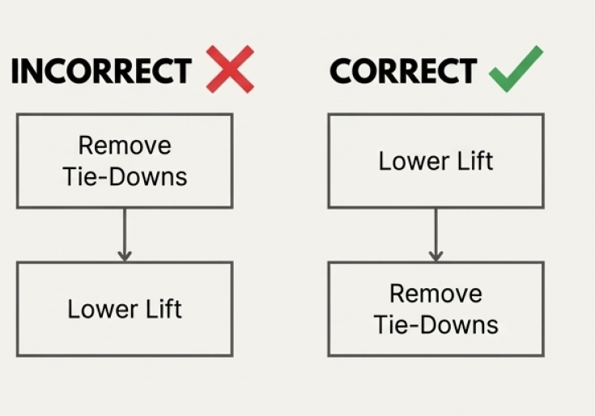
CASE FILE #5: THE UNSECURED ROLL-AWAY
What prevention opportunities can you identify?
THE SITUATION
After parking on a slight incline, a staff member removed an individual’s wheelchair tie-downs before lowering the lift. The staff member left the unsecured individual near the open van door to operate the lift. The individual’s wheelchair, which had known faulty brakes, rolled out of the open door and fell to the ground.
What prevention opportunities do you see?
Use the 6 Lenses to identify what could have prevented this incident

Slide 17
What Prevention opportunities do you see?
Case File #5 Your Analysis
Use the 6 Lenses of Prevention
Safe Equipment
Training
What was the condition of the wheelchair brakes?
What should happen when equipment has known problems?
What unloading procedures do staff need to know?
What backup equipment should be available?
What order should be followed during wheelchair unloading?
Procedures
What safe parking practices should drivers understand?
What is the order for unloading a wheelchair user?
Person Specific
At what point should tie-downs be removed?
What individual safety considerations are important during unloading?
Where should people be positioned during unloading operations?
How should known equipment issues for specific people be managed?
What should guide staff when equipment has known problems?
Administrative Oversight
Driving Safety
How often should wheelchairs be inspected for safety?
What parking considerations are important for wheelchair unloading?
What systems should track equipment problems?
How does parking location affect unloading safety?
What is the policy for using equipment with known safety issues?

Slide 18
Prevention Opportunities Identified
Case File #5 Compare your analysis
6 Lenses of Prevention
Safe Equipment
Training
A wheelchair with broken brakes creates an immediate safety risk
Staff need to learn and practice the right unloading steps: Lower lift FIRST, then remove tie-downs
Having a backup wheelchair available when the main one has problems keeps people safe
Safe parking practices are part of defensive driving training
Procedures
Person Specific
The correct unloading order is: Lower lift FIRST, position wheelchair safely, THEN remove tie-downs
When someone's equipment has known problems, it needs immediate attention and solutions
Never leave someone in an unsecured wheelchair near an open door
Visual guides posted in vehicles can reinforce correct sequences
A person's safety is at risk when their personal equipment has safety problems
Administrative Oversight
Driving Safety
Checking wheelchairs for safety every three months (with written records) creates responsibility
Parking on flat, level surfaces is important for safe wheelchair unloading
Having a system to track equipment problems keeps known issues from continuing
Knowing safe parking practices and choosing the right spot are part of defensive driving
Equipment with broken safety features should be taken out of transportation use right away

Slide 19
KEY FINDINGS: A SINGLE MISTAKE RARELY CAUSES A CRISIS. SYSTEMIC FAILURES DO.
Three critical patterns appeared in every case file:
1
TRAINING GAPS:
One-time training is not enough. Competency must be verified and refreshed.
2
3
EQUIPMENT FAILURES:
Known issues like broken tie-downs and faulty brakes were left unaddressed. Proactive maintenance is non-negotiable.
VERIFICATION GAPS:
“Trust but verify.” A second check, a pre-trip inspection, or supervisor oversight catches errors before they cause harm.
FOR DIRECT CARE STAFF
FOR ADMINISTRATORS
Speak up when you see broken equipment. Ask for help when unsure. Never skip a step in a safety procedure. Follow person-specific plans exactly.
Invest in equipment maintenance and replacement. Implement systematic verification processes. Prioritize ongoing training with competency assessments. Build accountability systems.

Slide 20

Comprehensive PREVENTION Planning
Immediate Actions to Consider
Equipment Safety
Staff Readiness
Inspect all vehicle tie-downs and wheelchair brakes—take broken equipment out of service
Review all driver records to check current qualifications
Check first aid kits to make sure they are fully stocked and easy to reach in every vehicle
Retrain all staff: All Four tie-downs are needed every trip, no exceptions
Check wheelchair securement parts to make sure they match (manufacturer-matched parts only)
Review support plans for all people who need transfer help or have medical conditions
Policy Establishment
Procedure Review
Consider a clear guideline: Call 911 for any medical emergency during transport
Set up a two-person check system for wheelchair securement before leaving
Consider a driver-present-first boarding approach (no boarding until driver arrives and climate control is on)
Post visual securement checklists in every vehicle
Set a clear guideline for immediate medical check-up for any head impact during transport
Post emergency medical guidelines in every vehicle

Slide 21


Comprehensive PREVENTION Planning
SYSTEMIC PREVENTION SUGGESTIONS (Build Into Ongoing Operations)
Training & Competency
Equipment Management
Bi-annual first aid/CPR certification for all transportation staff (Cases 2, 3)
Weekly vehicle equipment inspection checklists with documentation (Cases 1, 3, 5)
Check wheelchair securement skills hands-on every three months (Cases 1, 3, 5)
Schedule for replacing equipment based on what the manufacturer recommends (Cases 3, 5)
Training on seizure first aid and safe transfers (Cases 2, 3)
System to track equipment problems with automatic follow-up for unresolved safety issues (Cases 3, 5)
Training on managing obstacles while keeping safety steps in place (Case 3)
Budget set aside for immediate replacement of safety-critical equipment (Cases 3, 5)
Defensive driving certification including safe parking and emergency response (Cases 1, 3, 5)
Daily checks before trips including physical pull-test of securement straps (Cases 1, 3)

Slide 22


Comprehensive PREVENTION Planning
SYSTEMIC PREVENTION SUGGESTIONS (Build Into Ongoing Operations)
Administrative Oversight
Person-Specific Planning
GPS tracking systems to monitor driving behavior and emergency response (Cases 1, 3, 4)
Transportation plans for people with medical conditions (seizures, heat sensitivity, etc.)
(Cases 2, 3, 4)
Supervisors complete spot-checks of vehicle departures every three months (Cases 1, 2)
Staff review of support plans before each route to know who needs assistance (Case 2,4)
Regular driver license and driving record checks (Case 3)
Communication systems between programs and transportation staff about daily assistance needs (Case 2,4)
Camera systems in vehicles for monitoring and coaching opportunities (Cases 1, 2)
System for programs and transportation to coordinate schedules (Case 4)
Assign specific staff members to be responsible during boarding and transport (Case 2)

Slide 23

Comprehensive PREVENTION Planning
SYSTEMIC PREVENTION SUGGESTIONS (Build Into Ongoing Operations)
Procedures & Protocols
Verification Systems
Boarding order (people who need help first, independent people last) (Cases 2, 4)
Two-person check for all wheelchair securement before leaving (Cases 1, 3)
The correct unloading sequence: Lower lift FIRST, then remove tie-downs (Case 5)
Video monitoring of boarding/unloading with supervisor review (Case 2)
Weather-specific guidelines for extreme heat and cold (Case 4)
Physical inspection requirements before trips (Cases 1, 3, 5)
Emergency medical guidelines with clear decision steps (Cases 2, 3)
Supervisor sign-off on weekly equipment checklists (Cases 3, 5)
All transportation staff must review support plans (Cases 2, 4)

Slide 24
Your PREVENTION Plan
Reflection Questions for Your Team:
Next Steps:
Assessment: Which of these system issues exist in your organization today?
Prioritization: Which immediate actions can you implement this week?
Resource Planning: What budget, staffing, or equipment investments are needed?
Timeline: What's your 30-day, 90-day, and 1-year implementation plan?
Accountability: Who is responsible for each prevention system?
Measurement: How will you verify that these systems are working?
Schedule a team meeting to review all 5 case files
Complete a gap analysis using the 6 Lenses framework
Develop your organization's prevention action plan
Assign who is responsible and set timelines for each system change
Set up tracking systems to follow implementation

Slide 25
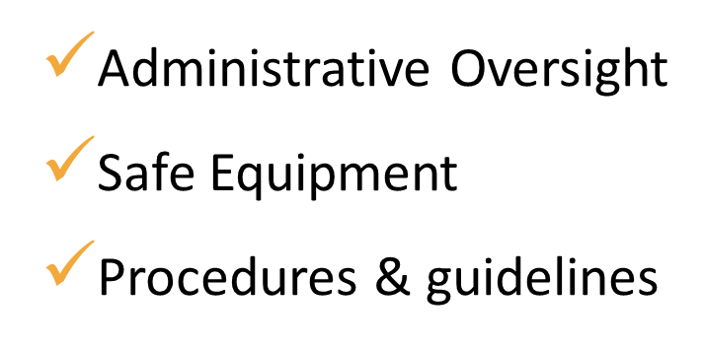
REMEMBER: PREVENTION IS SYSTEMATIC, NOT REACTIVE
The case files showed that no single mistake causes a crisis—system failures do. Your prevention plan must address all 6 Lenses:
Person-Specific needs
Driving Safely practices
Training & skills building
What you recognize, you can prevent.

Slide 26
Legal Disclaimer
The content within this newsletter is provided for informational purposes only and should not be construed as a regulatory requirement. It serves as a general resource for providers and is not intended to cover every possible scenario. This information does not constitute professional, legal, or medical advice. It is suggested that providers review the material and if applicable, adapt the guidelines to their specific needs. Additionally, providers should consult with their agency’s legal counsel or wheelchair safety experts for personalized advice.
Providers are responsible for ensuring that their policies and practices comply with all relevant state laws, codes, regulations, and administrative directives from pertinent state oversight agencies concerning the safe transportation of individuals, including those using wheelchairs.
Providers should not rely solely on the information presented in this newsletter for making decisions related to compliance or safety practices.

