Slide 1

WIOA Performance Guidance
Workforce Program Oversight & Development &
Office of Research and Information
September 11, 2026

Slide 2
Agenda
WIOA Performance Indicators
Levels of Performance
Local Statistical Adjustment Model/ Performance Targets
Corrective Action Process
NJDOL Local Performance Guidance WD-PY26-2.pdf

Slide 3
WIOA Performance Indicators
Employment Rate-2nd Quarter after Exit*
Employment Rate-4th Quarter after Exit*
Median Earnings
Credential Attainment
Measurable Skills Gains
Effectiveness in Serving Employers(New)
*Education and Employment for Youth
Notes:
Under the Workforce Innovation and Opportunity Act, the States are responsible for six performance indicators. The sixth indicator, effectiveness in serving employers is solely the responsibility of the State. The other five are reported to USDOL as an average of the outcomes for all local areas. As such, NJDOL has developed a new policy related regarding local area performance which we will discuss in this presentation.

Slide 4
Adult and DW Performance Indicators
Employment Rate-2nd Quarter after Exit
Employment Rate-4th Quarter after Exit
Median Earnings
Credential Attainment
Measurable Skills Gains
Notes:
The three first indicators in yellow are the Employment-based indicators. Anyone who becomes a WIOA participant will be counted in these indicators regardless of the services they receive. Also, the outcomes for most participants will be captured from wage records. The exception would be those in employment not recorded in the wage record, such as self employment., Participants will be included in the Credential Attainment and Measurable Skills Gain indicators depending on what services they receive.

Slide 5
Youth Indicators
Youth Education and Employment Rate-2nd Quarter after Exit
Youth Education and Employment Rate-4th Quarter after Exit
Median Earnings
Credential Attainment
Measurable Skill Gains
Notes:
For youth, all participants will go into the first three indicators as with the Adults, although for youth the first two indicators are different, because they include postsecondary placement as well as employment, which will discuss in more detail later.

Slide 6
Employment Rate (Adult/DW)
Employment Rate – 2nd Quarter After Exit is the percentage of program participants who are in unsubsidized employment during the second quarter after exit from the program.
Employment Rate – Fourth Quarter After Exit is the percentage of program participants who are in unsubsidized employment during the fourth quarter after exit from the program.
Notes:
Employment rate in second and fourth quarter after exit are straight forward. A person is counted if they show up in the Wage record as having employment in the private sector or public sector for which the employer does not receive a subsidy from public funds to offset all or a part of the wages and costs of employing an individual. There are limited circumstances in which a person would not show up in the Wage record, such as

Slide 7
Education and Employment Rate
Education and Employment Rate-Second Quarter After Exit-This measure is the percentage of title I Youth program participants who are in education or training activities, or in unsubsidized employment, during the second quarter after exit from the program.
Education and Employment Rate-Fourth Quarter After Exit-This measure is the percentage of title I Youth program participants who are in education or training activities, or in unsubsidized employment, during the second quarter after exit from the program.

Slide 8
Median Earnings
Median Earnings – 2nd Quarter After Exit is the median earnings of program participants who are in unsubsidized employment during the second quarter after exit from the program, as established through direct UI wage record match or supplemental wage information.

Slide 9
Credential Attainment
All participants in either a postsecondary education or training program (other than OJT* and customized training) OR in a secondary education program at or above the 9th grade level without a secondary school diploma or its equivalent
*Participants in Registered Apprenticeship are NOT excluded.
  Credential can be obtained during the program or within 1 year (365 days) following exit
  If participant obtains secondary school diploma or equivalent, they must also be employed or in an education/training program leading to a postsecondary credential within 1 year after exit

Slide 10
Measurable Skills Gain
The percentage of program participants who, during a program year, are in an education or training program that leads to a recognized postsecondary credential or employment and who are achieving measurable skill gains, defined as documented academic, technical, occupational, or other forms of progress, towards such a credential or employment.
Is a real-time indicator
While a participant may achieve more than one in a reporting period, only one is reported
Requires regular communication with WIOA providers
Timely data entry is critical!

Slide 11
USDOL
Levels of Performance for States
Expected: The levels of performance proposed by the State prior to negotiations for each primary indicator of performance for each core program.
Negotiated: The levels of performance mutually agreed to by the State and the Departments for each respective program.
Adjusted: The levels of performance determined by adjusting the negotiated levels of performance at the end of the program year to reflect actual characteristics of participants served and the actual economic conditions experienced using the objective regression statistical adjustment model (SAM).
Actual: The outcome reported by a State for each primary indicator of performance for each core program. The Departments will compare actual levels of performance to the adjusted levels of performance at the close of the program year to determine the State’s performance success or failure.

Slide 12
Levels of Performance: Adjustment Factors
An adjustment factor is developed for all performance indicators based on the difference between what the model predicted for service and outcomes, and what the actual levels of service and outcomes were in a given program year
Individual indicator score is the proportion the actual level of performance represents of the adjusted level of performance for a single performance indicator for a single program. It is calculated by dividing the actual level of performance achieved by the adjusted level of performance.
Notes:
This leads to a positive or negative adjustment factor that then determines whether the initial targets for the state need to be lowered or increased.

Slide 13
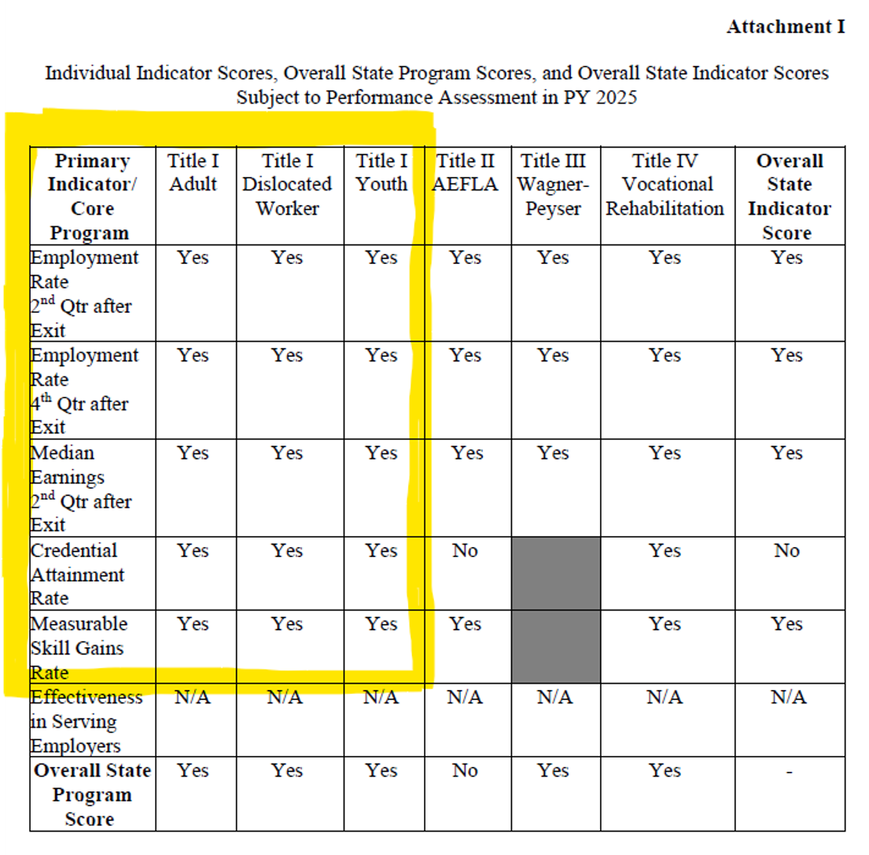
USDOL – TEN #03-26
WIOA State Performance Accountability
Assessment
PY 2025

Slide 14
Local SAM: Local Area Targets for PY26/PY27
Model uses four years of PIRL data: PY22, PY23, PY24, PY25
  Coefficients created using years of past performance
Local Economic Indicators from same PY22-PY25 years
Baseline = PY25 (Youth Baseline = PY23-PY25 average)
  Coefficients applied to Baseline PY25 = PY 26 Targets
PY27 targets set by fixed increments (USDOL used for state targets)
Local Targets compared to State Targets, outliers addressed.
Negotiations – only what is NOT in model.

Slide 15
Local Area Performance Thresholds for New Jersey
Threshold for Technical Assistance in Year 1: Local areas with performance below 90 percent of the negotiated and/or adjusted goal for an individual indicator score for any primary will receive technical assistance to help improve their outcomes for that program.
Threshold for Corrective Action in Year 2: The State will issue corrective actions if a local area’s performance falls below 80 percent of the negotiated and/or adjusted goal for an individual indicator score for any primary indicator of performance.
Accountability: Local WDBs that fail to achieve at least 80 percent of their adjusted performance goal for any individual indicator score for a second program year will be subject to corrective actions and/or penalties.

Slide 16
Corrective Actions
Initial Notification and Technical Assistance: LWDB Directors will be notified of performance non-compliance through technical assistance and monitoring activities
Follow-Up Notification: NJDOL will issue a formal letter indicating non-compliance and potential initiation of corrective actions if there is no progress two quarters after initial notification. This notice will be sent to the Chief Elected Official and include the LWDB Director and Chair.

Slide 17
Formal Initiation of Corrective Actions and Penalties
NJDOL will re-evaluate the LWDA’s levels of performance after certification of the final quarterly report. This evaluation will include the post-Program Year Assessment of performance.
Statistical Adjustment Model(SAM)-The local SAM will be utilized to produce adjusted performance goals for the local area after the program year ends, based on actual economic conditions and participant characteristics. The evaluation will also consider whether levels of service are appropriate based on funding and demographics, and if Federal and State spending targets are being met.
If unresolved, NJDOL will notify the Chief Elected Official of the finalized corrective action plan and penalties. Details will include timelines, effective dates, and appeal rights as per N.J.A.C. 12:42-3.11.
Notes:
Because the majority of performance measures are exit-based, performance will be re-evaluated after certification of the final quarterly report.

Slide 18

Questions

Slide 19

This Photo by Unknown Author is licensed under CC BY-SA

