Slide 1
State of Innovation:
Building a Stronger and Fairer Economy in New Jersey

Slide 2
New Jersey is a state with rich economic assets, including a highly talented workforce (2nd ranked education system in the US, highest concentration of scientists and engineers in the world per square mile), rich global diversity (3rd highest composition of foreign-born residents in the US), strong organic industry clusters (22 Fortune 500 headquarters, 400+ biotechnology companies), and a strategic geographic advantage in the center of the densely populated, talent-rich Northeast corridor
Despite these assets, NJ has experienced stagnant economic growth alongside
diminishing access to economic opportunity over the past decade, including:
0.2% GDP growth (46th in the US from 2007-2017)
-1.7% real median income growth (50th in the US from 2006-2016)
1.7 percentage point increase in poverty rate (47th in the US from 2006-2016)

Slide 3
We are charting a new course to create a Stronger and Fairer New Jersey economy by focusing on five key goals for 2025
What it means for NJ?
Driving faster job growth over this time period than all Northeast peer states by fostering a better, more supportive business climate
Approximately 300,000 increase in jobs
1
Achieving faster median wage growth over this time period than all Northeast peer states
Approximately 4% growth in wages or $1,500+ increase in median wages
2
Creating the most diverse innovation ecosystem in the nation and doubling venture capital investment in the state
Approximately 40K more women and minorities in STEM, and $625 million in new VC investment
3
Erasing the racial and gender wage and employment gaps
Approximately 42,000 more women and minorities employed; $15-23K increase in wages
4
Encouraging thriving and inclusive New Jersey urban centers and downtowns by reducing poverty across the state with a specific focus in urban centers
Reduce city poverty rate to state average (approximately 16 p.p. on average)
5

Slide 4
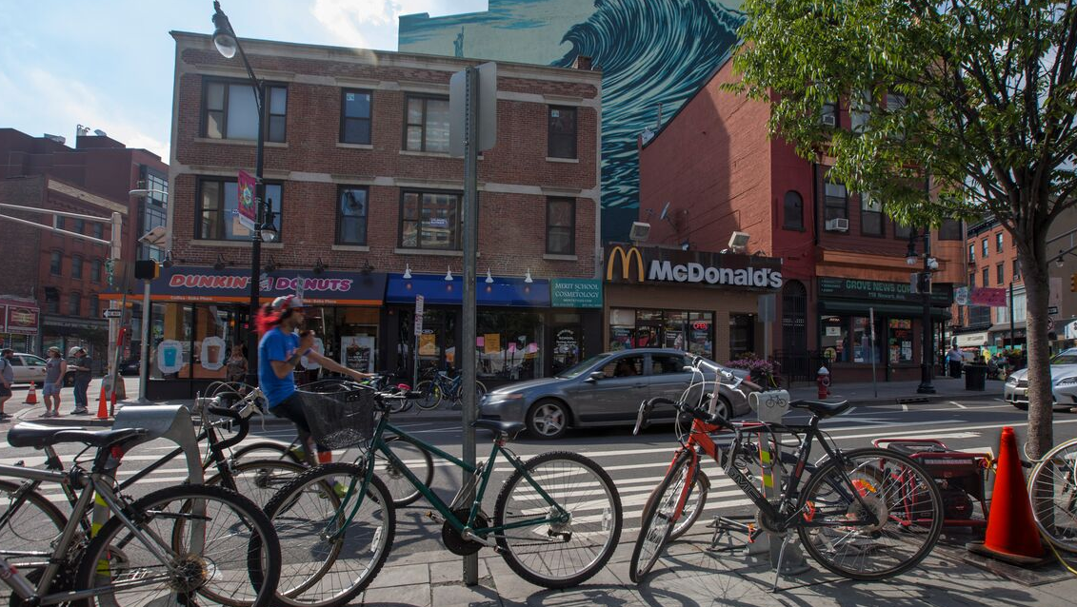
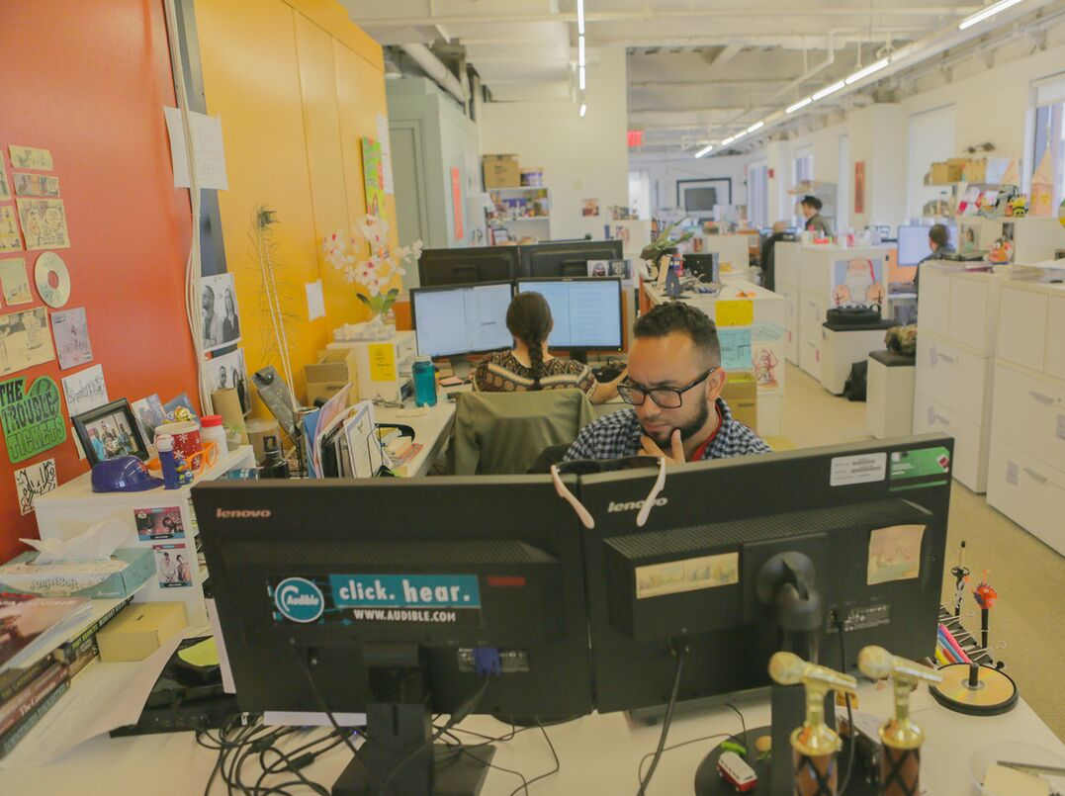
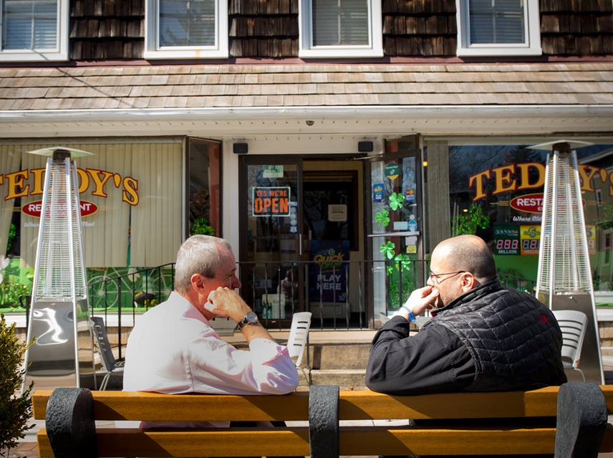
1
2
Investing in people to help all New Jersey residents find meaningful work
Investing in communities
to build world-class cities, towns, and infrastructure
3
4
Making New Jersey the State of Innovation
to create more and better jobs across the state
Making government work better
to improve New Jersey’s competitiveness and business climate

Slide 5
Signature EDA efforts to meet our goals
Opportunity Zone strategies
Create a digital marketplace at NJEDA and partner with “One-Stop Shop” at DCA to help guide municipalities and “Ready to Go” investment projects through NJRA
New place-based incentive program, NJ Aspire
Help to catalyze investments in commercial, residential and mixed-use (including parking) projects, with a particular focus on cities, downtowns and suburban neighborhoods served by mass transit.
Brownfield redevelopment incentive program
Develop an enhanced incentive program and EDA loan fund to work with DEP to support brownfield redevelopment.
Historic preservation tax credit program
Support revitalization of historic buildings, primarily in urban areas- “New ideas need old buildings”

