Slide 1

EOF B1 & B3 Contract Attachment Training
New Jersey Office of the Secretary of Higher Education (OSHE)
Educational Opportunity Fund (EOF) Program

Slide 2
OSHE/EOF Central Staff
Dr. Hasani Carter
Hasani.Carter@oshe.nj.gov
Peter Collazo
Peter.Collazo@oshe.nj.gov
Hema Patel
Hema.Patel@oshe.nj.gov
Catherine Sackey
Catherine.Sackey@oshe.nj.gov
Dr. Stephanie Shanklin
Stephanie.Shanklin@oshe.nj.gov
OSHE Finance
Tiffany Hazzard
Tiffany.Hazzard@oshe.nj.gov
Kevin Kobylowski
Kevin.Kobylowski@oshe.nj.gov

Slide 3



Purpose of this Training
To provide an overview of the EOF B1 Mission and Goals & B3 Program Support Contract Budget Attachments and the changes that have been made for FY25
To review the process of completing the B1 and B3 Contract Attachments
To review the process of completing the FY25 B1 & B3 Contract Attachments and submission deadlines

Slide 4
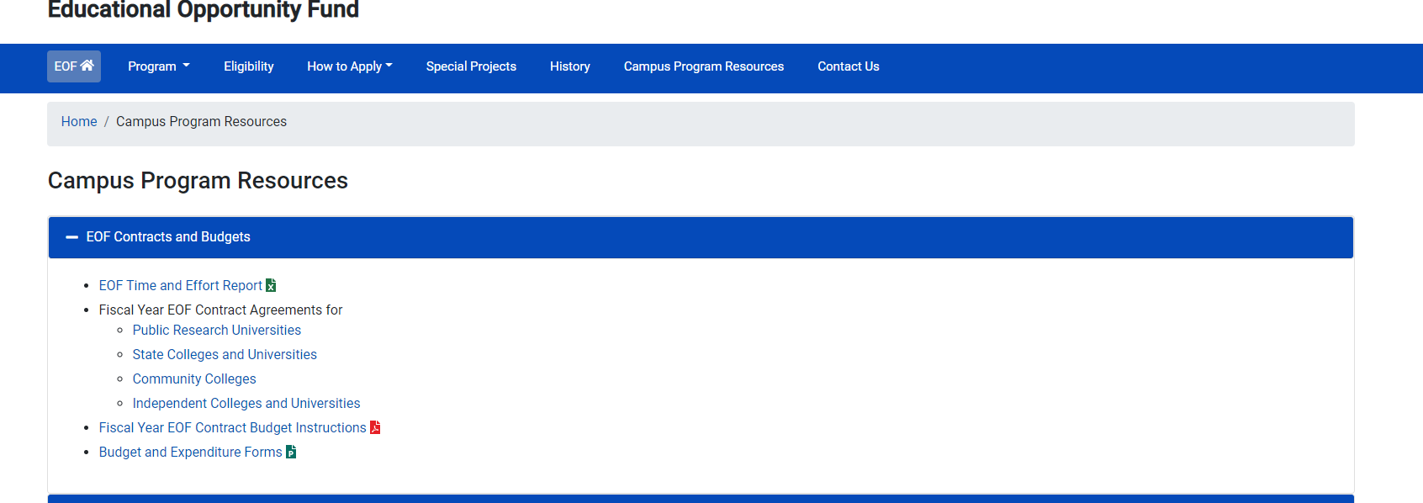
FY25 EOF Program
Contracts and Budget Forms
Notes:
Where can you find EOF FY23 program contracts and budget documents?
All EOF Contract Budget Attachments can be found on the EOF Campus Program Resources webpage, within the EOF Contracts and Budgets section:

Slide 5
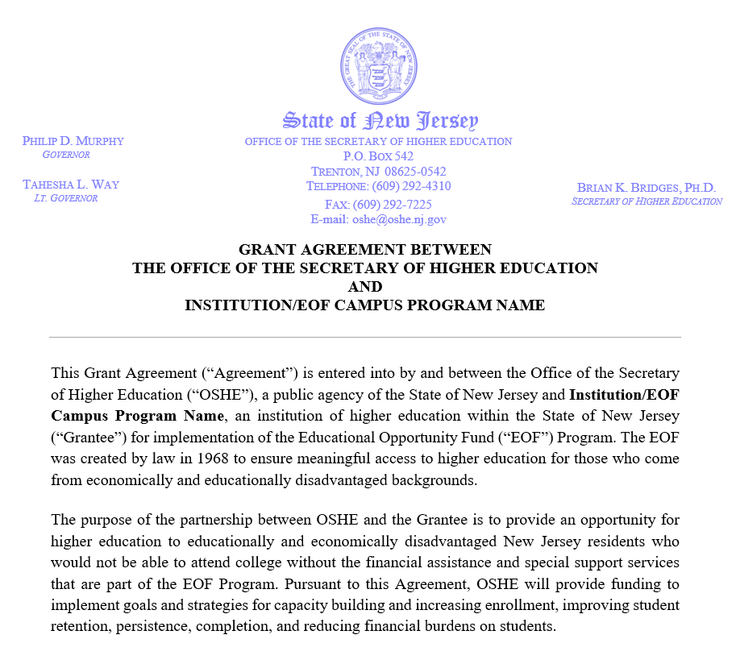
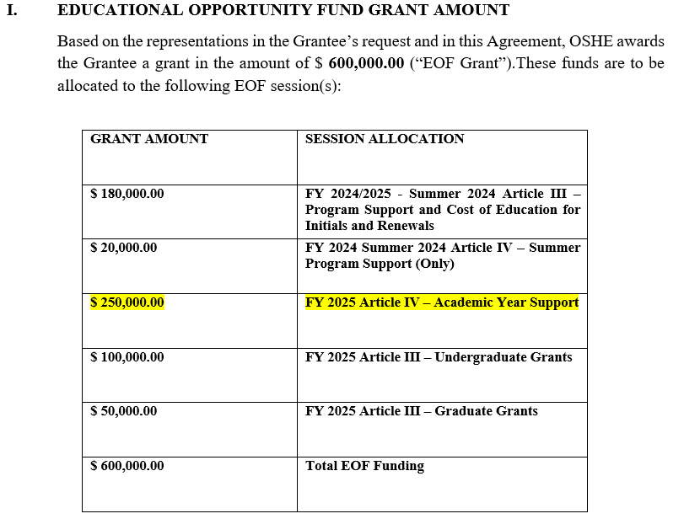
FY25 EOF Program Contract
Notes:
New for 2022 – Updated EOF Contract
The FY 2023 EOF contract has been updated to align the formatting of EOF’s campus program contracts with other OSHE contracts.
FY23 contract includes 2022 Summer Program Allocations AND FY23 Academic Year Allocations
Please note that EOF summer payments cannot be executed until a signed contract has been received.
- Section I. “EDUCATIONAL OPPORTUNITY FUND GRANT AMOUNT” within each respective EOF campus program’s contract lists their respective FY 2023 allocation information.
- Programs should use this information to develop their respective budgets attachments.
Contract/Expenditure Report signature pages will be completed via DocuSign.
After the EOF Central Office staff completes the review of the fiscal year contract documents, the contract signature page will be signed by the EOF Executive Director and a final copy will be emailed to the EOF campus Program Director.
All Signed contracts must be received by June 20, 2022. If your contract signature page is incomplete, you will not receive an advance payment. Please contact our office for assistance with DocuSign.
Additionally, if your institution owes any refunds to OSHE/EOF, you will not receive an advance payment until all refunds have been received.

Slide 6
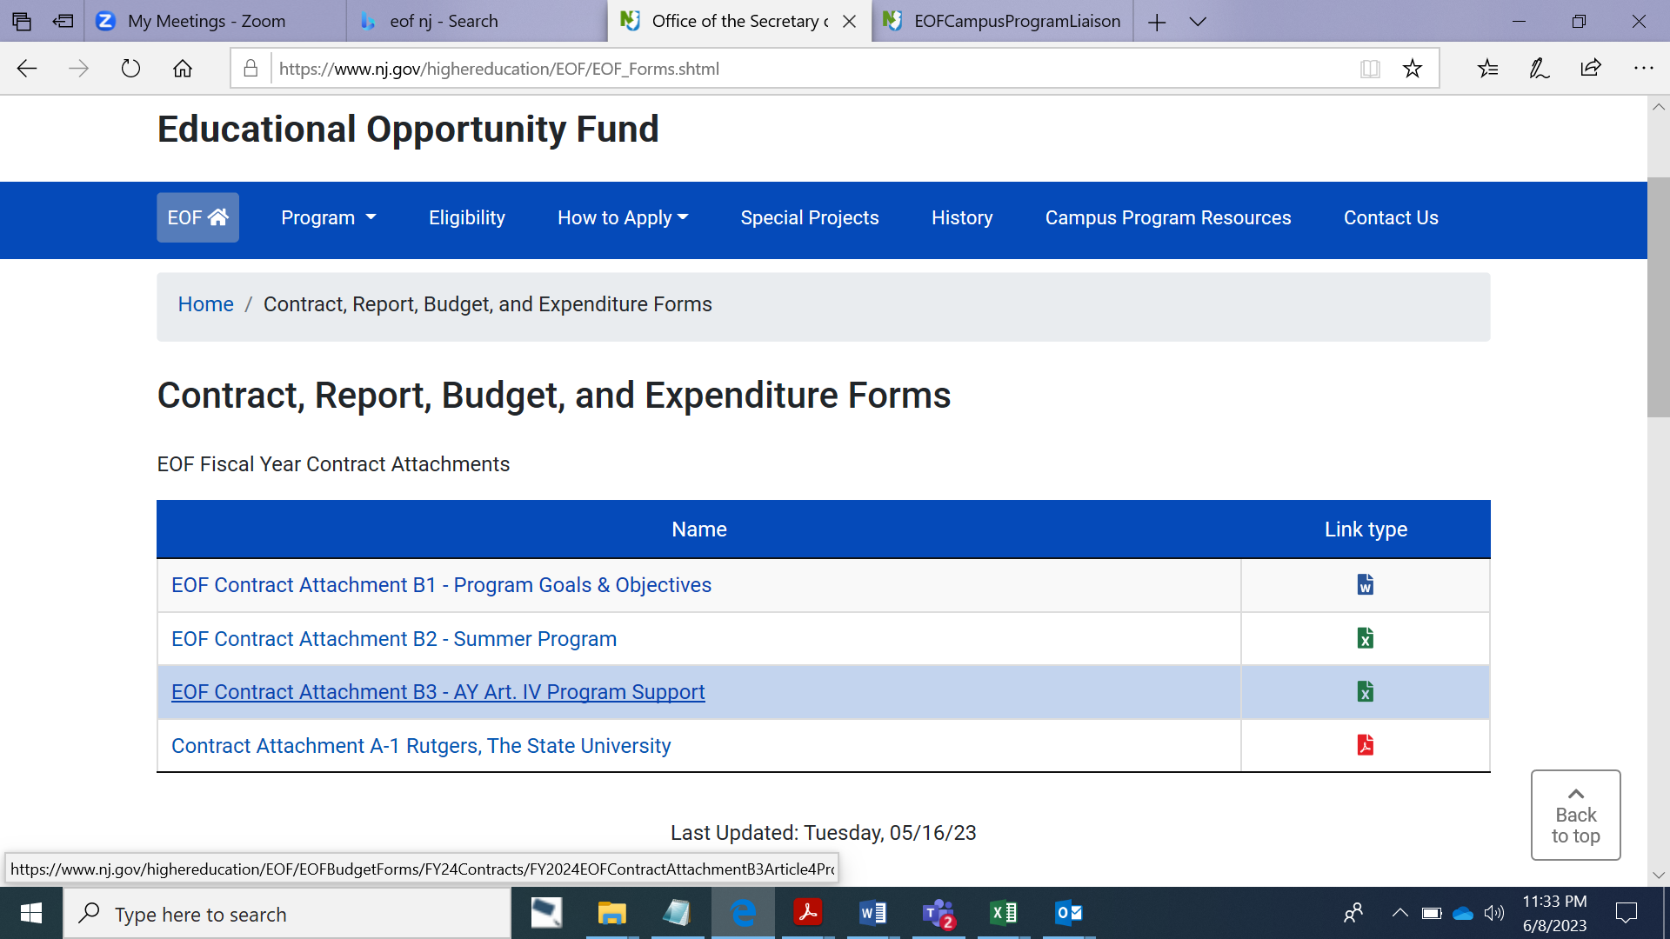
FY25 EOF B1 and B3 Program
Contract Attachments
Notes:
Where can you find EOF FY23 program contracts and budget documents?
All EOF Contract Budget Attachments can be found on the EOF Campus Program Resources webpage, within the EOF Contracts and Budgets section:

Slide 7
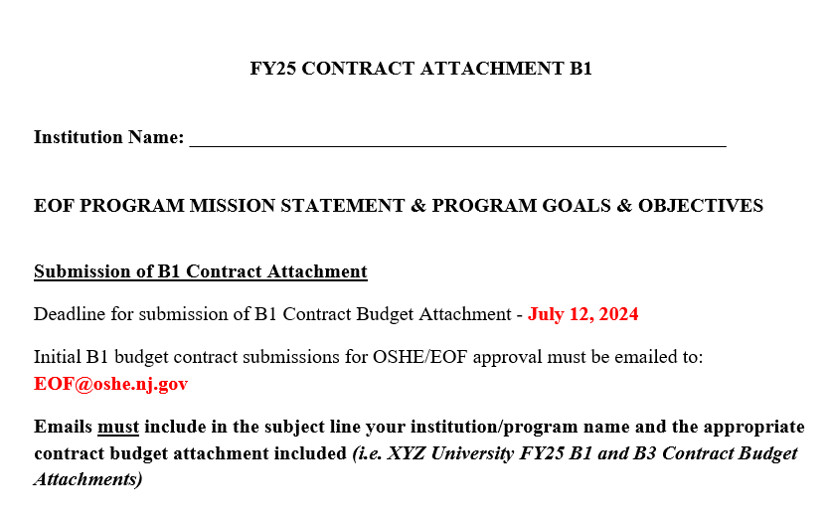
FY25 EOF B1 Contract Attachment
Notes:
Where can you find EOF FY23 program contracts and budget documents?
All EOF Contract Budget Attachments can be found on the EOF Campus Program Resources webpage, within the EOF Contracts and Budgets section:

Slide 8
Virtual Review of the B1 Contract Budget Attachment
Office of the Secretary of Higher Education- EOF Contract, Report, Budget, and Expenditure Forms (nj.gov)
Notes:
Spend Down Calculator tool
“Annual Salary in Dollars” enter the annual total salary for each position listed in the personnel section of the budget.
Budget using whole dollars
Expenditure reports will include actual monies spent (show pennies)
“Professional Development & Student Leadership Development” itemize costs of staff and student registration fees for conferences, webinars, and leadership development activities. Include also professional membership fees and consultant presentation costs.
“Travel” itemize travel expenses for professional staff development, recruitment activities, student educational development and student travel for leadership activities. For all travel for professional development (i.e. attendance at conferences), programs must articulate how this information is beneficial for the program (do not simply state “will enhance staff knowledge of best practices”).
Narrative/Line Item Descriptions – for all student development and leadership activities, programs must document some form of pre- and post-activity assessment of what was learned. Additionally support to attend professional conferences must include some form of post-activity assessment of what was learned relative to the program’s current and future offerings. Documentation of this assessment must be kept (i.e. Discussion of what was learned at the conference at a staff meeting held on xx/xx/20xx and information based on what was learned, a validation or suggestion of change for current practice should be considered.)
Program Advisory Board (PAB) itemize expenses for PAB meetings & functions. Only programs that have a PAB (membership list, by-laws & minutes of meetings) should list expenses. Otherwise leave this category blank.
Within the Narrative Description section, provide a brief description of each item listed in each of the Art. IV budget categories.
Example: Educational Materials & Supplies
Acceptable: purchase of textbooks for tutors @ a total cost of $500.00
Not acceptable (too vague): purchase of textbooks
Not acceptable: purchase of books and supplies for student usage
Example: Student Leadership Activity
Acceptable: “XYZ” student leadership activity. Students will be provided a pre- and post-activity assessment to gauge their cultural and self-awareness regarding “XYZ”. The educational purpose of this activity is to provide students with instructions and tools to help identify and improve in the areas of “A, B, & C”.
Not acceptable: (too vague) Student event to help create student solidarity.

Slide 9
EOF B3 Program Support Budget
Notes:
Spend Down Calculator tool
“Annual Salary in Dollars” enter the annual total salary for each position listed in the personnel section of the budget.
Budget using whole dollars
Expenditure reports will include actual monies spent (show pennies)
“Professional Development & Student Leadership Development” itemize costs of staff and student registration fees for conferences, webinars, and leadership development activities. Include also professional membership fees and consultant presentation costs.
“Travel” itemize travel expenses for professional staff development, recruitment activities, student educational development and student travel for leadership activities. For all travel for professional development (i.e. attendance at conferences), programs must articulate how this information is beneficial for the program (do not simply state “will enhance staff knowledge of best practices”).
Narrative/Line Item Descriptions – for all student development and leadership activities, programs must document some form of pre- and post-activity assessment of what was learned. Additionally support to attend professional conferences must include some form of post-activity assessment of what was learned relative to the program’s current and future offerings. Documentation of this assessment must be kept (i.e. Discussion of what was learned at the conference at a staff meeting held on xx/xx/20xx and information based on what was learned, a validation or suggestion of change for current practice should be considered.)
Program Advisory Board (PAB) itemize expenses for PAB meetings & functions. Only programs that have a PAB (membership list, by-laws & minutes of meetings) should list expenses. Otherwise leave this category blank.
Within the Narrative Description section, provide a brief description of each item listed in each of the Art. IV budget categories.
Example: Educational Materials & Supplies
Acceptable: purchase of textbooks for tutors @ a total cost of $500.00
Not acceptable (too vague): purchase of textbooks
Not acceptable: purchase of books and supplies for student usage
Example: Student Leadership Activity
Acceptable: “XYZ” student leadership activity. Students will be provided a pre- and post-activity assessment to gauge their cultural and self-awareness regarding “XYZ”. The educational purpose of this activity is to provide students with instructions and tools to help identify and improve in the areas of “A, B, & C”.
Not acceptable: (too vague) Student event to help create student solidarity.

Slide 10
FY25 EOF B3 Contract Attachment
Notes:
Where can you find EOF FY23 program contracts and budget documents?
All EOF Contract Budget Attachments can be found on the EOF Campus Program Resources webpage, within the EOF Contracts and Budgets section:

Slide 11
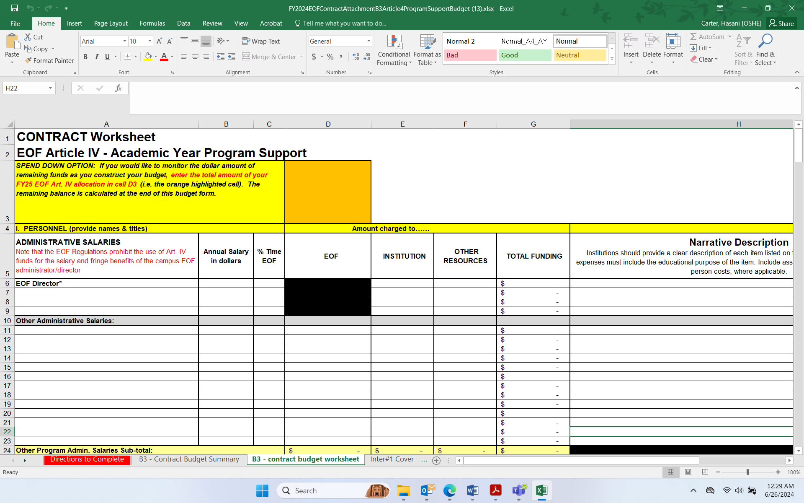
FY25 B3 Program Support Budget

Slide 12
Disbursement of FY25 Art. IV
Academic Year Allocations
Programs will receive 75% of their academic year Art. IV allocation in July
      Programs that owe a refund or report will not receive funding until all items are submitted and correct.
      Determined by internal processes.
  Note: FY25 Art. IV AY Program Support payee reference format =
  EOF AY4 FY25 (Inst./Program Name) ADV PMT
Balance (up to 25%) of the academic year Art. IV allocation will be sent in June.

Slide 13
Art. IV Academic Year Allowable Expenses
Funds used to assist with paying for EOF 12-month staff and student support activities that occur between July 1, 2024 – June 30, 2025)
      Salaries: 12 month salaries, wages and fringe benefits for permanent program positions for a specified period of time
          - May not include those staff whose total percentage of commitment to the EOF program is less than 10%.
      Educational Materials & Supplies
      Consumable Materials & Supplies
      Professional Development & Student Leadership Development
      Program Advisory Board
      Other Services (communications, utilities, overhead)
Each budget item must have a narrative description
For additional details, please refer to EOF Regulations (N.J.A.C. 9A:11-6.10) (Pgs. 37-38).
Notes:
B3 contract attachments outlines the Art. IV budget for program support services
All program financial resources must be shown on the respective contract budget: EOF Art. IV, institutional funds and other sources.
Requires a dollar for dollar match against the EOF allocation from institutional and other funding resources. Reference - EOF regulation 9A:11-6.9 (c)
Compensation and payment for activities must have occurred within the identified time period associated with the respective contract budget from which the funds were paid from.
Must ensure that the appropriate documentation and accountability records (i.e. description of time and effort, timesheets, etc.) are kept for all individuals whose percentage of involvement with the EOF program is less than 100%

Slide 14
Art. IV Academic Year Funding Restrictions
The EOF campus program administrator’s salary and fringe benefits
Fringe benefits for 12-month EOF staff at public senior institutions
Fringe benefits in excess of 21 percent of the salaries and wages paid by EOF funds for 12-month EOF staff at community colleges and independent institutions
Employee benefits for academic year student assistants and part-time personnel
The purchase of office furniture and/or décor items;
Transportation of students for normal commuting costs
The cost of instruction for which students are charged tuition
Other student costs that normally are covered by a student’s financial aid package, such as: any fees, room and board, transportation, funds for printing, and childcare
Lobbying, partisan political contributions, and/or fund-raising activities
The purchase of medications, drugs, or alcoholic beverages
Indirect expenses (such as space, heat, lights, postage, and telephone) that exceed 10 percent of the total academic year Art. IV allocation.

Slide 15
Art. IV Institutional Match: Allowable
The EOF campus program administrator’s salary and fringe benefits
Funds contributed or donated to the institution by public agencies, private organizations or individuals
Overhead (up to 20% of Art. IV Academic Year allocation) such as the cost of building maintenance, security, insurance/liability, etc.; cannot include space, heat, lights, postage, and telephone
Real or personal property contributed or donated to the institution by public agencies, private organizations, or individuals
The provision and maintenance of state of the art technological equipment (such as computer hardware, modems, fax machines)
Direct services rendered by other institutional staff to the EOF program (Services to EOF students should be above and beyond what all students would normally receive and for audit purposes is defined as part of the individual’s job responsibilities)
All or a portion of any EOF staff member’s salary, wages, or fringe benefits (certain restrictions do apply)

Slide 16
Art. IV Institutional Match: Not Allowable
Program reporting supervisors and other high level institutional officers who are required to serve all students
Any Institutional Staff whose total contribution to the EOF program is less than 10%. (Note: If a staff member resigns or is removed from their position, an adjustment to your contract is required)
Items and services normally provided to students by the institution without charge
Items and services normally provided to the institution by other government agencies without charge
Charges incurred by the institution as program costs but require no cash outlay by the institution during the grant period
Any cost incurred or contribution of services made in a prior fiscal year

Slide 17
Time & Effort
Institutions must have an approved waiver from the OSHE/EOF Office if the Program Director is less than 100% time EOF.
*** REMINDER – EOF TIME AND EFFORT REPORT ***
MANDATORY FOR ALL EOF DIRECTORS WHO ARE LESS THAN 100% TIME EOF.
All monthly reports must be included with the Final Art. IV B3 Expenditure Report (i.e. July 1, 2024-June 30, 2025).
Failure to submit this information means we cannot accurately assess the institution’s financial and labor commitment, as outlined in the submitted budget and approved waiver.
  Therefore, the Director’s salary from the institutional match will be disallowed.
  If the institution’s financial commitment falls below the required “Dollar-for-Dollar match” of Art. IV funds, the institution will not be permitted to adjust the contract and your program must return the disallowed amount.
Institutions must also properly document the time and effort for all staff including those who are less than 100% time EOF.
Notes:
Directors role defined in Regulations (9A:11-4.4 Institutional administration, pg.24-26)
Mandatory - Program Directors who are less than 100% time EOF are required to keep a monthly time and effort report on file. A copy of the EOF Time & Effort report can be found on our website within the EOF campus program resources webpage: https://www.nj.gov/highereducation/EOF/EOF_Program_Resources.shtml
Waivers must be resubmitted if there is a change in title, personnel, responsibilities, or if any elements of the original approved waiver has been impacted.

Slide 18
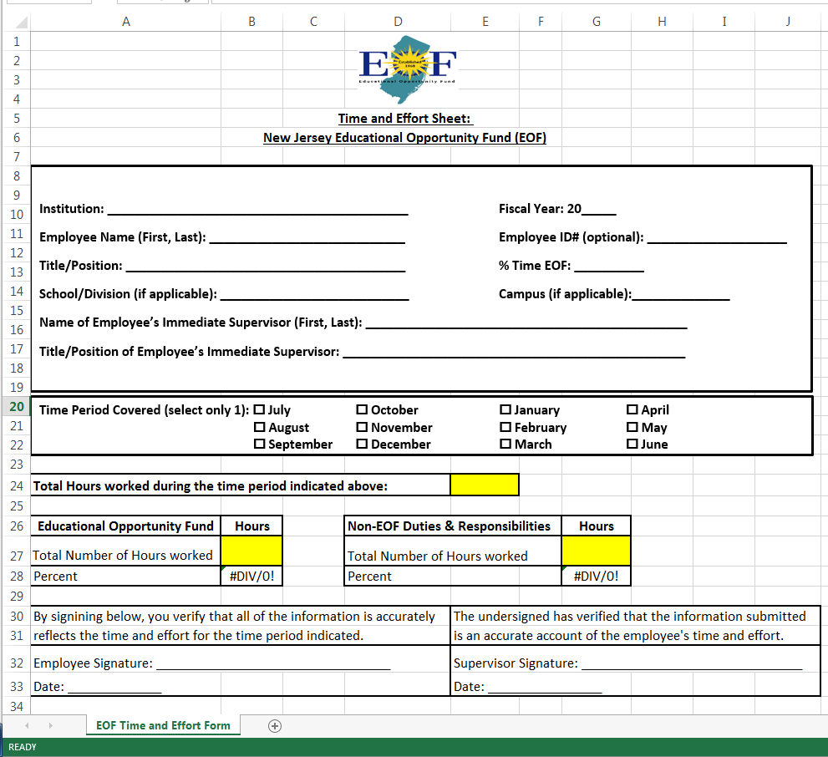
Time & Effort

Slide 19
Virtual Review of the B3 Contract Budget Attachment
Office of the Secretary of Higher Education- EOF Contract, Report, Budget, and Expenditure Forms (nj.gov)
Notes:
Spend Down Calculator tool
“Annual Salary in Dollars” enter the annual total salary for each position listed in the personnel section of the budget.
Budget using whole dollars
Expenditure reports will include actual monies spent (show pennies)
“Professional Development & Student Leadership Development” itemize costs of staff and student registration fees for conferences, webinars, and leadership development activities. Include also professional membership fees and consultant presentation costs.
“Travel” itemize travel expenses for professional staff development, recruitment activities, student educational development and student travel for leadership activities. For all travel for professional development (i.e. attendance at conferences), programs must articulate how this information is beneficial for the program (do not simply state “will enhance staff knowledge of best practices”).
Narrative/Line Item Descriptions – for all student development and leadership activities, programs must document some form of pre- and post-activity assessment of what was learned. Additionally support to attend professional conferences must include some form of post-activity assessment of what was learned relative to the program’s current and future offerings. Documentation of this assessment must be kept (i.e. Discussion of what was learned at the conference at a staff meeting held on xx/xx/20xx and information based on what was learned, a validation or suggestion of change for current practice should be considered.)
Program Advisory Board (PAB) itemize expenses for PAB meetings & functions. Only programs that have a PAB (membership list, by-laws & minutes of meetings) should list expenses. Otherwise leave this category blank.
Within the Narrative Description section, provide a brief description of each item listed in each of the Art. IV budget categories.
Example: Educational Materials & Supplies
Acceptable: purchase of textbooks for tutors @ a total cost of $500.00
Not acceptable (too vague): purchase of textbooks
Not acceptable: purchase of books and supplies for student usage
Example: Student Leadership Activity
Acceptable: “XYZ” student leadership activity. Students will be provided a pre- and post-activity assessment to gauge their cultural and self-awareness regarding “XYZ”. The educational purpose of this activity is to provide students with instructions and tools to help identify and improve in the areas of “A, B, & C”.
Not acceptable: (too vague) Student event to help create student solidarity.

Slide 20
Budget Submission: Final Checklist
PERSONNEL
Provide names & titles
Annual Salaries and % Time & Effort
Line item/Narrative descriptions
OTHER
Correct allocation/Institution name
Institutional match
Utilized full allocation
Naming convention and Email subject used
Ensure no restricted expenditures have been included

Slide 21
Due by:
July 12, 2024
  Email Subject Line:
    (Institution/Program Name) EOF FY25 Art. IV B3 Contract Attachment
  Electronic File Submission:
  EOF B1 Program Mission, Goals & Objectives (Must be sent in MS Word format)
      Naming Convention:
        (Insert Institution/Program Name) EOF FY25 B1 Contract Attachment
            - Example: New Jersey State College EOF FY25 B1 Contract Attachment
  EOF B3 Article IV Academic Year Program Support Budget
      Naming Convention:
        (Insert Institution/Program Name) EOF FY25 B3 Contract Attachment
            - Example: New Jersey State College EOF FY25 B3 Contract Attachment
Email B1 and B3 to: EOF@OSHE.NJ.GOV w/CC: Hasani.Carter@oshe.nj.gov
Do not:
Convert the budget documents to PDF
Save submissions as password protected documents
Provide a link to a file sharing portal (i.e., Google Docs, Microsoft Teams, SharePoint, One Drive, etc.)

Slide 22
Budget Modifications
Changes to your original, approved budget require prior written approval form OSHE/EOF Central Office Staff.
      This includes modifications between categories (i.e. moving money from the budgeted line for staff salaries to the line for Educational Materials and Supplies) as well as new items that were not part of the original fiscal year contract.
      Budget Modifications within the same category without requesting approval is allowed.
  Budget modifications must be submitted via email to your Program Liaison with the following information:
          Moving Funds from (identify category, row #, & item)
          Moving Funds to (identify category, row # & item)
          Amount/Change
          Rationale
Notes:
Required:
Email including rationale proposed modification narrative explaining both “why” and “where” you are looking to re-distribute your existing funds in Email body.

Slide 23
Budget Modifications
  Submit the approved EOF Art. IV FY24 budget file (Excel) with proposed modifications listed in the appropriate column(s) on the B3 - Contract Budget Summary tab and highlighted in red on the line-item description tab.
  All requests must be sent to your liaison by March 21, 2025. Budget requests submitted after that date will be reviewed on a case by case for approval.

Slide 24
Budget Modifications
Email Body Sample:
Hello (Insert name of EOF program liaison),
On behalf of the University of New Jersey’s EOF program, I am seeking OSHE’s approval to conduct the appropriate B3 budget modification. We have been informed that effective November 30, 2024, Donna Miles (EOF counselor) will be leaving to take another position at another institution. As a result, we expect to have a cost savings of $3,000 in EOF Article 4 funds due to our inability to hire a replacement until January 1, 2025.
We would like to move $3,000 in Article 4 funds from our Counselor section (from Donna Miles line, Row#44) to Consumable Materials & Supplies for the purposes of purchasing additional recruitment and marketing materials (Row #98). We would like to purchase additional printed pamphlets, pens, and student inquiry cards to distribute during our various high school visits and open house sessions. If you have any questions regarding our appeal, please let me know.
Thank you,
Dr. Jane Doe, EOF Director
University of New Jersey

Slide 25
Submission Deadlines
The EOF campus program director must ensure that all documents are submitted by the posted deadlines.
Contract Attachments B1 and B3 are due by July 12, 2024.
Documents must be emailed in original format to EOF@OSHE.NJ.GOV (w/cc: Hasani.Carter@oshe.nj.gov)
Late documents may result in suspension of payments.

Slide 26
EOF Program Liaison Assignments
HASANI CARTER | PETER COLLAZO | HEMA PATEL | STEPHANIE SHANKLIN
Email: hasani.carter@oshe.nj.gov | Email: peter.collazo@oshe.nj.gov | Email: hema.patel@oshe.nj.gov | Email: stephanie.shanklin@oshe.nj.gov
Rutgers University - Camden | County College of Morris | Bergen Community College | Atlantic Cape Community College
Rutgers University - College of Nursing | Felician University | Brookdale Community College | Caldwell University
Rutgers University - Graduate Bio-medical | Middlesex College | Essex County College | Camden County College
Rutgers University - Graduate Education Prep | Monmouth University | Fairleigh Dickinson University - Florham | Centenary University
Rutgers University - Graduate Studies (except Bio-medical) | Ramapo College of New Jersey | Fairleigh Dickinson University - Metropolitan | Drew University
Rutgers University - New Jersey Medical School | Rowan School of Osteopathic Medicine (SOM) - Graduate (Only) | Hudson County Community College | Georgian Court University
Rutgers University - Newark | Rowan School of Osteopathic Medicine (SOM) - Pre-Matric | Kean University | Montclair State University
Rutgers University - ODASIS | Rowan School of Osteopathic Medicine (SOM) - Summer Prep | Mercer County Community College | Montclair State University - Bloomfield
Rutgers University - Office of EOF Administration | Rowan University - Camden | New Jersey City University | Montclair State University - Health Careers Program
Rutgers University - Robert Wood Johnson Medical School | Rowan University - Cooper Medical School - Graduate (Only) | New Jersey Institute of Technology | Rider University
Rutgers University - School of Arts and Sciences (New Brunswick) | Rowan University - Cooper Medical School - PULSE Program | Ocean County College | Rowan College at Burlington County
Rutgers University - School of Engineering | Rowan University - Glassboro | Passaic County Community College | Rowan College of South Jersey - Cumberland
Rutgers University - School of Environmental and Biological Sciences | Rowan University - Graduate Bio-medical | Raritan Valley Community College | Rowan College of South Jersey - Gloucester
Rutgers University - School of Health Professions | Saint Peter's University | Sussex County Community College | Seton Hall - Law
Rutgers University - School of Pharmacy | Salem Community College | The College of New Jersey | Seton Hall University - Main
Rutgers University - Summer Grads | St. Elizabeth University | Union College of Union County, NJ | Seton Hall University - Pre-Legal
 | Stevens Institute of Technology | Warren County Community College | Seton Hall University - Pre-Med/Pre-Dent Plus
 | William Paterson University |  | Stockton University - Atlantic City
 |  |  | Stockton University - Galloway

Slide 27
Resources
OSHE/EOF Website:
http://www.state.nj.us/highereducation/EOF/EOF_Program_Resources.shtml

Slide 28

QUESTIONS?

Slide 29

Thank You!
We look forward to working with you

