Slide 1










































2021 EOF Graduate Award Ceremony
~ Community Colleges ~
April 9, 2021
Hosted by:
Office of the Secretary of Higher Education (OSHE)
EOFPANJ
Fairleigh Dickinson University

Slide 2



Total Number of Awardees = 50

Slide 3
Academic Achievement
(3.2-3.49)
Shanida Biroo Gabriela Hernandez
Brett Hiles Ryan Carlos Kersey
Andy Lozano Barjuah Massa
Kimberly Nagales Jacob Oechsle
Maricela Torres

Slide 4
Outstanding Academic Achievement (3.5-3.99)
Vanessa Aguirre Heather Block
Danielle Bourguignon Heather Boyd
MacKenzie Butler Marelin Cantillo
Alyssa Carpenter Jessica DeStefano
Valentina Ganta Scarlet Heredia
Leyla Hurtado Amanda Hyrns
Karishma Karabi Bria Mack
Amna Malik Mario Orellana
Irene Ortiz Rene Ruiz
John Joseph Wallace Virginia Williams
Allison Wilson

Slide 5
Distinguished Scholar (4.0)
Kelvin Xao Min Fong Savannah Seran

Slide 6


Total Number of Awardees = 41

Slide 7
Academic Achievement
(3.2-3.49)
Sara Abdelsalam Dayelin Almonte
Patricia Cairo Julian Campillo-Ciccone
Marissa Cavallomagno Omar Cirilo
Loreta Doko Anthony Fiala
Oscar Garcia Stewart Hernandez
Hani Huzien Destiny Lampley
Natalia Matallana Silvia Paulino
Yavuz Sahbaz Lissu Valenzuela

Slide 8
Outstanding Academic Achievement
(3.5-3.99)
Jennifer Arreaga Genesis Capellan
Gabriella Carmenatty Maha Faraj
Gerardo Gonzalez Angel Hazim
Rita Intriago Waheeb Khan
Edward Lara Jungin Lee
Fouzia Masoud Laila Metwaly
Maaidah Mohyuddin Erisa Molla
Sandy Muqbel Mohini Patel
Pankti Patel Joseph Pauls
Valery Rivas Tamaris Rodriguez
Mohammad Sikander Dayan Turasz
Ashley Valdez

Slide 9
Outstanding Achievement
(No GPA Requirement; 1-per program)
Genesis Capellan

Slide 10
Distinguished Scholar (4.0)
Wonhee Seo

Slide 11
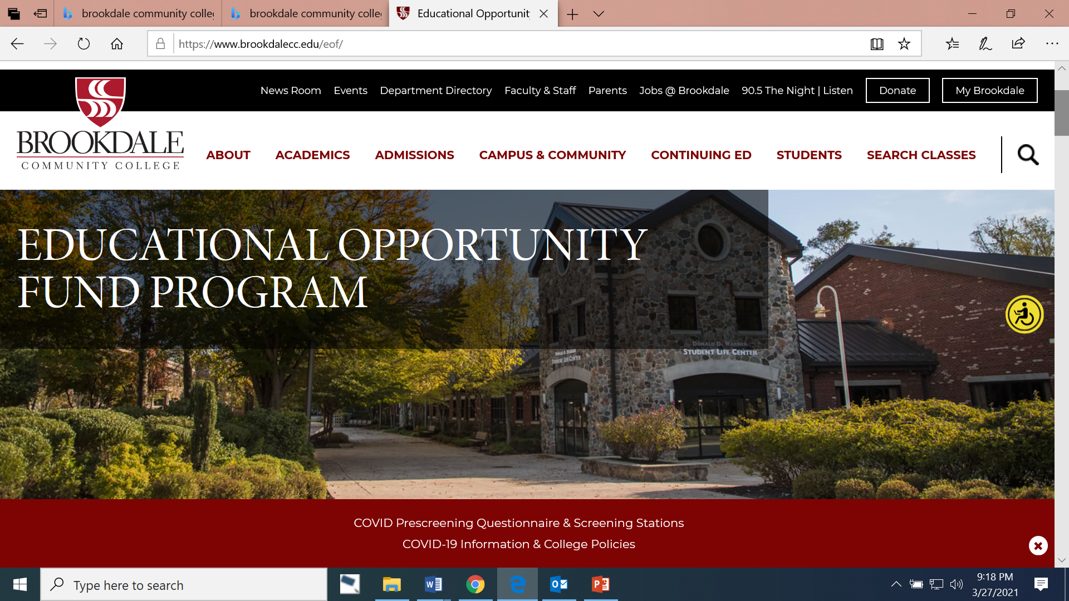

EOF GRADUATE ACHIEVEMENT AWARD RECIPIENTS
Total Number of Awardees = 43

Slide 12

Academic Achievement
(3.2-3.49)
Rose Adu Abner Betancourt Gomez
Erica Cruz James Lancaster

Slide 13
Outstanding Academic Achievement
(3.5-3.99)
Kinza Ali Latesha Grant
Yeimi Hernandez Cruz Lauren Kiernan
James McNerlin Diana Moca
Michael Torres Angel Valerio

Slide 14
Outstanding Achievement
(No GPA Requirement; 1-per program)
Keyana Johnson

Slide 15
Distinguished Scholar (4.0)
Christine Herrera Margaret Olanubi

Slide 16
Educational Opportunity Fund
Total Number of Awardees = 34

Slide 17

Academic Achievement
(3.2-3.49)
Robert Brooks Jillian Endres
Samrawit Gebretensay Trinh Huynh
Lydia Ireland Judith Jackson
Jacqueline Maldonado Yezane Marrero
Danielle McCubbin Jennifer Pennington
Jennifer Ruiz-Torres Yenifer Vasquez
Michelle Williams

Slide 18
Outstanding Academic Achievement
(3.5-3.99)
Claudia Corson Nayelis Fernandez-Bonsenor
Ashley Haenn Yunior Maria-Torres
Giovani Mateo Jennifer Mercado
Alonso Orozco

Slide 19
Outstanding Achievement
(No GPA Requirement; 1-per program)
Yasmeiri Silverio

Slide 20
Distinguished Scholar (4.0)
Vinh Bui

Slide 21

Total Number of Awardees = 15

Slide 22

Academic Achievement
(3.2-3.49)
Sohier Abdelfattah Daniela Agudelo
Andrea Argueta Ashley Diaz-Mena
Maricris Flores Megan Maute
Luis Velasquez-Rodriguez

Slide 23
Outstanding Academic Achievement
(3.5-3.99)
Jane Roz Abbe Amy Betancourth
Mollie Plunkett Monica Revell
Amira Wilkins

Slide 24
Outstanding Achievement
(No GPA Requirement; 1-per program)
Essence Johnson

Slide 25

Educational Opportunity Fund
Total Number of Awardees = 103

Slide 26

Academic Achievement
(3.2-3.49)
Awara Abena Adjei Omoh J. Ajayi
Justin Alieri Yasheka Anderson
Antionette Bennett Keyron Blakely
Angela Boror Jennifer Caba
Jennifer Castaneda Duarte Christopher Chamba
Khaliah Cooper Niurka Cruz-Rodriguez
Rene David Mohamed El-Moutaoukkil
Joseph Finley Shuler Lisa Gabriel
Jalen Hayden Sultanah Herrington
William James Jr. Crismerys Javier
Mailma Jones Thomas Tee Jones
Fasia Kamara Schaffouse Lormilus
Khadijah Marshall Felice Mason
Mazeline Nicolas Myrna Noel
Smith Noziere Karen Oliveire

Slide 27
Academic Achievement
(3.2-3.49)
Esther Olufunto Akinbowale Carla Elizabeth Orbe
Alkabir Owens Joseph Panico
Halexther Rivero Jonathan Rodriguez
Arianny Rosario Mina Sadek
Kandine Sharpe Ellen Tinney
Erika Torres

Slide 28
Outstanding Academic Achievement
(3.5-3.99)
Joan Acorlor Charles Adibe
Salma Alami Yadri Monica Alvarado
Lius A. Andrade Criolo Princess Andrews
Ruth Aoakohene Lynnette Arhin-Baiden
Faustina Asaana Helena Averiyire
Karla Barrientos-Martinez Emmanuel Basoah
Jenny Clarke Beatrice Danquah
Elda Domnguez Christy Erukanure
Karmelyn Espinoza Rachelle Exantus
Tamera Fadael Austin Feliciano
Fan Fan Garcon Fatima Ghannam
Haftom Gidey Stacy Ann Green
Prisca Ibeneme Rashina James
Cathleen Laurent Estela Lozano

Slide 29
Outstanding Academic Achievement
(3.5-3.99)
Shakir Major Kenya Marshall
Lenny K. Mata Cuevas Rochelle McCoy
Adriana Moreno Nwanneka Ofor
Ife Olasehinde Eyitayo Otesanya
Mary Pittman Rachelle Pittman
Mothila Puvanendra Helem Quintana
Genelle Rollins Jimena Ruidias
Melissa Ruiz Yara Santana
Johanne Sauveur Mounirata Sawadogo
Margaret Schroeder Florine Smith
Tahirah Smith Marie Nedge Thelusma
Nyuyen Trang Melvernia Tucker
Manuela Urrego Madrid Joseph Visco
Aarion Weeks Mariama Yanka
Ulrion Zinsou Victoire Zinsou

Slide 30
Outstanding Achievement
(No GPA Requirement; 1-per program)
Joseph Finley Shuler

Slide 31
Distinguished Scholar (4.0)
Alex Nunez Ramires
Wicktoria Piaszczynska
Robert Chiossi

Slide 32

EDUCATIONAL OPPORTUNITY FUND
Total Number of Awardees = 24

Slide 33

Academic Achievement
(3.2-3.49)
Aylin Alejandro Krysta Alvarez
Ahmed Faragalla Melinda McLendon
Raul Mendez Steven Montero
Melissa Murray Karl Ramos
Natasha Rozon Tyler Sarmiento

Slide 34
Outstanding Academic Achievement
(3.5-3.99)
Arlene Albert Nara Bautista
Mary Claire Elizabeth Decina Kevin Diaz
Simone Ebeid Christine Olukere
Matthew Polidario Hector Roman
Jasmin Sanchez Reem Sharaf
Shirley Tapia Tatiana Villegas
Mauricio Zamora

Slide 35
Outstanding Achievement
(No GPA Requirement; 1-per program)
Jasmin Sanchez

Slide 36

Educational Opportunity Fund
Total Number of Awardees = 8

Slide 37

Academic Achievement
(3.2-3.49)
Carlissa Almonte Taveras Tyler Anderson
Jesmy Castellon-Martinez Brian Williams

Slide 38
Outstanding Academic Achievement
(3.5-3.99)
Gauriben Patel Moses Possible
Yajaziel Reyes-Estrada

Slide 39
Outstanding Achievement
(No GPA Requirement; 1-per program)
Jose Orellana-Pacheco

Slide 40


Educational Opportunity Fund
Total Number of Awardees = 29

Slide 41
Academic Achievement
(3.2-3.49)
Mohammad Ahmed Marry Famosa
Leonchi Guzman Caitlyn Lugo
Asiya Mohamed Abdul Cader Diana Osorio
Adirma Rosario Luis Solano Sarabia
Sabrina Tuffour Maria Urrutia Mencia

Slide 42
Outstanding Academic Achievement
(3.5-3.99)
Yasra Ahmed A'sana Baldwin
Samantha Camarillo Stefhanya Cuevas-Nieto
Kahela Haroon Ana Huertas
Joussef Ibarra Keeratjot Kaur
Fiorela Martinez Tapia Samah Naeem
Natalia Neparidze Nathalia Ramos
Kimberly Reyes Martinez Fatima Rivera
Agny Valle Ania Valle

Slide 43
Outstanding Achievement
(No GPA Requirement; 1-per program)
Charita Wimberly-Amons

Slide 44



EDUCATIONAL OPPORTUNITY
FUND
Total Number of Awardees = 11

Slide 45

Academic Achievement
(3.2-3.49)
Spencer Grant Sarah McHenry
Alexzia Quiles Cesar Serrano

Slide 46
Outstanding Academic Achievement
(3.5-3.99)
Jackolin Hernandez-Lopez Freddy Juarez
Valentina Marrone Grace Roveda
Leah-Marie Williams

Slide 47
Outstanding Achievement
(No GPA Requirement; 1-per program)
Zachary Carroll

Slide 48
Distinguished Scholar (4.0)
Charles Pastori

Slide 49

Passaic County Community College
Educational Opportunity Fund Program
Total Number of Awardees = 7
Notes:
Place PCCC EOF emblem here with full name of College and full name of program. Ask Mr. Noguera or Ms. Carter for the right emblem. Spell out name of college and program.

Slide 50

Academic Achievement
(3.2-3.49)
Dean Awari Joy Fagan

Slide 51

Outstanding Academic Achievement
(3.5-3.99)
Isela Coyotecatl Marina Diaz Betances
Velma Hodges Lena Jamhour

Slide 52
Outstanding Achievement
(No GPA Requirement; 1-per program)
Knowlasia Jones

Slide 53

Educational Opportunity Fund
Total Number of Awardees = 30

Slide 54
Academic Achievement
(3.2-3.49)
Daniela Bogantes Salas Sasha Paiz-Cruz
Emilia Pineda Romero Brittany Rojas

Slide 55

Outstanding Academic Achievement
(3.5-3.99)
Jacqueline Braida Daniella Cascante-Alfaro
Estephanye Castaneda Muskaan Kashyap
Jasmeen Kaur Abigail Kirsinger
Maksym Lelyanov Vinicio Morera
Jacinda Nembhard Flabia Recinos Peres
Eric Sinchi Jessica Smith
Nidia Ugalde Hilary Vasconez
Ayden Vaval Melissa Vogelaar
Nazceer Whitley

Slide 56
Outstanding Achievement
(No GPA Requirement; 1-per program)
Chazz McGee

Slide 57
Distinguished Scholar (4.0)
John Peluso

Slide 58

Total Number of Awardees = 26

Slide 59

Academic Achievement
(3.2-3.49)
Emerlyn Anderson Kierra Jones
Ce'Ondra Long

Slide 60

Outstanding Academic Achievement
(3.5-3.99)
Midori Carr-Pritchett Denisse Hernandez Jarquin
Michelle Ross Nazim Tijani

Slide 61
Distinguished Scholar (4.0)
Christopher Zacharko Gregory Zacharko
Nicholas Zacharko

Slide 62

Educational Opportunity Fund
Total Number of Awardees = 23

Slide 63

Academic Achievement
(3.2-3.49)
Brooke Bryant Jesus Calixto
Isabella Felice Sana Hussain
Felicia Jones Azucar Marion-Miller
Daniel Mendez Michelle Mendez
Tanisha Mori Disha Patel
Amanda Paulaitis Mariah Paulaitis
Jessica Reichardt Yeila Rivera

Slide 64

Outstanding Academic Achievement
(3.5-3.99)
Katia Antonetti Justin Fennal
Sacha Jimenez Khadejah Scott
Cesar Sosa

Slide 65
Outstanding Achievement
(No GPA Requirement; 1-per program)
Justin Fennal

Slide 66

Educational Opportunity Fund
Total Number of Awardees = 26

Slide 67

Academic Achievement
(3.2-3.49)
Tazia Bey Academic Victoria Burgos
Stacy Costa Israt Jashim
Ariana Medina Griffin Rego
Noel Trotz Gemel Tutu
Alaanah Wilson

Slide 68
Outstanding Academic Achievement
(3.5-3.99)
Jai'din Barber Asia Boone
Brandon Painter

Slide 69
Outstanding Achievement
(No GPA Requirement; 1-per program)
Dauri Genao

Slide 70

Educational Opportunity Fund
Total Number of Awardees = 8

Slide 71

Academic Achievement
(3.2-3.49)
Abby Henson

Slide 72
Outstanding Academic Achievement
(3.5-3.99)
Cynthia Davis Amira Dunn
Laila Elkabany Vicky Guzman

Slide 73
Outstanding Achievement
(No GPA Requirement; 1-per program)
Nasira Justice

Slide 74

Total Number of Awardees = 11

Slide 75
Academic Achievement
(3.2-3.49)
Maci Kiss

Slide 76
Outstanding Academic Achievement
(3.5-3.99)
Emily Drake Marsali Endrizzi
Paul Esposito Madison Post
Kelly Salomon Elias Wenarsky

Slide 77
Outstanding Achievement
(No GPA Requirement; 1-per program)
Conor Mitnick

Slide 78


Educational Opportunity Fund
Total Number of Awardees = 28

Slide 79

Academic Achievement
(3.2-3.49)
Brian Bejarano Emely Diaz
Sandra Escobar Anthony Raymond
Aileen Salazar Angel Soto

Slide 80
Outstanding Academic Achievement
(3.5-3.99)
Muhammad Ali L'kyre Barber
Christino Barbosa Kianie Bush
Amanda Dawson-Annan Sarah Delva
Jahtiana Foote Jeslin George
Bruno Gomez Faith Greene
Lizbet Martinez Jeludys Marzan
Azalea Matias Daniel Mejia
Irene Negron Dayanara Rosado
Andrea Sermeno Christal Stanford
Maria Valdivia Anahi Zurita

Slide 81

Educational Opportunity Fund
Total Number of Awardees = 4

Slide 82

Academic Achievement
(3.2-3.49)
Madison Fears Zulymar Nieves

Slide 83
Outstanding Academic Achievement
(3.5-3.99)
Maracena Massarino-Moneta

Slide 84
Outstanding Achievement
(No GPA Requirement; 1-per program)
Nanaama Tandoh

Slide 85

EOF Statewide Alumni Association (EOFSAA)
Congratulations to all of the Awardees!
A special professional network of people from various backgrounds and industries.
A comradery of people with shared experiences.
Access to personal and professional resources to help enhance your development and quality of life.
Exclusive invitations to alumni only networking events.
Join us on Facebook: https://www.facebook.com/groups/27577721332/

