Slide 1










































2021 EOF Graduate Award Ceremony
~ Research Institutions ~
April 9, 2021
Hosted by:
Office of the Secretary of Higher Education (OSHE)
EOFPANJ
Fairleigh Dickinson University

Slide 2

Educational Opportunity Fund
Total Number of Awardees = 67

Slide 3

Academic Achievement
(3.2-3.49)
Aaliyah Agarini Kiara S. Aguedo Rojas
Stacy Aguilar Shabina Ali
Luz Corado Polo Berline Delinois
Rudgerry G. Guillaume Natasha Intriago
Jessica Jean Steven Matheis
Rockaya Ndoye Altiede Pierre
Moduana Pobee-Orleans Kelly Porres
Laila Rhenai Aedan Sarmiento
Darllene Severino Hernandez Dani Sosa

Slide 4
Outstanding Academic Achievement
(3.5-3.99)
Christine Acquah Safiatou Akondo
Emely Alba Nerline J. Arens
Jessica Canales Duarte Savannah Cepeda
Adrienne Dollar Michael Fuccilli
Lina Kim Michael Polny
Diana Retamozo Beatriz Sosa
Melissa Zea

Slide 5
Educational Opportunity Fund
Health Careers Program (HCP)
Total Number of Awardees = 7

Slide 6
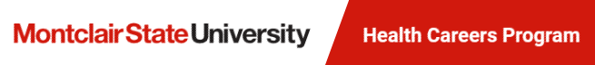
Academic Achievement
(3.2-3.49)
April Aracena Nedjie Jocelyn
Erick Romero

Slide 7
Outstanding Academic Achievement
(3.5-3.99)
Kimberly Calix Joelle Hosenu
Naomi Rodriguez

Slide 8
Outstanding Achievement
(No GPA Requirement; 1-per program)
Joelle Hosenu

Slide 9

Educational Opportunity Program
Total Number of Awardees = 24

Slide 10

Academic Achievement
(3.2-3.49)
Steven Antonio Aquino-Garcia Samia Dwekat
Alana Lima Alves Miriam Marquez
Marina Nagib Pooja Patel

Slide 11
Outstanding Academic Achievement
(3.5-3.99)
Sami Abdo Ana Astudillo
Andy Chang Luz M. Contreras
Felix De Dios Elisee Doh
Stephania Fenton Ariana Gutierrez
Victoriya Kelyman Jessy Joel Martinez
Nataly Paredes Vaishnavi Patel
Yashkumar Rana Arisleidy Reyes Castillo
Omar Sardena Tashi D. Sherpa
Ramy Yacoub

Slide 12
Outstanding Achievement
(No GPA Requirement; 1-per program)
Kemoy Williams

Slide 13


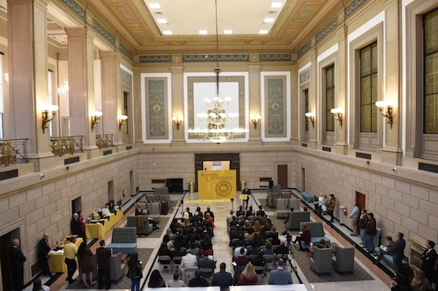
Rowan University-Camden
Total Number of Awardees = 9

Slide 14

Academic Achievement
(3.2-3.49)
Katerine Carrillo Cierra Farrow
Rosleidy Fernandez Alanna Inoa
Melina Lora LeRon Young

Slide 15
Outstanding Academic Achievement
(3.5-3.99)
Luis Acevedo Carley Tran

Slide 16
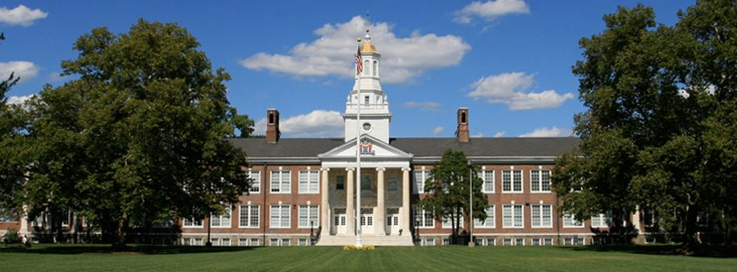
Rowan University-Glassboro
Educational Opportunity Fund Program
Total Number of Awardees = 27

Slide 17
Academic Achievement
(3.2-3.49)
Kaydeanne Francis Stephen Osei
Dyone Payne Juhi Surti
Kymonie Thomas-Nagil Maridel Tineo

Slide 18
Outstanding Academic Achievement
(3.5-3.99)
Catherine Carr Nhadjah Crawford-Bell
Iris Estevez Yaslin Reyes
Shania Terry

Slide 19

Educational Opportunity Fund Program
Learning today. Leading tomorrow.
Total Number of Awardees = 49

Slide 20

Academic Achievement
(3.2-3.49)
Nabeel M Ahmed Kiara L Bland
Kristina Macmahon Raquel Perez
Julie T Pham Joseph S Rein
Tatiana A Roberts Sinem N Uslu
Khamira A Vaughan Donesha J Webb

Slide 21
Outstanding Academic Achievement
(3.5-3.99)
Kenya L Andrews Maggie L Battle
Samera D Bishop Robert J Demarco
Courtney L Eckstadt Sabrina Gonzalez-Morabito
Amy Hoang Imran Kurun
Alanis E Lopez Amanda R Mcclellan
Diaab N Medley-Davis Shannon E Moran
Java A Myers Selena M Perez
Shannon N Taylor Daisy Velazquez

Slide 22
Outstanding Achievement
(No GPA Requirement; 1-per program)
Aurelio Sotelo

Slide 23
School of Engineering
Educational Opportunity Fund
Total Number of Awardees = 17

Slide 24
Academic Achievement
(3.2-3.49)
Jonathan Banks Mohamad Chacha
Dhruvkumar Patel Kush Patel
Brandon Rivera Joseph Salguero
Alejandro Salvador-Garcia Gregory Sarjue

Slide 25
Outstanding Academic Achievement
(3.5-3.99)
Maksymilian Gruszecki Nour Jurri
Jacqueline Mawalla Eriksson Nolasco
Marie Vilsaint

Slide 26
Outstanding Achievement
(No GPA Requirement; 1-per program)
Joseph Salguero

Slide 27

Educational Opportunity Fund Program
Total Number of Awardees = 83

Slide 28

Academic Achievement
(3.2-3.49)
Christopher Debe Christian Y Gomez-Seino
Adriana Gonzalez-Campos Lydia M Khalil
Salsabyl A Mansour Dominik Pergel
Riley Sequeira Aayushkumar S Shah
Fidline Sylvain

Slide 29
Outstanding Academic Achievement
(3.5-3.99)
Salma Abdalla Mariam M Abdelmoula
Taisha F Blanc Herve Borgella
Brittany R Caldwell Frandy A Castellano Gutierrez
Yvonne C Crooks Carola L Figueroa
Jailene Gavilanes Maryann A Okoye
Andres R Ortega Monica R Reis
Usvah Rizvi Ashly Sanchez Sanz
Harry K Sisco Yerines Suriel-Baez

Slide 30

Rutgers
Biomedical
Health
Sciences
Total Number of Awardees = 16

Slide 31
Academic Achievement
(3.2-3.49)
Shaida Akhter Pius Anyanwu
Sajeda Hussain Kathy Huynh
Rachel O'Brien Ashley Perez
Romeris Rosario-Restituyo Faith Serrano

Slide 32
Outstanding Academic Achievement
(3.5-3.99)
Asmaa Abuawad Cindy De La Cruz
Caitlyn Garcia Cathryn Garcia
Suraya Momtaz Nishat Poppy
Dina Vazquez

Slide 33
Outstanding Achievement
(No GPA Requirement; 1-per program)
Mikaela Montiel

Slide 34

Educational Opportunity Fund
Total Number of Awardees = 7

Slide 35

Academic Achievement
(3.2-3.49)
Youssef Abdelmoula Kassidy Baum
Lora Gawargi Michelle Segovia

Slide 36
Outstanding Academic Achievement
(3.5-3.99)
Tin Le Jinglan Wu

Slide 37
Outstanding Achievement
(No GPA Requirement; 1-per program)
Kassidy Baum

Slide 38
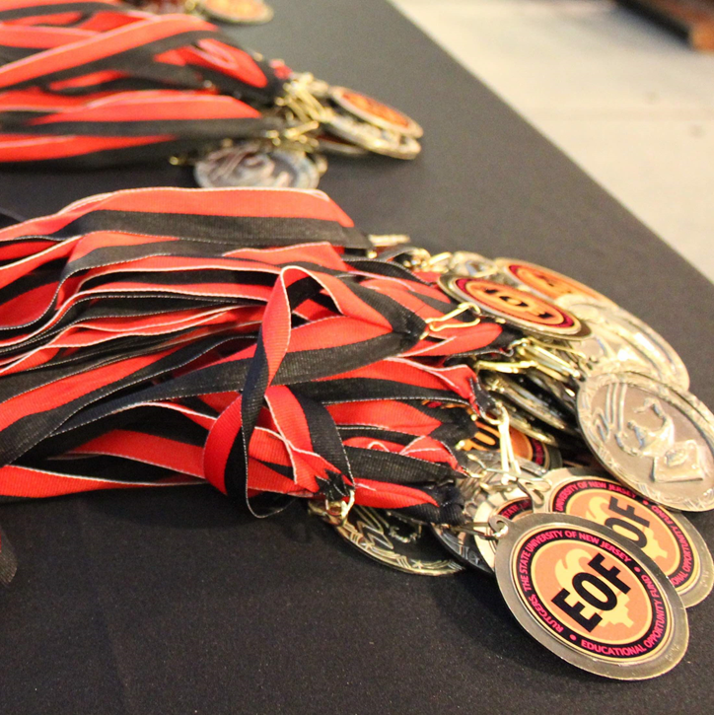
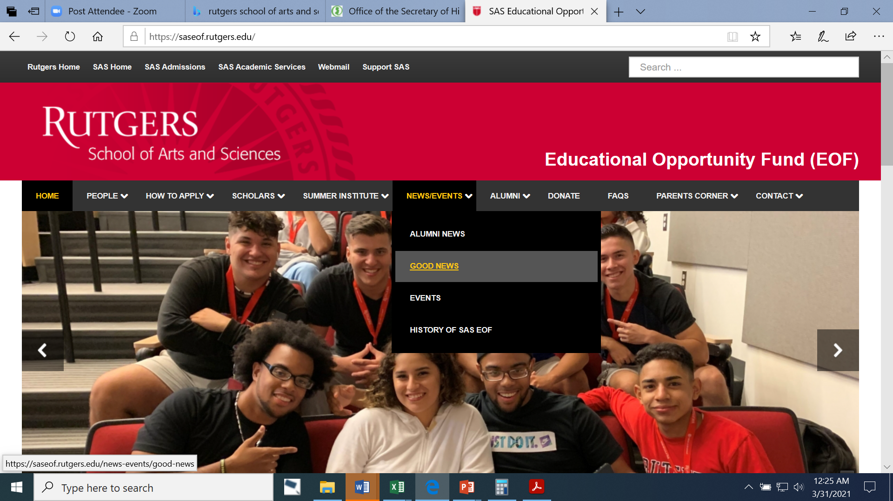
Total Number of Awardees = 193

Slide 39

Academic Achievement
(3.2-3.49)
Prince Henry Abruquah Dianna Alvarez
Brian Aparicio Reyes Kimberlyn Avendano
Alyssa Bailey Adel Bensahla
Kiara Bueno Shanice Burgos
Jeandalize Caba Newton Cabrera
Jelinette Cadavid Hongwei Cai
Randy Campo Jeimy Castro
Loriann Chambliss Clare Choi
Naddhya Chong Angelique Clark
Azanna Clemmings Mariangely Colon
Nanette Dande Alexis Dejesus

Slide 40
Academic Achievement
(3.2-3.49)
Amarah Ellahi Vanessa Espin
Juliana Felix Riley Fields
Samantha Figueredo Alexander Gall
Sthefany Garcia Chelsea Gonzalez
Moriah Hajduk Shaila Hasan
Barbara Hejzyk Osaumwense Idemudia
Jessica Isaac Michael Jasper
Jessica Jerez Joyce Jimenezmatos
Sarah Kassab Jasman Kaur
Carlos Lantigua-Mateo Memunatu Leigh
Rimsha Liaquat Jinfeng Lin

Slide 41
Academic Achievement
(3.2-3.49)
Ambar Liriano Bryant Magdaleno
Alim Memon Matthew Menendez
Mohraeel Mikhail Joceline Morales
Zainab Nabeel Ricardo Nava
Mary Olivier Angelice Oramas
Gulden Ozdemir Jaskiran Pal
Rushikumar Patel Franny Perez
Madelane Quijada Faria Rahman
Michelle Ramirez-Cruz Sherron Randall
Angel Reyes Peter Saad
Zarfshan Shahid Akirra Smalls
Jahmir Sterling Jennifer Suarez

Slide 42
Academic Achievement
(3.2-3.49)
Fouzia Sultana Emill Taveras
Lizbeth Torralba Diane Tran
Renzo Vargas Claudia Vazallo
Brenda Vidals Alexis Wilkins
Yousrah Younous Laiba Zeb

Slide 43
Outstanding Academic Achievement
(3.5-3.99)
Saif Abid Syed Ali
Jasmine Bagner Natalia Bak
Jesse Barbieri Patricia Batista
Sanaa Choudhry Jennifer Delgado
Nicole Doucette Sena Dzirasa
Alexis Etes Alisa Farley
Alejandro Funez Jhoana Garcia
Kyra Glover Gabriela Gonzalez
Yasmine Hafez Mun Hew
Gertrude Honutse Favour Imhomoh
Saidya Iqbal Jihun Joo

Slide 44
Outstanding Academic Achievement
(3.5-3.99)
Samuel Juarez Fatyma Karamoko
Mandeep Kaur Ushna Khan
Zainab Khan Antonio Laguardia
Lizbeth Lopez Perez Saad Malik
Marielis Mejia Darian Napodano
Brielle Nowicki Shamshrita Pandey
Dhanisha Patel Crystal Paulino
Jiawen Qin Juan Quezada
Viviane Racine Diana Rodriguez
Siris Rodriguez Rimsha Saeed
Diego Salguero Vasi Saqib

Slide 45
Outstanding Academic Achievement
(3.5-3.99)
Mildred Sarpong Rahul Sharma
Zaid Siddiqui Gabriela Silguero
Kimberly Silverio Diaz Roopjeet Singh
Lara Tablieh Yenny Tavarez
Naeem Uddin Fernando Venegas
Stephanie Vieira Ryan Whipple

Slide 46
Outstanding Achievement
(No GPA Requirement; 1-per program)
Tahj Burnette

Slide 47
Distinguished Scholar (4.0)
Tahj Burnette Rosmery Saldana

Slide 48
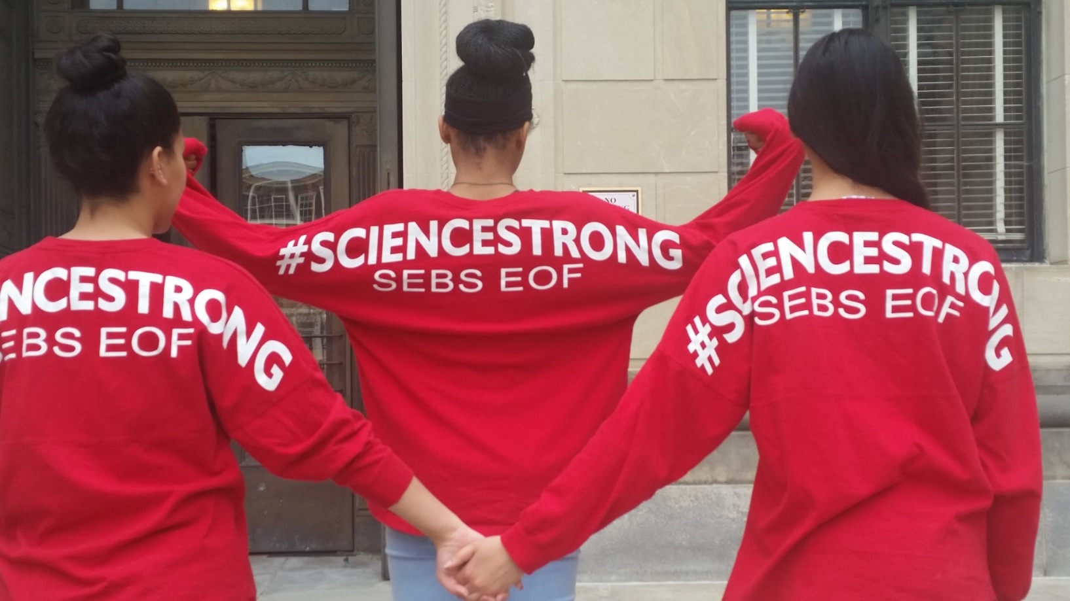
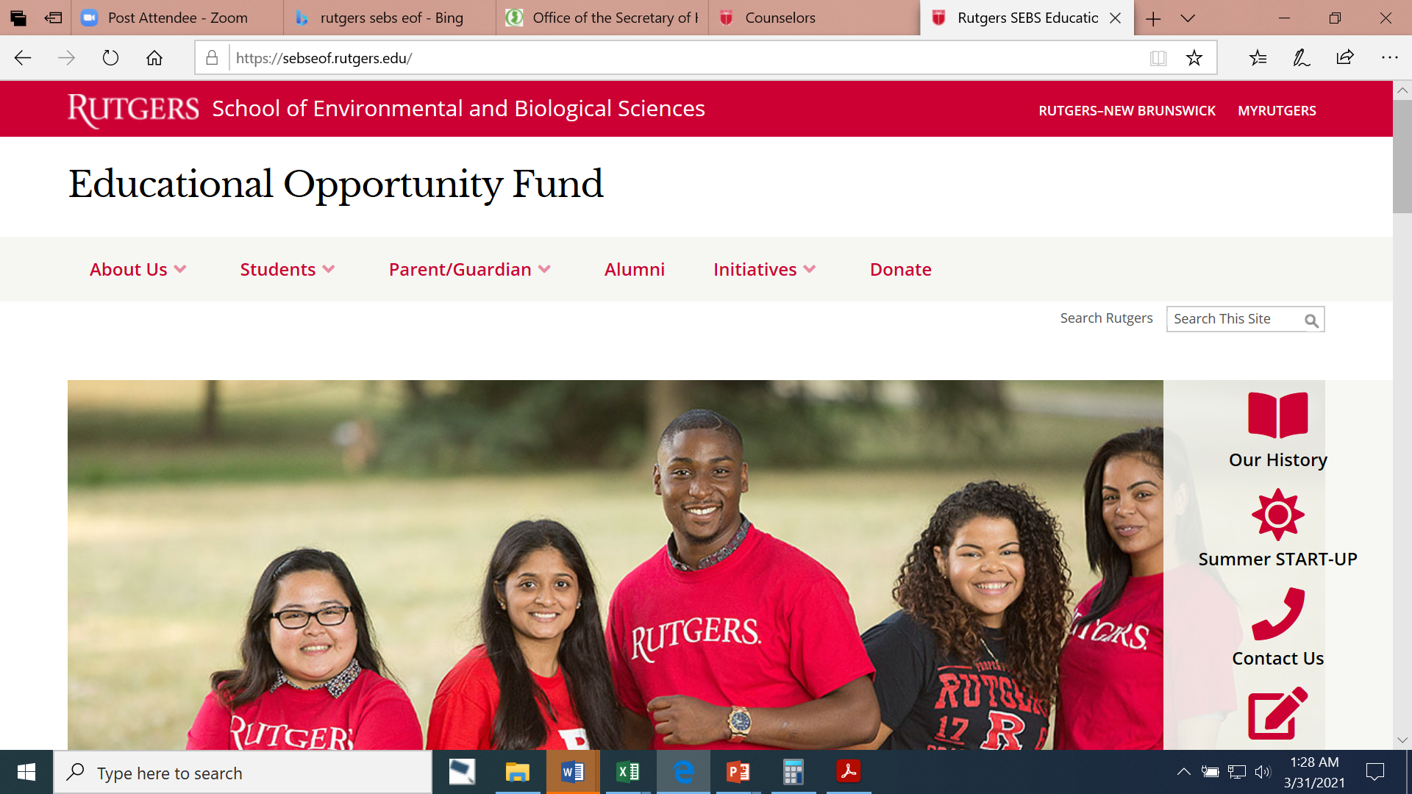
Total Number of Awardees = 22

Slide 49

Academic Achievement
(3.2-3.49)
Hadir Abdelal Alejandra Aguilar
Victoria Armas Yahia Chahine
Yarelis Cortes Jailene Figueroa
Jeffery Garcia-Sanchez Luis Gasca
Mateo Gonzalez Mengyao Liu
Angely Melendez Bhumi Patel
Zaire Sanders Leonela Smith

Slide 50
Outstanding Academic Achievement
(3.5-3.99)
Ludvinna Bazile Issam Eljitan
Glenda Labbe Carlos Mejia-Toro

Slide 51
Outstanding Achievement
(No GPA Requirement; 1-per program)
Steven Jeanty

Slide 52
The Educational Opportunity Fund Program (EOF)
Total Number of Awardees = 7

Slide 53
Outstanding Academic Achievement
(3.5-3.99)
Dara Deandrea Giannotti Lourdes Laracuente
Evelyn Mendez Jennifer Morquecho
Shymira Reeves Deisy Sasaguay

Slide 54
Outstanding Achievement
(No GPA Requirement; 1-per program)
Evelyn Mendez

Slide 55

EOF Statewide Alumni Association (EOFSAA)
Congratulations to all of the Awardees!
A special professional network of people from various backgrounds and industries.
A comradery of people with shared experiences.
Access to personal and professional resources to help enhance your development and quality of life.
Exclusive invitations to alumni only networking events.
Join us on Facebook: https://www.facebook.com/groups/27577721332/

