Slide 1










































2021 EOF Graduate Award Ceremony
~ State Institutions ~
April 9, 2021
Hosted by:
Office of the Secretary of Higher Education (OSHE)
EOFPANJ
Fairleigh Dickinson University

Slide 2


EOF
GRADUATE ACHIEVEMENT AWARDS
Exceptional Educational Opportunities Program
Total Number of Awardees = 52

Slide 3



Academic Achievement
(3.2-3.49)
Ginaud Boyer Victoria Carden
Lynda Clerjuste Mario Fanous
Shadya Hamdan Vivian Igwagu
Kia Labarrere Gregory Morel
Janvi Patel Riddhi Patel
Valerie Sanchez Schamma Senat
Cynthia Sepulveda Kenya Silas
Deimesha Turner Johanna Vasquez
Jennifer Vega Dezarey Williams
Ashely Wray

Slide 4
OUTSTANDING Academic Achievement
(3.5-3.99)
Alexander Acevedo Daiquiri Garey
Alexis Giuffrida Andrea Gonzalez
Aislinn Guillen Ashley Isamar Bautista Vasquez
Ofelia Andrea Mesa-Gutierrez Christina Morrison
Cymberline Odeyemi Alexis Owens
Monae Powell Gimena Rapalo
Isabel Salazar Jennyfer Tello
Renea Thompson

Slide 5
Outstanding Achievement
(No GPA Requirement; 1-per program)
Ofelia Andrea Mesa-Gutierrez

Slide 6

OSP/EOF PROGRAM
Total Number of Awardees = 39

Slide 7
Academic Achievement
(3.2-3.49)
Archana Beemsigne Renee Behr
Glenroy Clarke Mathieu Germain
Eldry Gonzalez Phyllis Horne
Juelle Jackson Daniela Jara
Qua'niece Lanier Yarimar Martinez
Mark Patel Jimmy Rosario
Priscilla Sanango Caitlyn Tannu
Shatiana Thomas Jeniffer Torres

Slide 8
Outstanding Academic Achievement
(3.5-3.99)
Faheed Adenuga Alfredo Camacho
Jonathan Geffrard Alex Gerena-Aponte
Juanita Jones Andrew Kamta
Nicolle Monegro Soriano Ifrah Qasim
Christine St fleur Alva Toledo

Slide 9
Outstanding Achievement
(No GPA Requirement; 1-per program)
Eldry Gonzalez

Slide 10


Educational Opportunity Fund Program
Total Number of Awardees = 33

Slide 11

Academic Achievement
(3.2-3.49)
Christopher Arvelo Shawna Douglas
Javier Guzman Saman Kazim
Ida Lopez Windys Paulino
Carl Phillip Mariya Rastrigina
Melanie Valenti Laura Veloso
Melanie Villacis Tia Wallace
Kelli Young-Kravitz

Slide 12
OUTSTANDING Academic Achievement
(3.5-3.99)
Tamia Anderson Tyra Asberry
Carissa Bahadur Pauline Boustani
Sarah Eldib Jungim Lee
Val Loskor Debonaire Malcolm
Vanessa Messina Eda Sahgiller
David Samayoa Alvarado Anna Scarpis
Cheyenne Shannon Gabriela Ulloa-Parra

Slide 13
Outstanding Achievement
(No GPA Requirement; 1-per program)
Raquel Belen Tejeda

Slide 14



Atlantic City - Program
Educational Opportunity Fund
Total Number of Awardees = 1

Slide 15

Outstanding Achievement
(No GPA Requirement; 1-per program)
.
Shikeia Green

Slide 16
Galloway - Program
Educational Opportunity Fund
Total Number of Awardees = 35

Slide 17
Academic Achievement
(3.2-3.49)
Haneef Abdul-Jabbaar Tatiana Alston
Omar Hassanein Eric Lima
Alana Williams
.

Slide 18
OUTSTANDING Academic Achievement
(3.5-3.99)
Ashley Cody Aimie Crowley
Tania Gafanha Israel Guajardo
Mykola Hubchak Ki'tra Hunter
Lucy Martinez Na'Tiasia Morales-McClendon
Huong Nguyen

Slide 19

Educational Opportunity Fund
Total Number of Awardees = 60

Slide 20

Academic Achievement
(3.2-3.49)
Georgina Abdelmoety Maryum Bhatti
Vincent Bolognese Asia Cason
Seo Jung (Jade) Choi Joe Correa Jumbo
Jada Covington Diana Da Silva
Monica Doliscat Gisselle Flores
Gina Garcia Jasmine Greene
Tishane Jackson Simran Kaur
Naomi Odusanya Wesley Pena
Kimberly Powers Cynthia Ramirez
Alize Reiner Grace Sandel
David Santiago Cristina Santin

Slide 21
OUTSTANDING Academic Achievement
(3.5-3.99)
Jonathan Brito Yasmin Chahir
Jennifer Cirilo Ambar Cordero
Taylor Griffith Destiny Johnson
Calvin Kim Franklin Mai
Kevin Marin Ky'Ara Mccray
Genesaret Mora Javier Morales Arias
Eunice Olugbile Bianca Randolph
Carolyn Rivas Jennifer Salinas
Diana Solano Casimir Somenou
Destinee Stone Nathalie Torres
Kattlyn Vasquez Dominique Walker

Slide 22
Outstanding Achievement
(No GPA Requirement; 1-per program)
Eunice Olugbile

Slide 23

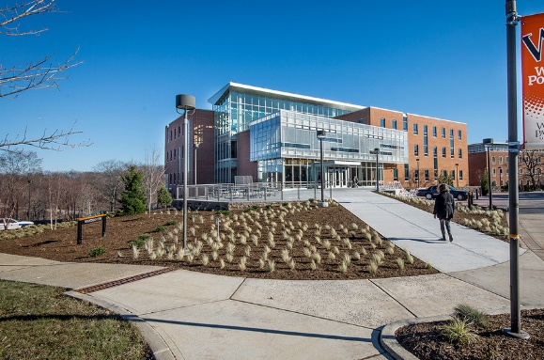
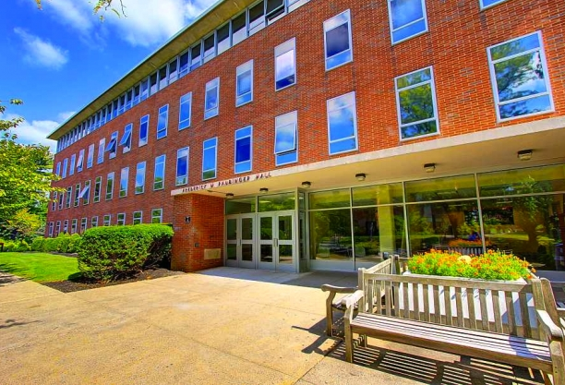
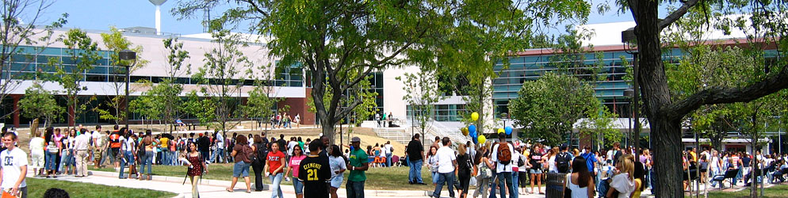
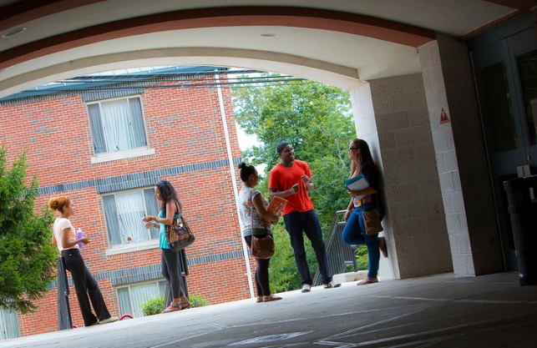
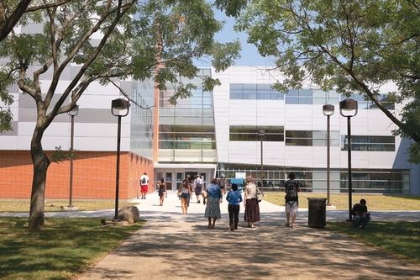
The Educational Opportunity Fund Program
Will.Power
Total Number of Awardees = 23

Slide 24


Academic Achievement
(3.2-3.49)
Francesca Carrasco Paula Cepeda
Wendy Diaz Dana Jaloudi
Elijah Mason Deliesha Mendez
Nicole Pena Quadeja Richardson
Paola Ruiz Jhenni Yascaribay

Slide 25
OUTSTANDING Academic Achievement
(3.5-3.99)
Shantal Bloise Aholibanna Canot
Katelin Jimenez Karizma Medina
Jeremy Torres

Slide 26
Outstanding Achievement
(No GPA Requirement; 1-per program)
Wilnell Martinez

Slide 27

EOF Statewide Alumni Association (EOFSAA)
Congratulations to all of the Awardees!
A special professional network of people from various backgrounds and industries.
A comradery of people with shared experiences.
Access to personal and professional resources to help enhance your development and quality of life.
Exclusive invitations to alumni only networking events.
Join us on Facebook: https://www.facebook.com/groups/27577721332/

