Slide 1
Firefighter Cancer Screening Reimbursement Program
SimpliGov Workflow Demonstration

Slide 2
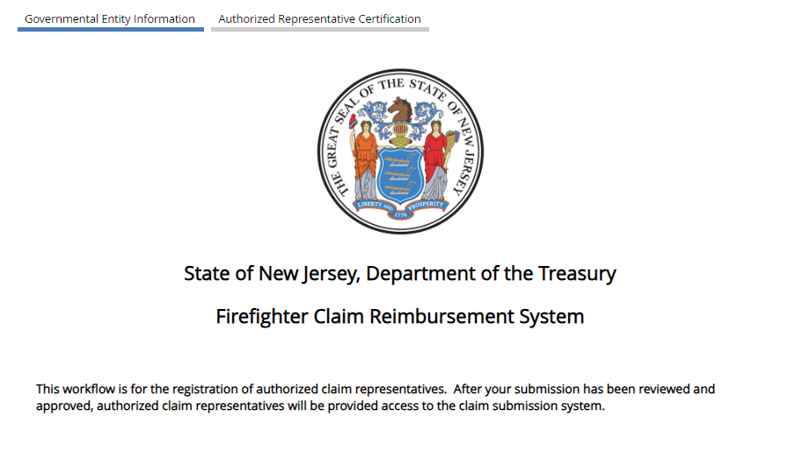
Registration Workflow
Governmental entities will be required to register with the Division of Administration: https://njtreas.prod.simpligov.com/prod/portal/ShowWorkFlow/AnonymousEmbed/1371fa6a-9f57-4124-b87b-debe64787d38
The registration step only needs to be completed once. Please do not complete this form for each reimbursement request.

Slide 3
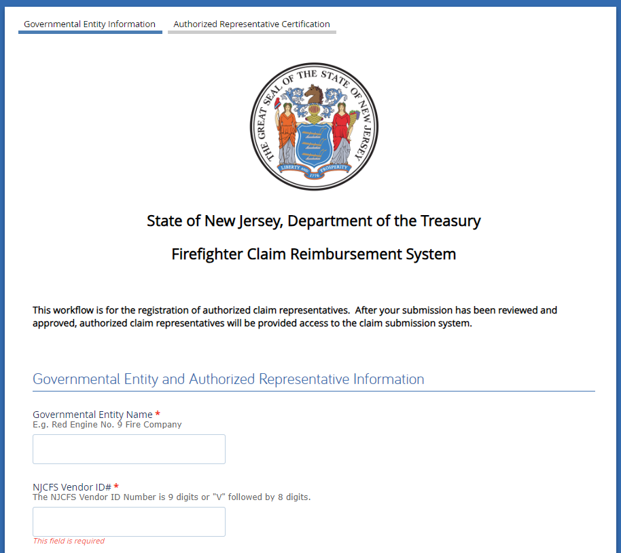
Governmental Entity Information
NOTE: All fields with a red asterisk are required fields.
Enter Governmental Entity Name
Enter NJCFS Vendor ID#
The NJCFS Vendor ID Number is 9 digits or “V” followed by 8 digits
Entities can either reach out to their main business office / fiscal officer to confirm which ID would be best to use, or they can contact OMB’s Vendor Control Unit (Email: AAIUNIT@treas.nj.gov / Phone: (609) 633-0783) for more information on their existing IDs
1
2

Slide 4
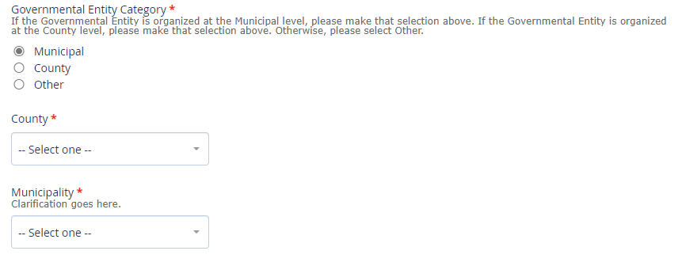
Governmental Entity
Please choose the selection that best fits your governmental entity: Municipal, County or Other
If Municipal is selected, you will be required to select a county and municipality from the drop down menus.
If County is selected, you will be required to select a county from the drop down menu.
If Other is selected, you will be required to explain the governmental entity.
1
2
3

Slide 5
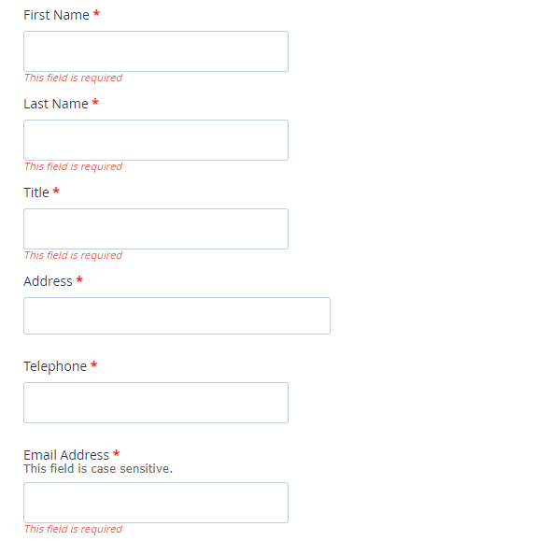
Authorized Representative Information
Enter the First Name, Last Name, Title, Address, Phone Number and Email Address for the Authorized Representative from the governmental entity.
Please enter this information carefully. It will be pre-populated on the claim reimbursement form.
The Authorized Representative will be able to submit claims for reimbursement.

Slide 6
Health Insurance Coverage Information
Indicate yes or no regarding the governmental entity’s health insurance coverage.
If not covered by SHBP, please select Insurance Benefits Provider or Self-Insure. If Insurance Benefits Provider is selected, enter the name of the insurance company.

Slide 7
Proof of Identity
A letter on County or Municipal letterhead must be uploaded with the registration, attesting to the authorized representative’s authority to submit claims on behalf of the governmental entity.
The letter should be in PDF format.

Slide 8
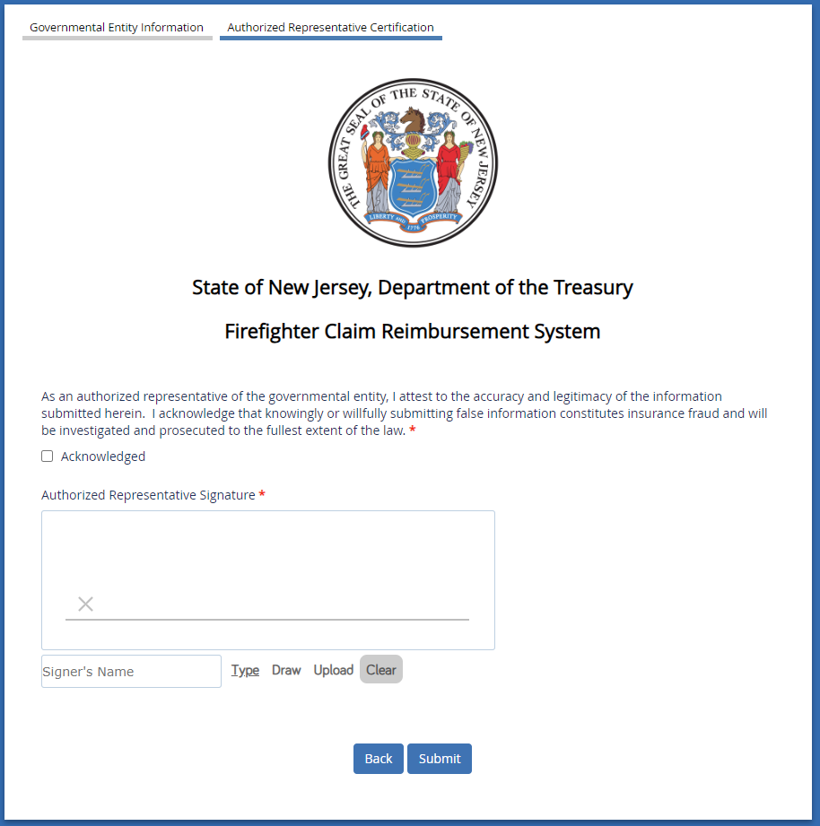
Authorized Representative Certification
Please read and sign off on the certification statement.
The signature can be typed, drawn with the mouse or be uploaded from your computer.
Once the submission has been reviewed and approved, an authorization code will be sent to the email address you used to register. You will need to add the authorization code to your myNJ account, which will grant you access to the SimpliGov dashboard to submit and track claims. Instructions will be included in the email on how to create a myNJ account should you not already have one.

Slide 9
Treasury Workflow External User Registration
Once the registration request has been reviewed and approved, you will receive an email to log into or set up your account in myNJ.
Type www.nj.gov into your internet browser.
Click Login near the upper left hand corner.

Slide 10
Treasury Workflow External User Registration
If you already have a myNJ account, enter your login and password.
If you do not have a myNJ account, click Sign Up in the lower right hand corner and follow the instructions to create an account.

Slide 11
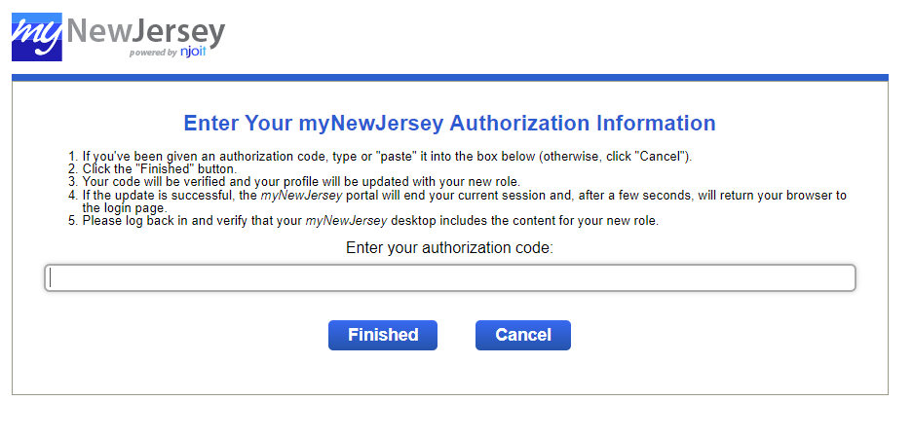
Treasury Workflow External User Registration
Once logged in, click “auth code” in upper right hand corner
Copy and paste the authorization code from the email you received. It will be a 12-digit alpha numeric code. Click Finished. The system will log you out. Log back in to your account. The SimpliGov Dashboard link will now be on your myNJ account under Treasury Links (see next slide).

Slide 12
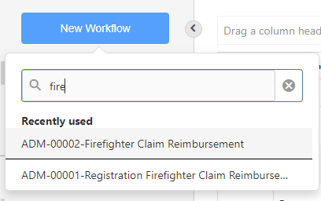
SimpliGov Dashboard
Click SimpliGov Dashboard from your myNJ homepage. It will open the SimpliGov workflow. The Dashboard will show any reimbursement claims you have filed, as well as their statuses. You can view the information and documents submitted for each claim by clicking the three dots in the Actions column and clicking View History.
To submit a new claim, click New Workflow in the upper left hand corner. Search for Firefighter Claim Reimbursement and select the link. Note: when you have completed the form once, it will automatically populate in recently used.

Slide 13
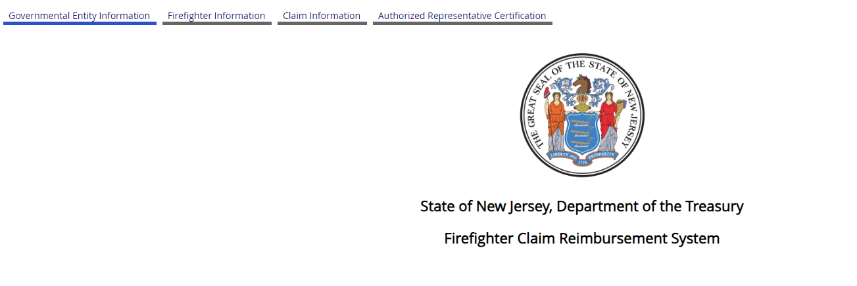
Claim Reimbursement System
A separate claim reimbursement must be submitted for each individual firefighter. Multiple reimbursement requests for the same firefighter can be submitted together.

Slide 14
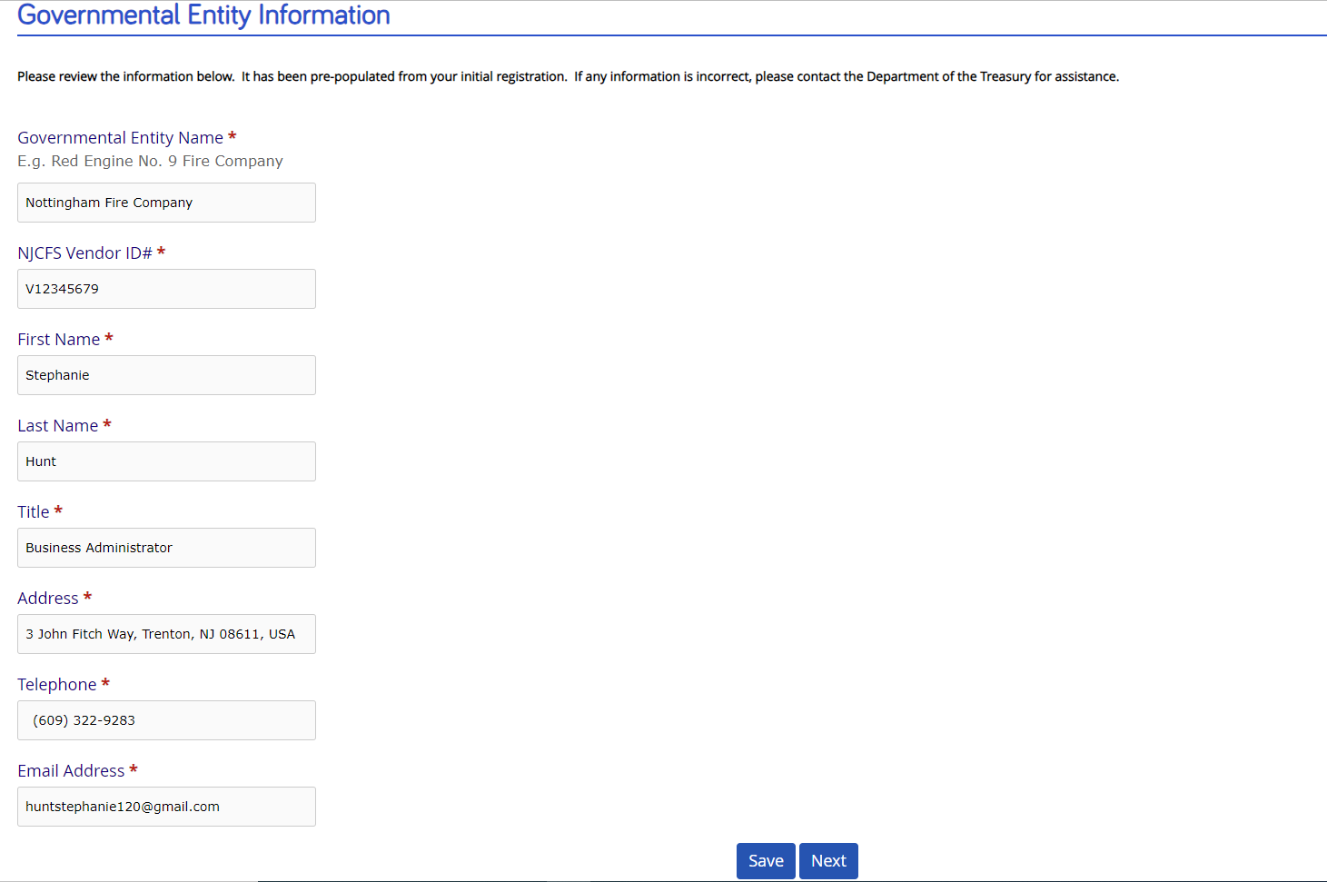
Governmental Entity Information
The information on this page will automatically pre-populate based on the registration request. Review the information and click Next.
If any information is incorrect, please contact Treasury Administration at FFCancerScreening@treas.nj.gov to have it corrected.

Slide 15
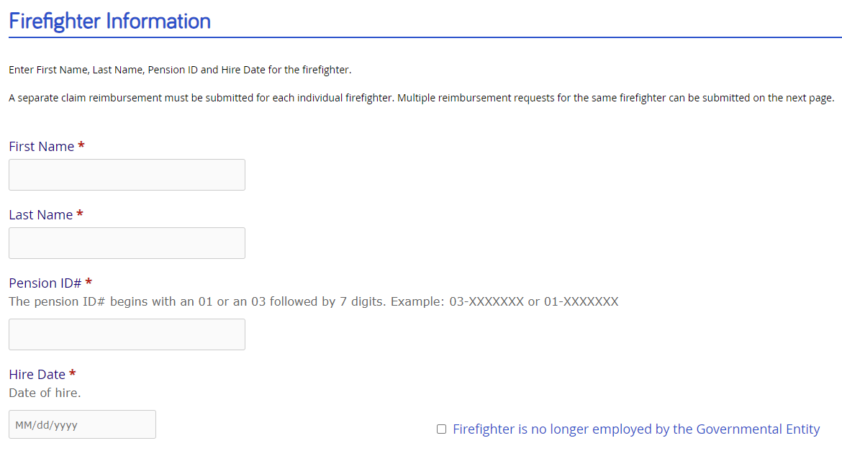
Firefighter Information
Enter First Name, Last Name, Pension ID and Hire Date for the firefighter.
You can select the hire date from the calendar, or enter it manually. If entered manually, it must be in mm/dd/yyyy format, with the slashes entered. It will not accept a date without the slashes.
If the firefighter is no longer employed by the governmental entity, check the box. You will be prompted to enter the termination date (in the same format as the hire date).

Slide 16
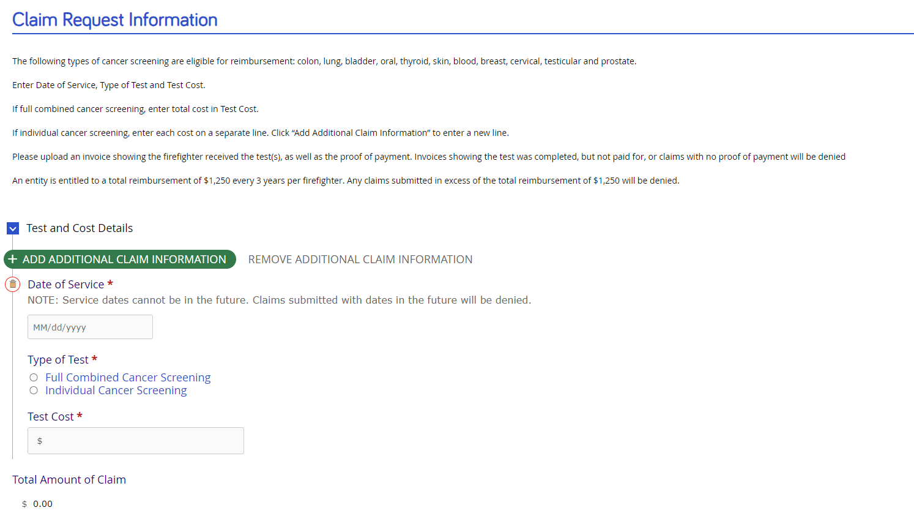
Claim Request Information
Enter the Date of Service, Type of Test (full combined or individual screening) and Test Cost.
Click the green ADD ADDITIONAL CLAIM INFORMATION button to add another claim for the same firefighter.
SimpliGov will tally all claims which will display in Total Amount of Claim.
Service dates cannot be in the future. Claims with a future date will be denied.
Total reimbursement amount per firefighter is $1,250 every 3 years. Claims submitted in excess of $1,250 every 3 years per individual firefighter will be denied.

Slide 17
Claim Request Information
An invoice to verify that tests have been performed by a physician or cancer screening company must be submitted with the payment request.
Treasury Administration will send payment to the governmental entity. The firefighter should not pay any cost out of pocket.

Slide 18
Authorized Representative Certification
Please read and sign off on the certification statement.
The signature can be typed, drawn with the mouse or a be uploaded from your computer.
Once submitted, Treasury Administration will review the claim. Please allow 7-10 business days for claims to be reviewed.

Slide 19
Questions?
Please contact FFCancerScreening@treas.nj.gov with any questions.

